Slide 1
Texas Rural Rental Housing Preservation
Jo Ann Sette
Southern Regional Appraiser
JoAnn.Sette@tx.usda.gov
(979) 213 - 4737

Slide 2
MULTI-FAMILY HOUSING
LOAN PROGRAMS
How to Save Time and Energy
In Multi-Family Lending
Up-front effort pays big dividends
Provides appraisers with correct information
Saves review time
An acceptable appraisal with less delay
Notes:
FY15 vs FY16 – 14% less time reviewing and 29 more assignments – Collaboration Works

Slide 3
Why are appraisals necessary?
Required by regulation for loan making.
Assessing adequacy of collateral
Value to debt ratio must be 1:1 or greater.
Determines equity
Establishes remaining economic life (REL)
Amortization term cannot be longer than reported REL.
Needed both in current condition and as if renovated
Report includes estimate of current market rents.
Conventional Rents for Comparable Units (CRCU)
Contract (Basic) Rents As Established by the Agency

Slide 4
What are the basic components of an appraisal?
Regulated by FIRREA and USPAP (Uniform Standards of Professional Appraisal Practice)
An opinion of the value of a property
May include a separate opinion of value of the intangible assets.
Highest and best use analysis required for each project
Three approaches to value depending on status of property
Cost approach
Sales comparison approach
Income capitalization approach
Reconciliation of value

Slide 5
RD Appraisal Requirements
HB-1-3560, Chapter 7, Security Requirements
7 CFR 3560 Subpart P
Attachment 7-C: values needed
Depends on specifics of loan
Can be present (current) or prospective (future) value(s), if appropriate
Attachment 7-F: Appraisal checklist
Attachment 7-H: Interest credit calculation
Attachment 7-I: Insurable value worksheet
Review of Appraisal is Required – RD Regional Appraisal Staff
Notes:
All RD 515 and 514 Loans – Appraisals on 538 Projects are submitted for review if the Program staff determines review is necessary.
Technical Appraisal Review: Review without independent opinion of value for all applicable RD programs

Slide 6
Making life easier
Successful Results in the loan application process rely upon detailed and correct information provided by the Applicant in the RD Property Information Form.
The completed Property Information Form is used by the RD Multifamily Staff and RD Regional Appraiser to create an Appraisal Guidance Document (AGD) with detailed RD appraisal requirements and information specific to that property. The Applicant provides the AGD to their 3rd party appraiser.

Slide 7
Making life easier-Usually
However, there may be exceptions, even to these guidelines.
Communication is necessary and is key to understanding transaction.
The 3rd party appraiser needs detailed information regarding RD appraisal requirements.
Contact the RD Multifamily Specialist assigned to the application if you have doubt!
Notes:
MFH is FULL of EXCEPTIONS .. keep in mind there are exceptions throughout the MFH program … decisions regarding exceptions should be discussed with program directors.

Slide 8
Project Information Form
Essential for appraiser
Appraisal is based on information and analyses requested.
Accurate information enables accurate conclusions.
Clear instructions will result in a report acceptable to RD
Essential for reviewer
Reviewer depends on this form to develop Appraisal Assignment Guidance (statement of work).
Providing good guidance can save multiple rewrites.
Acceptable appraisal product is more likely on first try if appraiser has Appraisal Assignment Guidance saving the applicant TIME AND MONEY.
Notes:
The property information form is not for RD Staff .. Its for the External Appraiser to help them complete the assignment more efficiently.

Slide 9
Section I—Information About Project
Date—so subsequent editions can be identified
RD Multifamily Specialist contact information—crucial for good communication
Project name, address, and contact information—also crucial
Appraiser needs to know where to direct questions or get missing information.

Slide 10
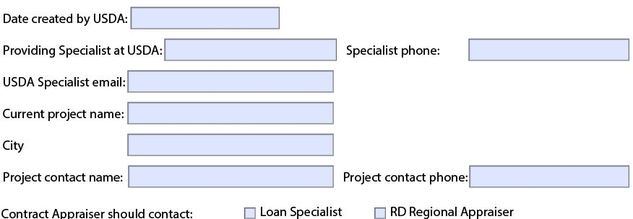
Section I—Information About Project
Please answer ALL applicable fields.

Slide 11
Section II—Application Data
Applicants ARE ENCORAGED to get guidance for 3rd party appraisers prior to ordering an appraisal on the property.
This information dictates if more than one appraisal or appraised value may be needed.

Slide 12
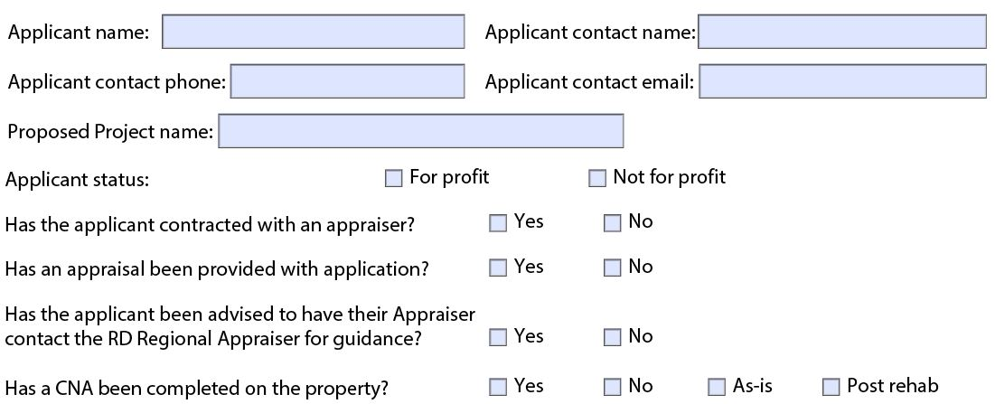
Section II—Application Data

Slide 13
Section II—Application Data
Notes:
PAT – Beverly Casey

Slide 14
Individual Property Information
Rental information will be used in valuation.
Type of Transaction influences values to be requested.

Slide 15
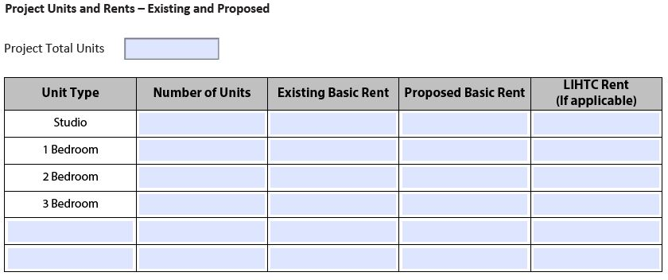
Individual Property Information

Slide 16
Individual Property Information
Potential rehabilitation also influences the values to be requested.
The 1924-13 is very important to both appraiser and reviewer.
Exception: An acceptable alternative form showing Developer Costs may be used when RD Funds are not included as part of rehabilitation. Any alternative form identifying development costs provided by the developer should essentially include the same information as the 1924-13.

Slide 17
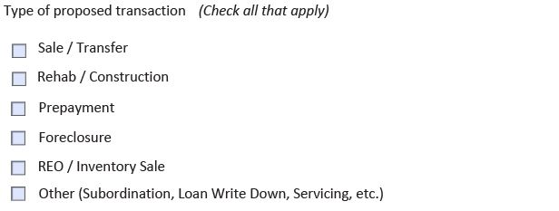
Individual Property Information
Notes:
The intent is for the form to be utilized in all transactions requiring an appraisal.

Slide 18
Individual Property Information
Notes:
or other cost estimation document

Slide 19
USDA Loans
Proposed rehab may result in a new loan.
Existing loan amounts and balances drive some of the analyses regarding interest credit subsidies addressed later.
Loan terms also are part of that calculation.
Third party loans / funding
Hard Debt vs Soft Debt
Are there payments resulting from the funding?

Slide 20
USDA Loans

Slide 21
USDA Loans

Slide 22
Tax Credits
Always analyzed separately from real property.
Federal tax credits have specified term and original amount.
This may not be the same as the value of those credits to the project.
The amount of the award may need to be determined, but is essential for valuation.
The applicable term also affects the valuation.

Slide 23
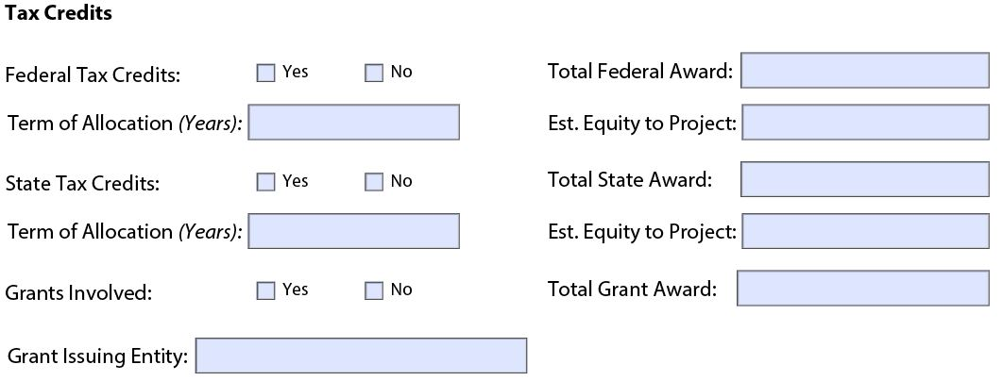
Tax Credits

Slide 24
Tax Credits
Federal Tax Credits (LIHTC)
State tax credits
Grants usually applied as going-in equity.
Grants are a source of funding but would not be valued as an intangible and would not be included in the estimated value of the real estate.

Slide 25
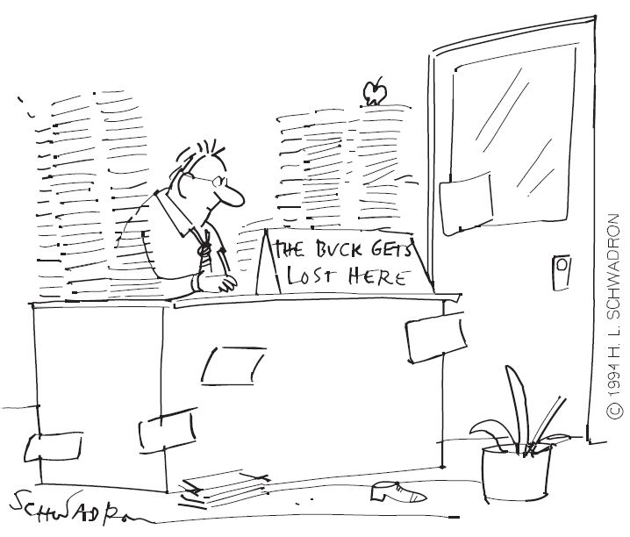
Tax Credits

Slide 26
Property Physical Configuration
If non-contiguous parcels, must have appraisal for each parcel.
If adjacent and being combined, need one appraisal to support single loan.

Slide 27
Property Physical Configuration
Notes:
Check with National Office regarding Consolidation

Slide 28
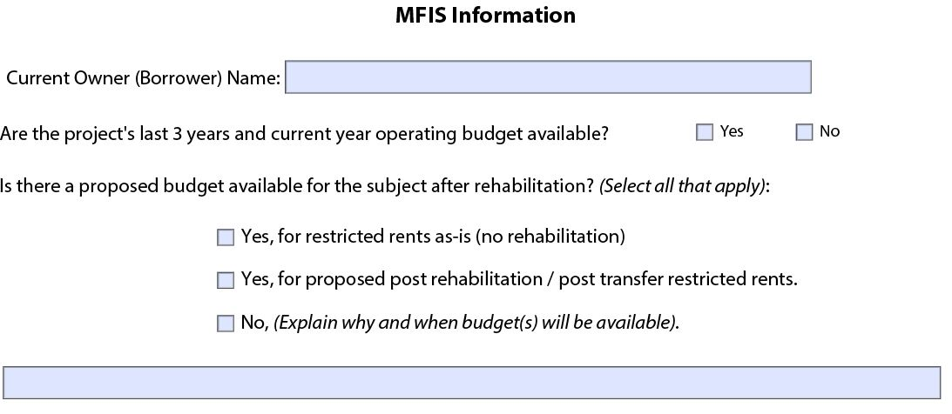
MFIS Information (Thank You – Thank You Very Much!)

Slide 29
MFIS Information
Appraiser needs historic operating information.
Proposed budget including income and expenses for property as if renovated
For market value as if unrestricted, appraiser will generate rental rates and expenses from market. (Expense Comparable are expected to be comparable in location and physical characteristics as the subject and current.)

Slide 30
Use Restrictions
Restrictions can affect the value, either as restricted or unrestricted.
Restrictive use provisions
If expired, can affect value requested.
If still in place, effect on value must be considered.

Slide 31
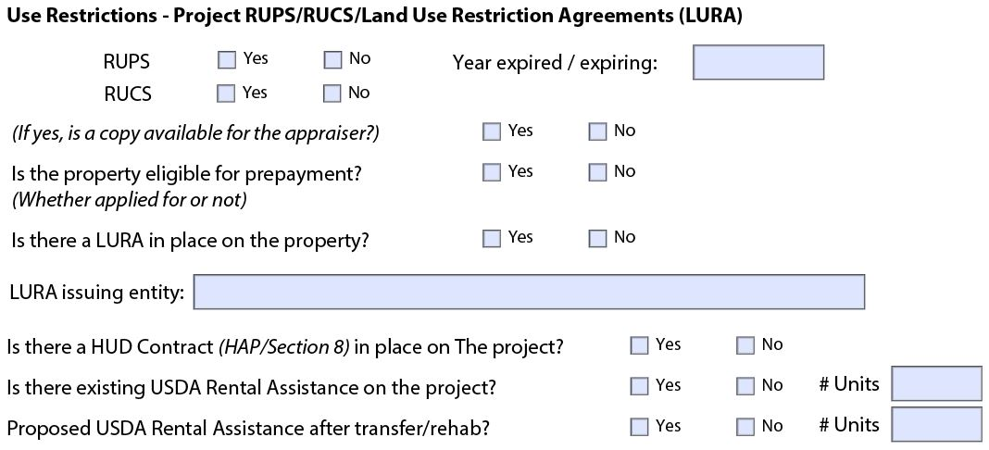
Use Restrictions

Slide 32
Use Restrictions
Eligibility for prepayment
Affects value to be requested
Loans with prepayment prohibitions include:
Initial 515 loan made on or after December 15, 1989
Subsequent loans made on or after December 15, 1989, for additional rental units
Questions – Contact your Multifamily Specialist
Notes:
We will talk about prepayment at the end of the presentation – RUPS/RUCS/LURA

Slide 33
Use Restrictions
Eligibility for prepayment
Loans without prepayment prohibitions but with restrictive-use provisions include:
Loans made after December 21, 1979, but prior to December 15, 1989,
Subsequent loans made on or after December 15, 1989, for purposes other than additional rental units,
Loans subsequently restricted by servicing actions including transfers.

Slide 34
Use Restrictions
Eligibility for prepayment
Loans made on or before December 21, 1979, or
If restrictive-use provisions have expired, may be eligible
See 3560.652 for requirements

Slide 35
Use Restrictions
Restrictive Use Covenants (RUCs)
Run with the land
Can be revised or removed as legally allowed
Must be considered if there is an effect on value
Notes:
RUCS – Agency is typically named as a party to the RUC

Slide 36
Use Restrictions
Land Use Restriction Agreement (LURA)
HUD Contract (HAP/Section 8) – Project Based Rental Assistance
USDA Rental Assistance and number of units
Notes:
LURA – often put in place by Housing Authorities as part of their lending process

Slide 37
USDA Loan Summary (expandable if necessary)

Slide 38
USDA Loan Summary
Is loan to be assumed?
New rates and terms
Need amount assumed (combined if combined – separate if separate)
Proposed USDA Note Rate
USDA subsidy rate
Term in years
Amortization period in years

Slide 39
USDA Loan Summary
Is loan to be assumed?
Same rates and terms
Amount assumed
Existing USDA Note Rate
Existing subsidy rate
Original term in years
Original amortization period
Date of original loan
Maturity date

Slide 40
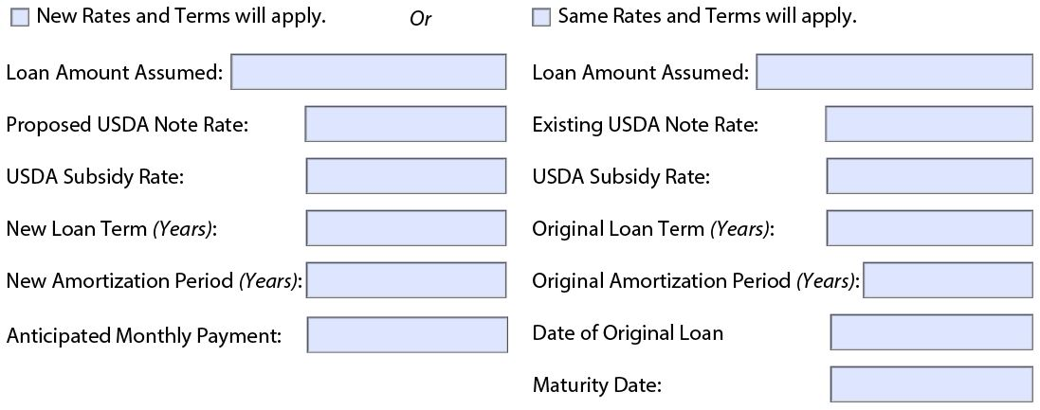
USDA Loan Summary (expandable if necessary)
Notes:
Information is needed by the Appraiser in determining the Interest Credit Subsidy.

Slide 41
USDA Loan Summary (expandable if necessary)
Are any loans being debt deferred?
Loan deferral period?
(NOTE: Interest Credit Subsidy should be requested on deferred loans.

Slide 42
USDA Loan File
Year property in service—determines eligibility for prepayment
Multiple phases?
If not contiguous, must have separate appraisals.
If physically adjacent
Will loans be consolidated? Then single report.
If not consolidated, are separate reports/values required?
If single owner, can do one report.
If different ownership, must have separate reports.

Slide 43
USDA Loan File

Slide 44
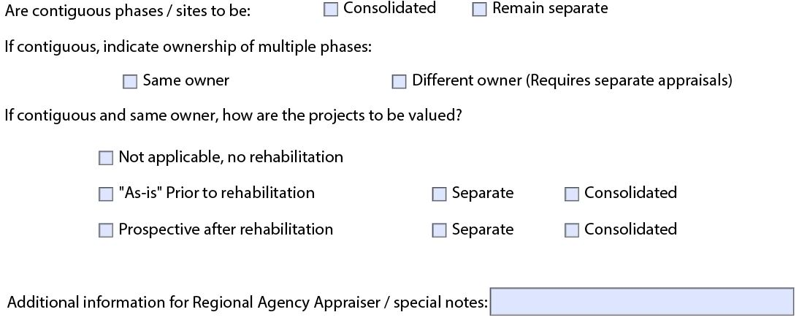
USDA Loan File

Slide 45
USDA Loan File
If same owner, three choices
No renovation or rehabilitation
If to be renovated, as is, prior to renovation
If to be renovated, as if completed, after renovation

Slide 46
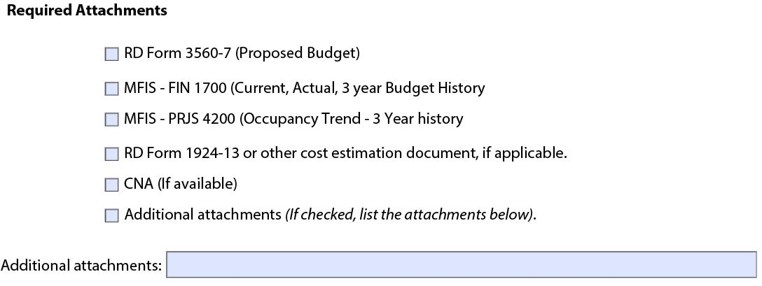
USDA Loan File

Slide 47
Farm Labor Housing
If so, is it located on or off farm?
Are there existing waivers applicable to the property?

Slide 48
538 Guaranteed Rural Rental Housing

Slide 49
Valuation Requests

Slide 50
Valuation Requests

Slide 51
Value types to be requested
RD typically uses only two types of value
Market value
Market value subject to restricted rents
These are current values of property in current condition
Many assignments also require prospective values
Only when value as of a future date is required
New construction
Rehabilitation
Some instances require both prospective and current values

Slide 52
Value types to be requested
Values apply to specific situations
If restricted rents, could be one or more of the following:
Prospective, as if construction/renovation completed
In current condition, plus analysis of intangible assets
Transfer
Loan assumption
Loan write-down
Subordination

Slide 53
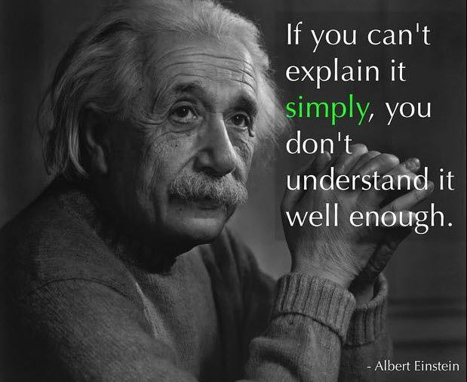
Value Types to be Requested – Attachment 7-C
Notes:
OH MY – Einstein has never read Attachment 7-C – Lets try to resolve the confusion

Slide 54
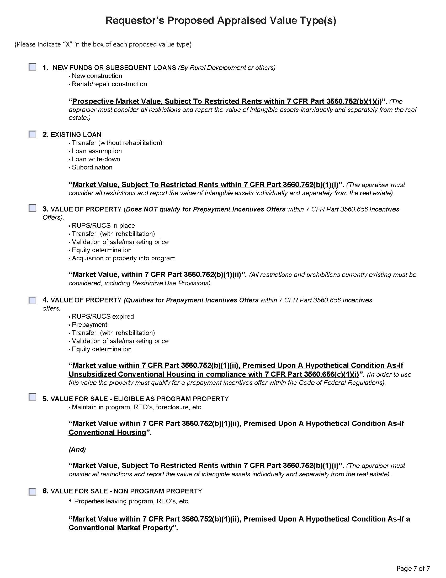
This is how “Value Types” appear in the
Property Information Form – Page 7.
Value Types are Taken Directly from
HB-1-3560, Chapter 7, Attachment 7-C
Notes:
Two Exceptions – Second Value of #1 – Not Required by Regulation nor used by Program Staff.
Liquidation Value has been removed – Confirmation with PMD & Net Recovery Value

Slide 55
Value types to be requested
Notes:
If there is rehabilitation – this value will always be requested – the basis for underwriting.

Slide 56
Value types to be requested

Slide 57
Value types to be requested
Values apply to specific situations
In current condition, but not including analysis of intangible assets
Validation of sale/market price
Equity determination
Acquisition of property into program

Slide 58
Value types to be requested
Notes:
Prepayment is found in 3560.656 – gets confusing

Slide 59
Value types to be requested
If not analyzed under restrictive rents:
Requires hypothetical condition “as if unsubsidized conventional housing”
Prepayment offers
Validation of sale/marketing price
Equity determination

Slide 60
Value types to be requested
If not analyzed under restrictive rents:

Slide 61
Value types to be requested
If for sale, need to analyze both values:
Maintain in program, REO’s, foreclosures
Market value as if conventional housing
Market value subject to restricted rents, with intangibles reported separately

Slide 62
Value types to be requested
If not analyzed under restrictive rents:
Liquidation of Collateral
Hypothetical condition as if conventional market property
“Conventional Market Property” recognizes alternative uses for the project may be considered

Slide 63
Additional Valuation Requests
Interest Credit Subsidy
Loan balance—as of effective date of appraisal
Loan term and note rate
Loan payment calculated by RD
Appraiser determines market rate through research
7-H details steps to calculate value of interest credit subsidy

Slide 64
Making Life Easier
Can we save time and energy in multi-family lending?
Up-front effort pays big dividends
Provides appraisers with correct information
Saves review time
Acceptable appraisal with less delay
Appraisers required 14% less time to complete 29 more assignments in 2016 compared to 2015
Collaboration works!

Slide 65
Making Life Easier
Any questions?
Current issues?
Recurring problems?
Dial for answers!

Slide 66
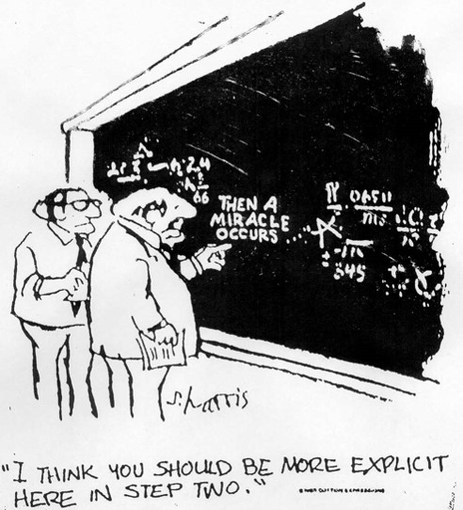
Appraisal Guidance
(How does the Miracle Happen?)
It’s All Because of YOU!!!

Slide 67
Jo Ann Sette
Southern Regional Appraiser
JoAnn Sette@tx.usda.gov
Office: 979.213.4737
Mike Schnetzler - RD, PSS, RHS
Senior National Office Appraiser
Mike.Schnetzler@wdc.usda.gov
Office: 505.220.8112
USDA is an equal opportunity provider, employer, and lender.

