Slide 1

PACE FINANCING
PACE FOR MULTIFAMILY HOUSING

Slide 2
HIGH CAPITAL COST
LOW ENERGY PRICES
+
=
LONG PAYBACK

Slide 3
LOWER
Utility Costs
INCREASE
Net Operating Income
Bottom Line: Increased Building Value

Slide 4
WHAT IS PACE?
A Way Of Paying For Capital Projects With No Money Out Of Pocket

Slide 5
100% LONG TERM FINANCING
IMMEDIATE POSITIVE CASH FLOW

Slide 6
How PACE Works
City or county
creates type of
assessment district
Property owners
voluntarily sign-up
for financing and
install energy/water
projects
Financing provided to property owner
to pay for energy project
Property owner
repays loan
through property
assessment

Slide 7
ELIGIBLE PROPERTIES
OFFICE/RETAIL
INDUSTRIAL
MULTIFAMILY (5+ UNITS)
NONPROFITS

Slide 8
NOT ELIGIBLE
NEW CONSTRUCTION
    i.e. Greenfield
GOVERNMENT PROPERTY
  Includes school districts, water authorities, etc.
SINGLE FAMILY RESIDENTIAL

Slide 9
ELIGIBLE MEASURES
Energy Efficiency
HVAC modification or replacement
Automated control systems
LED Lighting
Insulation
Windows and doors
Caulking, weather-stripping or air sealing
Water Efficiency
Water Fixtures
Reclaimed Water Systems
Rainwater collection
On-Site Generation
Solar panels
CHP

Slide 10
REPAYMENT
LONG SIMPLE PAYBACK?
NO PROBLEM!
UTILITY SAVINGS
INCREASED NOI

Slide 11

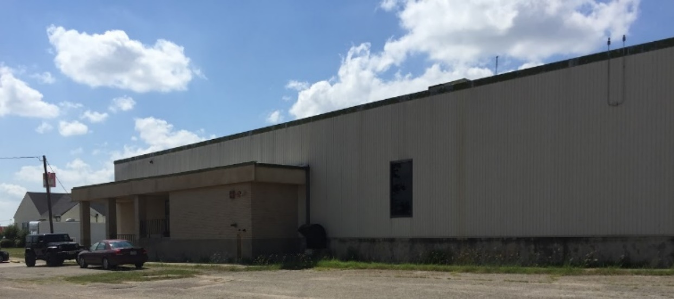
R.J. Liebe Company
Navarro County
Measures:
HVAC
Lighting
Investment: $325,000
187,000 annual KWh
60 – 80 new, permanent manufacturing jobs

Slide 12
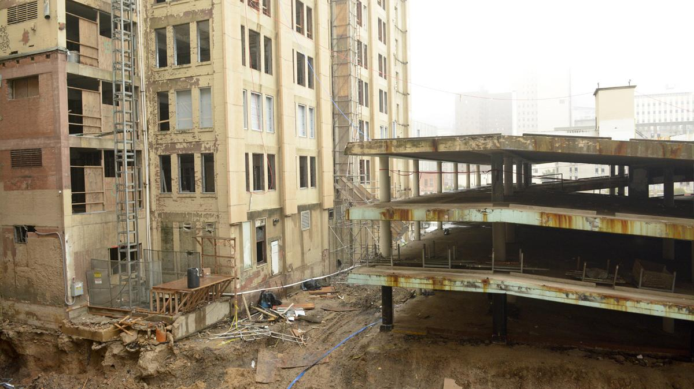
Historic Dallas Butler Brothers Building
Measures:
HVAC
Lighting
Windows
Insulation
Roof
Water Fixtures
Assessment Total: $24MM
Annual Savings: $2MM

Slide 14
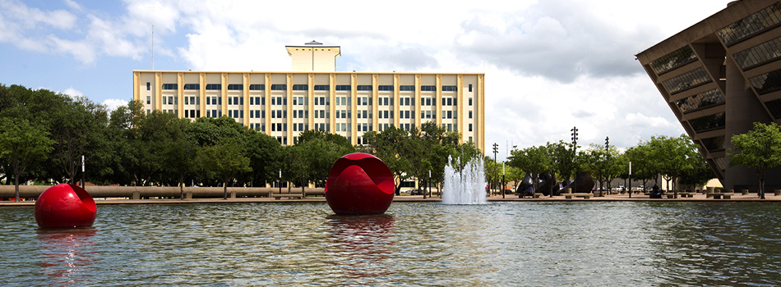

Slide 15
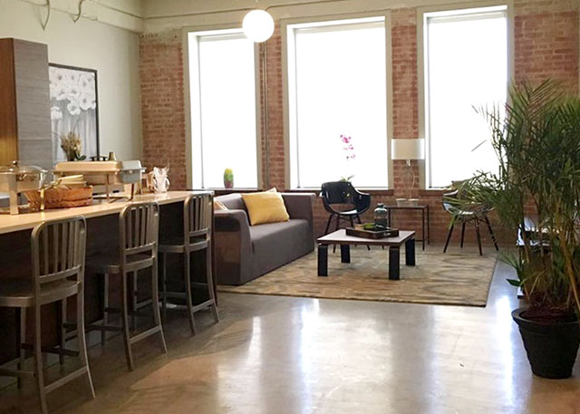

Slide 16
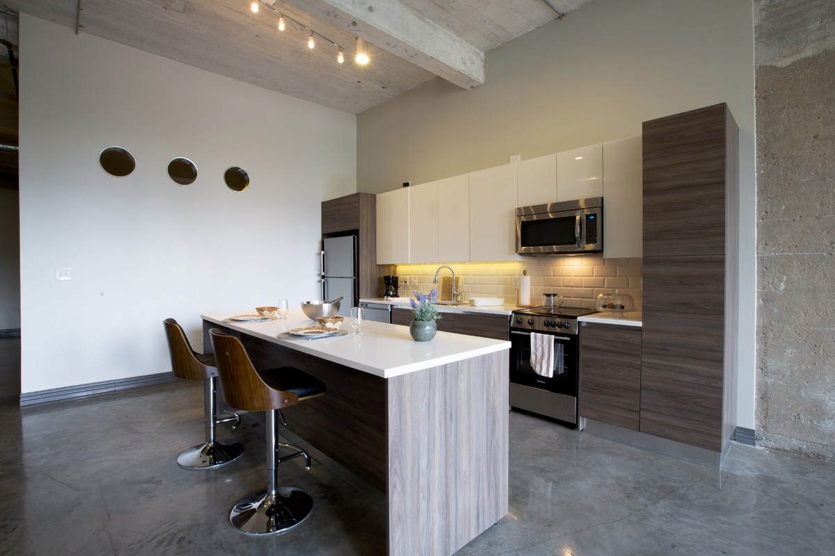

Slide 17
Butler Capital Stack
BEFORE PACE
6.25%
Senior Debt (EB-5)
$49.5MM
3%
Historic Tax Credits
$21.9MM
8.02% WACC
15%
Mezzanine loan
$22MM
10%
Equity
$22.4M

Slide 18
Butler Capital Stack
AFTER PACE
6.25%
Senior Debt (EB-5)
$49.5MM
3%
Historic Tax Credits
$21.9MM
6.34% WACC
15%
6.13%
Mezzanine loan
$22MM
PACE loan
$24MM
10%
Equity
$22.4M

Slide 19
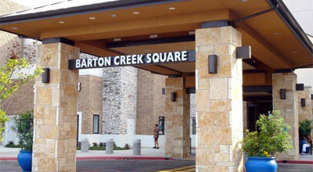
BARTON CREEK
ROUND ROCK OUTLETS
LAKELINE

Slide 20
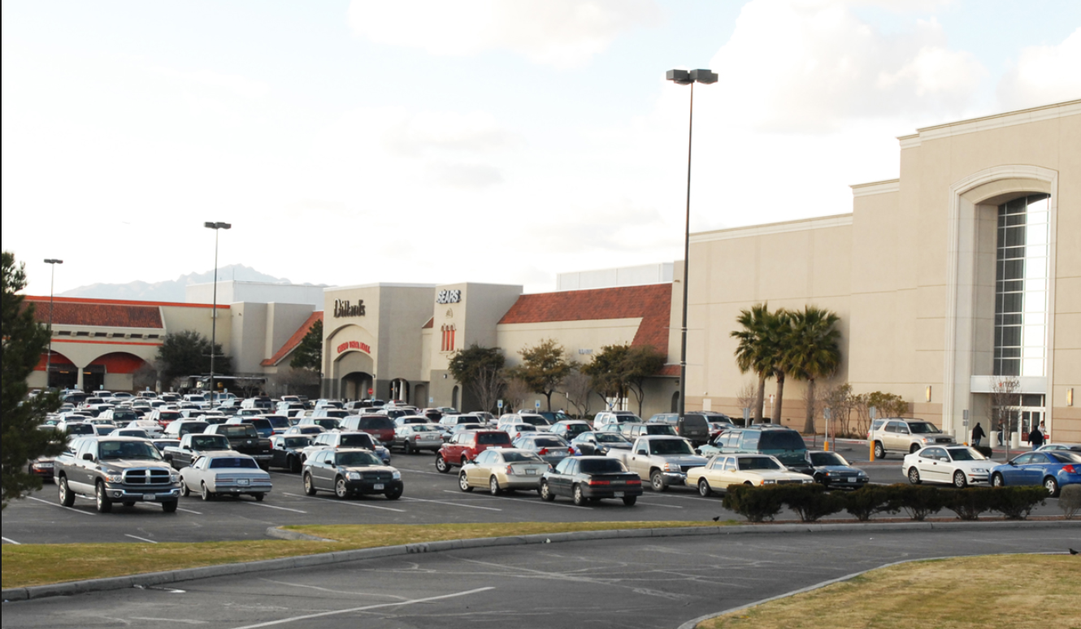
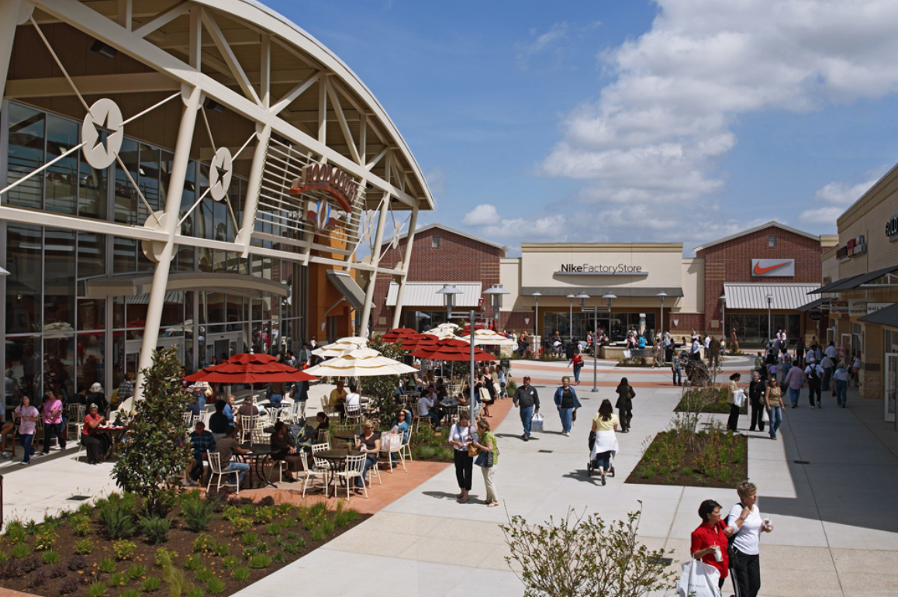
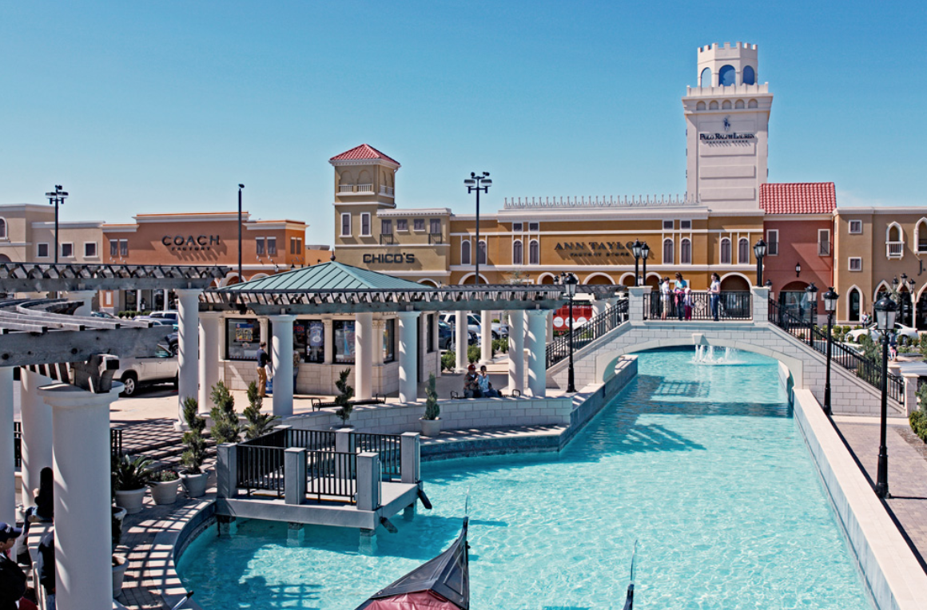
CIELO VISTA
HOUSTON PREMIUM OUTLETS
SAN MARCOS OUTLETS

Slide 21
MALL UPDATES
Measures:
Exterior LEDs
HVAC
VFDs
BAS
Weatherization of building shell
Low flow water fixtures
Total Project Cost: ~$4M
Annual Savings: $500,000

Slide 22
WHERE IS PACE?
  Live PACE Regions
  North Texas: Amarillo
  DFW: Cities of Dallas & Farmers Branch, Navarro & Tarrant Counties
  Central Texas: Travis, Hays & Williamson Counties
  South Texas: Nueces, Cameron, Hidalgo, & Willacy Counties
SE Texas: Brazos, Fort Bend & Jefferson Counties,
City of Houston
  West Texas: El Paso County

Slide 23

TEXAS’ OPEN-MARKET PACE PROGRAM ADMINISTRATOR

