Slide 1
Home Buyer Programs
Notes:
Welcome to Texas State Affordable Housing Corporation’s Home Buyer programs presentation. I am _________________ and I have been trained and certified by TSAHC to provide you with information regarding their programs. (Provide an introduction of yourself here and what you hope to accomplish by giving this training.)
Any modification to the slides must be approved by TSAHC. Please email Joniel Crim at jcrim@tsahc.org for approval.

Slide 2
About TSAHC
TSAHC is a 501(c)3 nonprofit organization. Our mission is to serve the housing needs of low-income Texans and other underserved populations. We fulfill our mission through our concept of:
Notes:
For those of you who are not familiar with the Texas State Affordable Housing Corporation, they are a statewide non-profit created at the direction of the Texas Legislature. Their mission is to serve the housing needs of low-income and moderate income Texans.
They have several programs including home buyer programs to help individuals and families buy a home in Texas. Those programs include the Homes for Texas Heroes Home Loan Program and the Home Sweet Texas Home Loan Program. Through these programs they help almost 2000 families buy a home each year. The main difference between the two programs are the eligible professions.
The Home Sweet Texas Home Loan Program is open to anyone regardless of profession and the Homes for Texas Heroes Home Loan Program is open to teachers, veterans, police officers, corrections officers, EMS personnel and fire fighters. Both programs require the individual or family to meet certain income limits for the county they are purchasing the home.

Slide 3
Home Buyer Programs
These Home Buyer Programs offer two types of assistance to home buyers STATEWIDE.
Notes:
TSAHC offers two types of assistance to help home buyers under both the Home Sweet Texas and Homes for Texas Heroes home loan programs. This assistance is available statewide with no limitation on location.
The first type of assistance, is a low interest rate mortgage loan with down payment assistance attached to the loan. The loan is a 30 year fixed rate mortgage loan and may be an FHA, VA, USDA or Conventional mortgage loan. The assistance may be used for your down payment and to help cover your closing costs.
The second type of assistance, is a special mortgage interest income tax credit. This income tax credit will help reduce the amount of income taxes you owe the IRS by as much as $2,000 a year, every year, as long as you live in the home. By reducing the amount of income taxes you owe, this increases your take home pay which may be used to help you pay for your mortgage payment.
This tax credit may be combined with the down payment assistance too. So, not only does TSAHC help you get into your home with the down payment assistance but they also provide an income tax credit which may help you pay your monthly payments.
I will provide more detail for both types of assistance on the next slides.

Slide 4
Loans with Down Payment Assistance
Several options are available to your borrower:
Assistance % is based upon total loan amount
(i.e.: 5% of $100,000 = $5,000)
No need to be first-time buyer
(must use to purchase primary residence)
Can be used to cover down payment and/or closing costs
3% Assistance | 4% Assistance | 5% Assistance
Notes:
If you would like to participate in the Down Payment Assistance program, you will have 3 different percentage levels of down payment assistance available to you. It will be up to you to decide which assistance option you need. Your loan officer can help you decide what’s best for you . Please note that the lower the amount of grant assistance you choose, the lower the interest rate will be on the 30 year fixed interest rate mortgage. Check with your loan officer for interest rates.
The grant assistance that you receive never needs to be repaid. There are no strings attached. You don’t have to purchase in any certain area of Texas nor do you need to stay in the property for any period of time. It is a TRUE gift.
Because of this, you have some flexibility when using the funds. You can put the money toward your down payment, closing costs, to reduce your loan balance or any combination of the three.
Also, you do not have to be a first time homebuyer to use TSAHC’s DPA program, however, it must be used to purchase your primary residence.
You may choose whichever mortgage loan type works best for you whether that’s an FHA, VA, USDA, or Conventional loan product. Your loan officer will

Slide 5
Loans with Down Payment Assistance
Option 1: Grant | Option 2: 2nd Lien
FHA, VA, USDA, or HFA Preferred Conventional Loan True gift that never needs to be repaid 3%, 4%, or 5% DPA options | HFA Preferred Conventional Loan 0% interest on 2nd Lien No monthly payments on 2nd Lien (repayable at time of 1st Lien payoff) Lower interest rates 5% DPA only

Slide 6
Loans with Down Payment Assistance
HFA Preferred Conventional Loan
TSAHC offers a special Fannie Mae loan called HFA Preferred Conventional. It has all the benefits of a traditional conventional loan with some added perks:
Only 3% down payment required
No upfront mortgage insurance (MI) premium
Lower minimum monthly MI rates
No Loan Level Pricing Adjustments (LLPAs)
MI can be cancelled

Slide 7
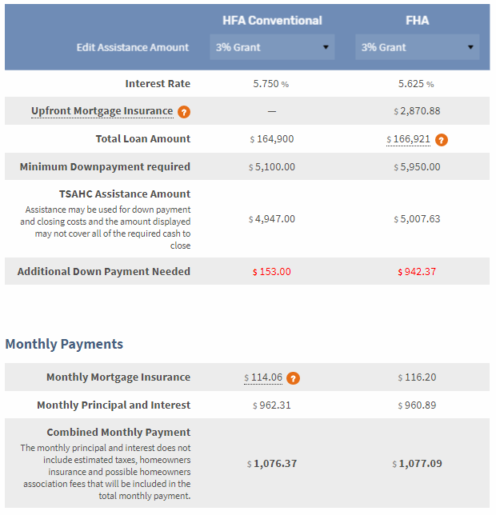
TSAHC Loan Comparison Calculator
Example: 680 FICO, $170,000 sales price, 3% DPA
Upfront MIP expense is $0 vs $2,870
Lower down pmt means less out-of-Pocket expense
Similar monthly payment
MI can be cancelled at 78% LTV making payment $114 cheaper in the long run

Slide 8
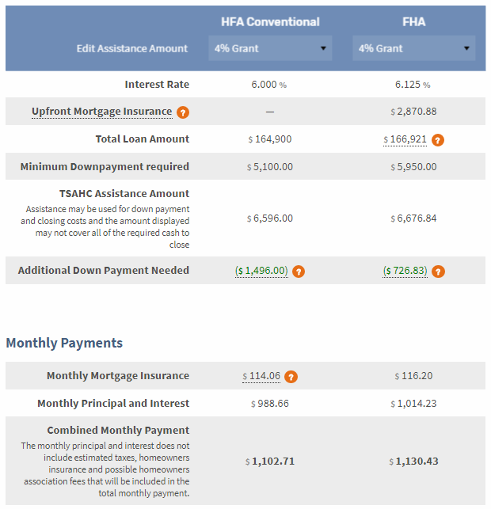
TSAHC Loan Comparison Calculator
Example: 680 FICO, $170,000 sales price, 4% DPA
Upfront MIP expense is $0 vs $2,870
Lower down pmt means DPA surplus of $1496 vs $726 (use toward closing cost)
Cheaper monthly payment
MI can be cancelled at 78% LTV making payment $114 cheaper in the long run

Slide 9
Mortgage Interest Tax Credits
Mortgage Credit Certificate (MCC)
First-time buyers only
(Waived for Qualified Veterans and Targeted Areas)
Annual tax credit worth up to $2,000
Must occupy the home as principal residence
Debt-to-income ratio reduced so buying power increased
FREE for Texas Heroes using our DPA program
Notes:
The second form of assistance is my personal favorite and I like to call it the gift that keeps on giving. This special mortgage interest tax credit is called a Mortgage Credit Certificate or MCC. This is a first-time homebuyer program only, with the definition of a first-time home buyer being anyone who hasn’t had ownership interest in a primary residence for the last 3 years.
Get the credit you deserve with TSAHC’s MCC!
As we discussed before, an MCC gives a homeowner the ability to claim an income tax credit equal to 40% of the mortgage interest paid up to a maximum of $2,000 a year. This credit may be used every year for the life of the loan, as long as you occupy the home as your principal residence.
Remember, this tax credit may be combined with TSAHC’s down payment assistance at the same time.
Plus, its free for Texas Heroes who are also using TSAHC’s down payment assistance!

Slide 10
Mortgage Interest Tax Credits
Mortgage Credit Certificate (MCC):
Equal to 40% of the mortgage interest paid up to a maximum $2,000 a year.
40%=$2,250
$2,000
Notes:
Here’s an example of how to calculate the amount of the tax credit specific to your situation. TSAHC provides an MCC credit rate of 40%. This means that 40% of the annual interest that you pay can be taken as a tax credit up to a maximum of $2,000 a year. The example shows that 40% of the annual interest paid in this scenario is $2,250. So, in this case, the home buyer can maximize the full $2,000 income tax credit.
As you can see, the MCC has the potential of saving you thousands of dollars over the life of the loan.

Slide 11
Mortgage Interest Tax Credits
What’s the difference between a tax credit
and a tax deduction?
Tax Credits = Reduction of tax liability
or taxes owed
Tax Deductions = Reduction of taxable income
Notes:
Some folks may be thinking that, everyone benefits from mortgage interest on your income taxes so why do I need an MCC? This is true but only holders of an MCC benefit from the dollar for dollar credit that an MCC provides.
What’s the difference between a tax credit and a tax deduction? Tax credits provide a dollar-for-dollar reduction of income tax liability or taxes owed, while tax deductions allow one to lower the amount of taxable income by the amount of the mortgage interest. As an example, if you pay $5,000 in mortgage interest and your income is $50,000, you can reduce the amount of your taxable income by the amount of interest you paid, which would reduce your taxable income to $45,000. This is the amount of income you will pay income taxes on. A $2,000 deduction, for example, might reduce your tax bill by only $300 to $400. A $2,000 tax credit cuts your tax bill by $2,000.

Slide 12
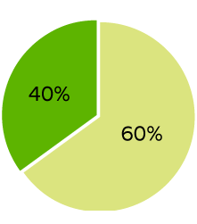
Mortgage Interest Tax Credits
An MCC allows you to take
advantage of both forms of savings:
All home owners may take
deductions but tax credits are only
available to holders of an MCC.
In this example, they can take the remaining mortgage interest in the amount of $3,625 ($5,625 - $2,000 credit) plus any property taxes, etc.
as a deduction.
Potential tax credit
Amount that may continue to be deducted
Notes:
An MCC allows you to take advantage of both forms of savings: Using the previous example, you can take the remaining mortgage interest in the amount of $3,625 ($5,625 - $2,000 credit) plus any property taxes, etc. as a deduction. An MCC is still better, let’s see what a dollar for dollar reduction of your tax liability can do for you on the next slide.

Slide 13
Mortgage Interest Tax Credits
Home buyer receives a refund every year? They may still benefit.
Payroll Income
Tax Withholding
Annual Tax Liability
$10,000
Paid too much
so they get a refund
Notes:
Let’s go over some fun examples on how the MCC works and how you might benefit from having an MCC. We have a lot of folks who say that they already receive a refund every year and they don't think they can benefit from the MCC. Well that's not always true, and I'll show you how. Let's say that this bucket represents our homebuyer Sally's income tax liability which happens to be $10,000 a year. Like most of us, Sally's employer has a portion of her paycheck set aside through her payroll income tax withholding, so that hopefully by the end of the year Sally will be able to cover her entire income tax liability. Fortunately for Sally, she had more than enough taken in payroll deductions to cover her $10,000 income tax liability. As you can see, once her bucket had $10,000, her remaining payroll deductions started over filling the bucket which resulted in a tax refund. In this example, Sally paid too much and gets her own money back as a tax refund. Let's see how an MCC could help Sally.

Slide 14
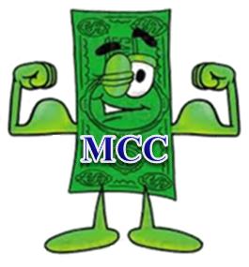
Mortgage Interest Tax Credits
Effect of an MCC on income tax liability
Payroll Income
Tax Withholding
stayed the same
The $2,000 MCC goes in the bucket
before payroll deductions
Borrower refund
increased by $2,000!
Remaining Tax Liability
$8,000
Annual Tax Liability
$10,000
Notes:
Let's say that Sally, again, has an income tax liability of $10,000 a year but this time she bought a new house as a first time home buyer and took advantage of the benefits of an MCC. Because Sally had an MCC, the $2000 MCC went into the bucket before any of her payroll deductions. Now, her remaining tax liability is only $8000. It directly reduced what she owed dollar for dollar. Let's assume Sally has the same amount taken out of each paycheck from her employer. Remember the bucket started off with the $2000 from the MCC in it first, so it's $2000 fuller now and more of the money that is being deducted from her paycheck is falling out of the bucket. Sally has more than covered her remaining tax liability of $8000 because she kept her payroll deductions the same, which means her tax refund has also increased by $2000. So, in this example Sally paid too much and gets her own money back as a tax refund which is now $2000 higher because of the MCC credit. Sally, instead, could update her W-4 form with her employer to reduce the amount of her payroll deductions by $166.67 a month. This is the $2,000 credit divided by 12. If Sally adjusts her W-4, then she will realize the credit every month by increasing her take home pay in the amount of $166.67.

Slide 15
Mortgage Interest Tax Credits
It’s your responsibility to claim the mortgage interest credit.
Claimed on federal income tax return
The credit cannot be greater than your income tax liability.
Any unused credit can be carried forward up to three years.
Notes:
It is important that you check with a CPA to confirm that an MCC will benefit you. And, you will also need to claim this credit every year on your tax return. However, it will likely benefit you if you have a tax liability. The credit cannot be greater than your income tax liability but any unused tax credit can be carried forward up to three years.
A tax liability simply means that you owe taxes on your annual income. Most folks pay federal income taxes on their income, whether it is deducted from each pay check or paid at tax time on the tax return.
This program is a great benefit to first time buyers. Essentially, its as if you are getting a lower interest rate on the mortgage because you are getting some of the interest money back in the form of this tax credit!

Slide 16
Important Takeaways
Borrower can purchase anywhere in Texas.
FREE MCC for Texas Heroes using DPA
Turnaround times are fast!
No need to be a first-time buyer to use TSAHC DPA
2 DPA Options: TRUE GRANT or Low Interest Repayable
Not required to stay in the home any number of years
Notes:
No need to be a first-time buyer to use TSAHC DPA
DPA is a TRUE GRANT, no need to be repaid – EVER!
Because this is a grant with no lien, there is NO requirement to stay in the home any number of years
A home buyer can purchase anywhere in the state of Texas because TSAHC is available STATEWIDE
There is no minimum time on the job required for Texas Heroes to get the free MCC
Turnaround times are fast! TSAHC’s turn time is 24-48 hours to review a file so it may not take any longer than a traditional loan.

Slide 17
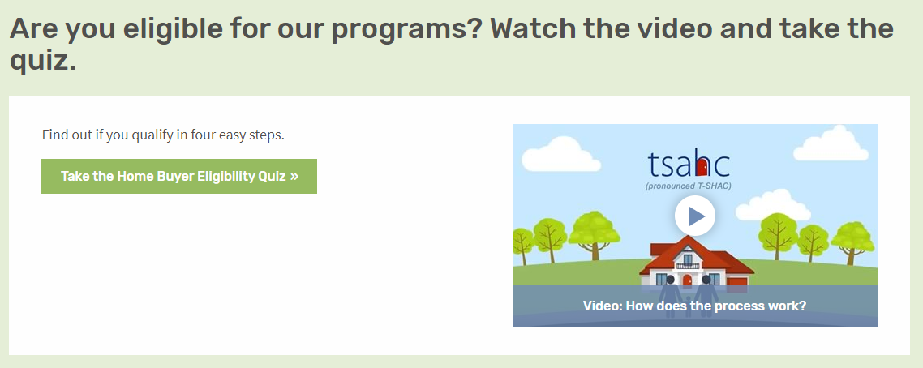
How to Get Started
Visit www.ReadyToBuyATexasHome.com to take the following steps:
1. Take the Eligibility Quiz
Notes:
LOAN OFFICERS: Slides 12-14 may be modified to promote you and your company.
REALTORS: Slides 12-14 may be modified to promote your preferred loan officer.
Any modification to the slides must be approved by TSAHC. Please email Joniel Crim at jcrim@tsahc.org for approval.
So how do you determine if you can use one or both of these programs?
First, visit www.ReadyToBuyATexasHome.com.
Click on the “Home Buyers & Renters” tab at the top of the page.
You will see ‘Take the Eligibility Quiz’.
This will walk you through the eligibility criteria with 4 easy questions.
Should you not see your job title listed, no worries! Just choose “my job title is not listed”.
You can also watch a short video about the programs!

Slide 18
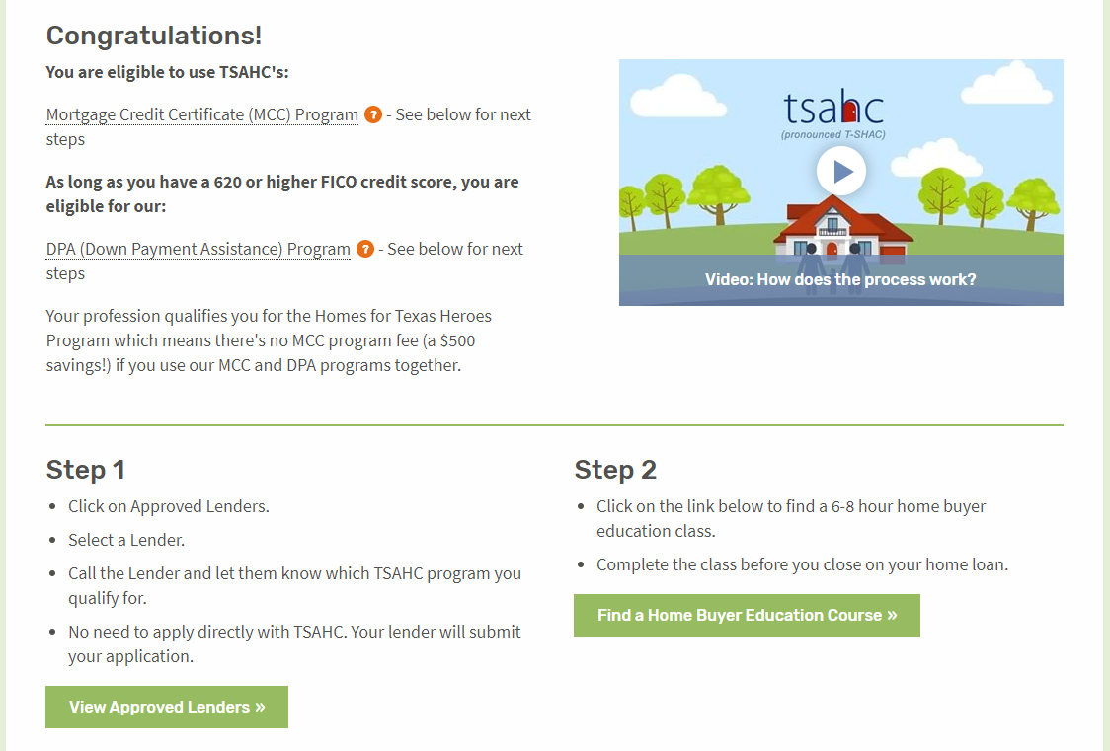
How to Get Started
Visit www.ReadyToBuyATexasHome.com to take the following steps:
2. Carefully read your quiz results for additional details and next steps.
Notes:
LOAN OFFICERS: Slides may be modified to promote you and your company.
REALTORS: Slides may be modified to promote your preferred loan officer.
Any modification to the slides must be approved by TSAHC. Please email Joniel Crim at jcrim@tsahc.org for approval.
Next, should you qualify, your quiz results will tell you what your next steps will be in order to move forward. Please note that for the Down Payment Assistance program, certain credit scores and debt to income ratios are required. To learn more about them, click on the link provided.
Step 1:
You will need to contact a preferred loan officer by clicking on the “View Lenders In Your Area” button. Choose a preferred loan officer from the list.
Then, simply inform the loan officer that you would like to use one or both of TSAHC’s programs. The loan officer will walk you through the remainder of the process, ensuring that you qualify and will also submit an application for the assistance on your behalf. No direct application to TSAHC is required. Everything is done by the loan officer.
Step 2:
Before closing on your home, you will need to complete a homebuyer education class. This class is extremely beneficial to you as a homeowner and will teach you all about the home buying process. You can find one in your area or online by clicking on the “Find a Home Buyer Education Course” button.

Slide 19
How to Get Started
Visit www.ReadyToBuyATexasHome.com to take the following steps:
3. Contact an Approved Lender to Apply.
Notes:
LOAN OFFICERS: Slides 12-14 may be modified to promote you and your company.
REALTORS: Slides 12-14 may be modified to promote your preferred loan officer.
Any modification to the slides must be approved by TSAHC. Please email Joniel Crim at jcrim@tsahc.org for approval.
When choosing a loan officer, know that TSAHC highlights loan officers who are knowledgeable and experienced in both the DPA and MCC programs.
The “Statewide Top Performing” section highlights loan officers who have done the most business with TSAHC statewide. Because of their extensive use of both the MCC and DPA programs, they are very knowledgeable about the process - providing a sense of confidence that a home buyer will have a good experience using either of TSAHC’s programs when working with them.
The same applies to the “Regional Top Performing Loan Officers” section that highlights loan officers who have done the most business with TSAHC in their particular region of Texas.
Also, in the “Preferred Loan Officers by County” section, you can find a list of loan officers that are approved in your county. These folks have helped at least four families use our programs in the past year.
And finally, the “Approved Mortgage Companies” section will help you see the companies that have been approved to use our programs in the state of Texas. Any loan officer working for one of these companies may help you purchase a home using TSAHC’s programs. If the loan officer is not yet familiar with TSAHC’s programs, simply put them in touch with TSAHC.

Slide 20
How to Get Started
Visit www.ReadyToBuyATexasHome.com to take the following steps:
4. Take a Home Buyer Education Course (Online or In Person)
Notes:
Home buyers need to complete a homebuyer education course prior to closing on the home loan.
When choosing a Home Buyer Education class, you have the option of taking an “Online Class” or an “In-Person Class”. The 3 online options that TSAHC allows are listed in the “Online Classes” section. Please just choose one to take and that will suffice. Should you like an “In-Person” class, you can find one near you by clicking on the “Find a Class Near You” button.

Slide 21
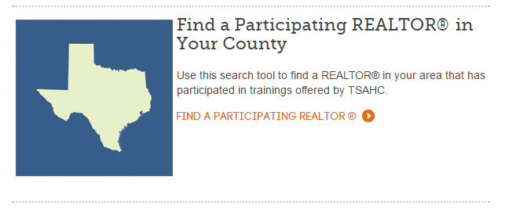
How to Get Started
Visit www.ReadyToBuyATexasHome.com to take the following steps:
4. Find a Participating Realtor
Notes:
LOAN OFFICERS: Slide 16 may be modified and additional slides added to promote your preferred Realtor.
REALTORS: Slide 16 may be modified and additional slides added to promote you and your company.
Any modification to the slides must be approved by TSAHC. Please email Joniel Crim at jcrim@tsahc.org for approval.
TSAHC does not require you to work with a REALTOR® that has been approved by TSAHC. However, if you are looking for a REALTOR®, TSAHC offers several resources to help you find one familiar with TSAHC’s down payment assistance and mortgage tax credit programs. Use this search tool to find a REALTOR® in your area that has participated in trainings offered by TSAHC.

Slide 22
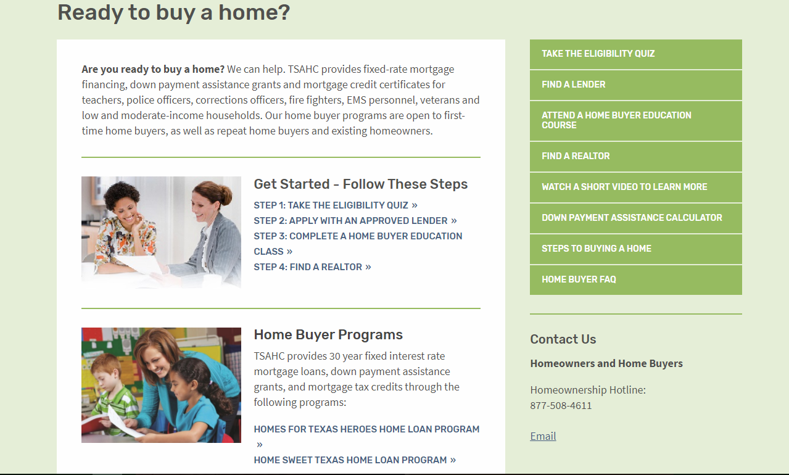
www.ReadyToBuyATexasHome.com
Notes:
Again, when visiting the Home Buyers and Renters section of www.ReadyToBuyATexasHome.com, you will find:
The Eligibility Quiz
Information for the Loans with Down Payment Assistance program
More information about the Mortgage Credit Certificate program
Many consumer resources including a “Steps to Buying a Home” page and webinar and the Texas Mortgage Calculator

Slide 23
Questions
ENTER YOUR CONTACT INFORMATION HERE
Visit www.ReadyToBuyATexasHome.com
Call TSAHC’s Homeownership Hotline: (877) 508-4611
Email Homeownership@TSAHC.org
Notes:
I want to thank you for your time today. I hope you are excited about the opportunity these programs may provide you to become a homeowner. I’m happy to answer any questions you might have for me now. If you have further questions, feel free to contact me with the following contact information. Should you want to talk to TSAHC directly, they may be contacted at the homeownership hotline, (877) 508-4611 or you may email them at Homeownership@tsahc.org.

