Slide 1
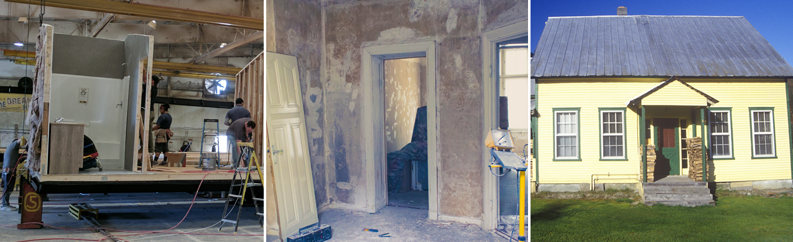
Doing More for Underserved Housing Markets
Overview of Fannie Mae’s Duty To Serve Plan

Slide 2
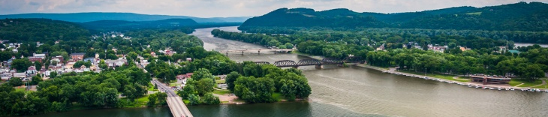
What is the Duty To Serve Rule?
A regulation issued in December 2016 by the Federal Housing Finance Agency
Driven by the Housing and Economic Recovery Act (HERA) of 2008, which guides our activities at Fannie Mae every day
It requires Fannie Mae and Freddie Mac to improve access to mortgage financing for those of modest means in three housing markets posing persistent challenges:
  Manufactured housing
  Affordable housing preservation
  Rural housing

Slide 3
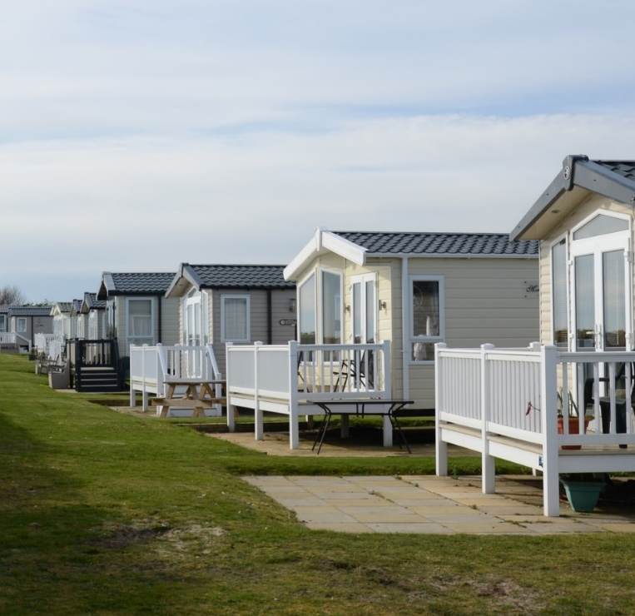
Why is Duty To Serve important?
Helps homeowners and communities
  Targets families of modest means
  Focuses on underserved market segments
  Sets the stage for broader economic benefits
Creates growth opportunities for the industry
  Explores unrealized market opportunities
  Encourages innovation to address market
  challenges and reduce costs
Aligns with Fannie Mae’s mission
  Builds on what we do best—tackling tough housing challenges
  Promotes access to safe, sustainable, and affordable housing options
  Manages risk to protect lenders, homeowners, and taxpayers

Slide 4
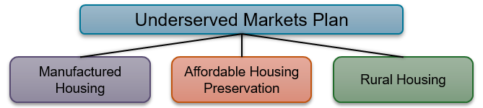
How are we approaching this challenge?
We’ve developed a three-year Underserved Markets Plan as required by FHFA, proposing activities to address the housing challenges in each market.
Our approach is to:
Analyze – Use research and analysis for a data-driven market understanding
Test and learn – Execute pilots and evaluating product and program changes
Partner and innovate – Listen and work closely with market-based experts
Do what we do best – Use the power of the secondary market to attract
private capital

Slide 5
Who and where are we trying to help?
Nationwide – We’re serving very low- to moderate-income families (earning ≤ Area Median Income) in each of the three underserved housing markets
Rural Multifamily - Increasing Delivery of 5 to 50 unit Loans
LIHTC – Reenter LIHTC Equity Investments
Rural Housing Market – We’re targeting specific high-needs populations and regions, including:
  Middle-Appalachia, Lower Mississippi Delta, and colonias
  Rural tracts in persistent poverty counties
  Native Americans and agricultural workers

Slide 6
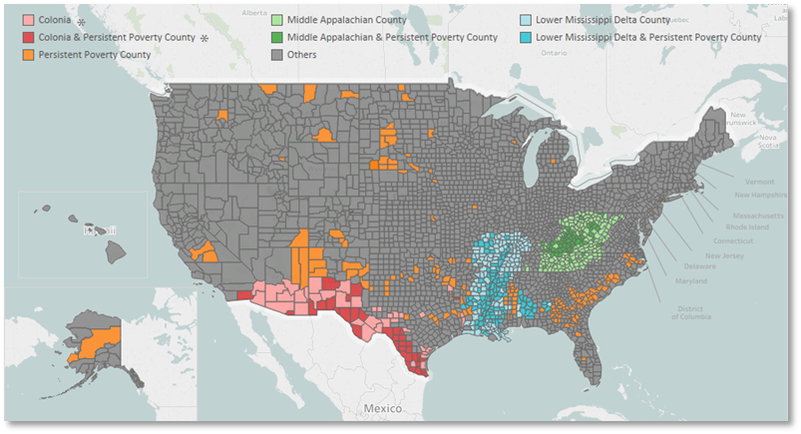
Rural market: Combined high-needs rural areas
Under the DTS rule, a colonia must be a community identified under a federal, State, tribal, or local program. Colonia information shown on the map above is courtesy of the State of Texas and the University of New Mexico.

Slide 7
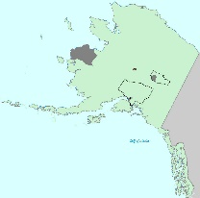
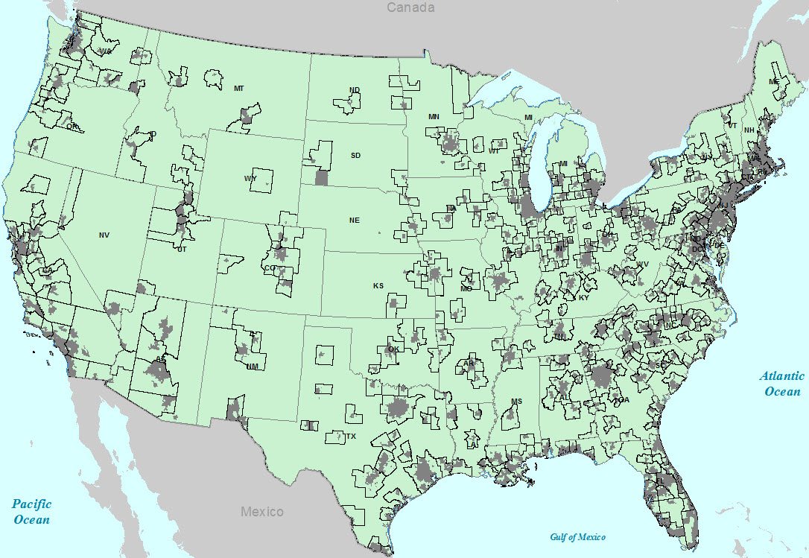
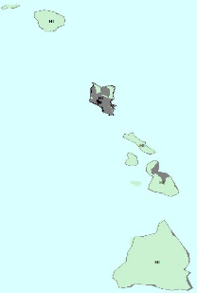
2017 FHFA Rural Areas
MSA
2017 Rural Tracts

Slide 8
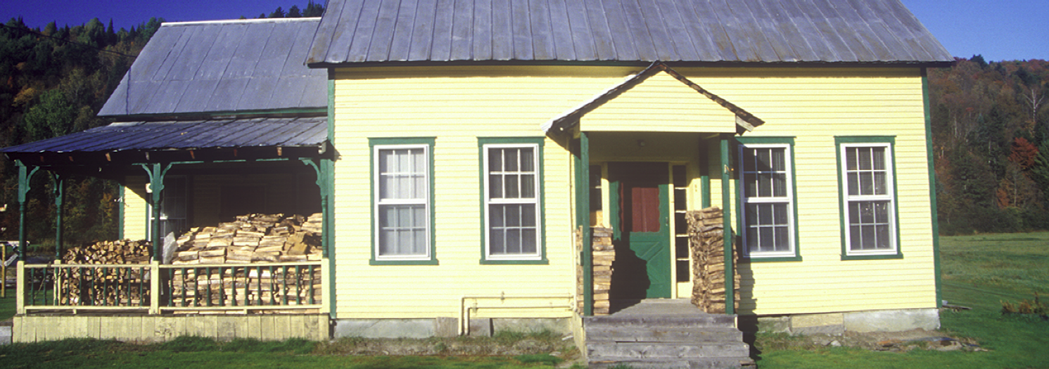
Rural Housing: Multifamily Actions
Purchase multifamily loans in Middle Appalachia, the Lower Mississippi Delta, and the colonias.
Purchase multifamily loans that support affordable housing for Native Americans and agricultural workers.
Re-establish our Low Income Housing Tax Credit (LIHTC) investment capacity.
Include LIHTC equity investments in the multifamily work-plans for high-needs rural regions and high-needs rural populations.
Expand Small Loan (5 to 50) purchase

Slide 9

Duty to Serve: How can you help?
Look for opportunities to help us implement our plan in 2018 and beyond:
Engage and innovate with Fannie Mae representatives and industry partners
Support future research, outreach, and pilots.
We welcome your ideas
and creativity!

Slide 10
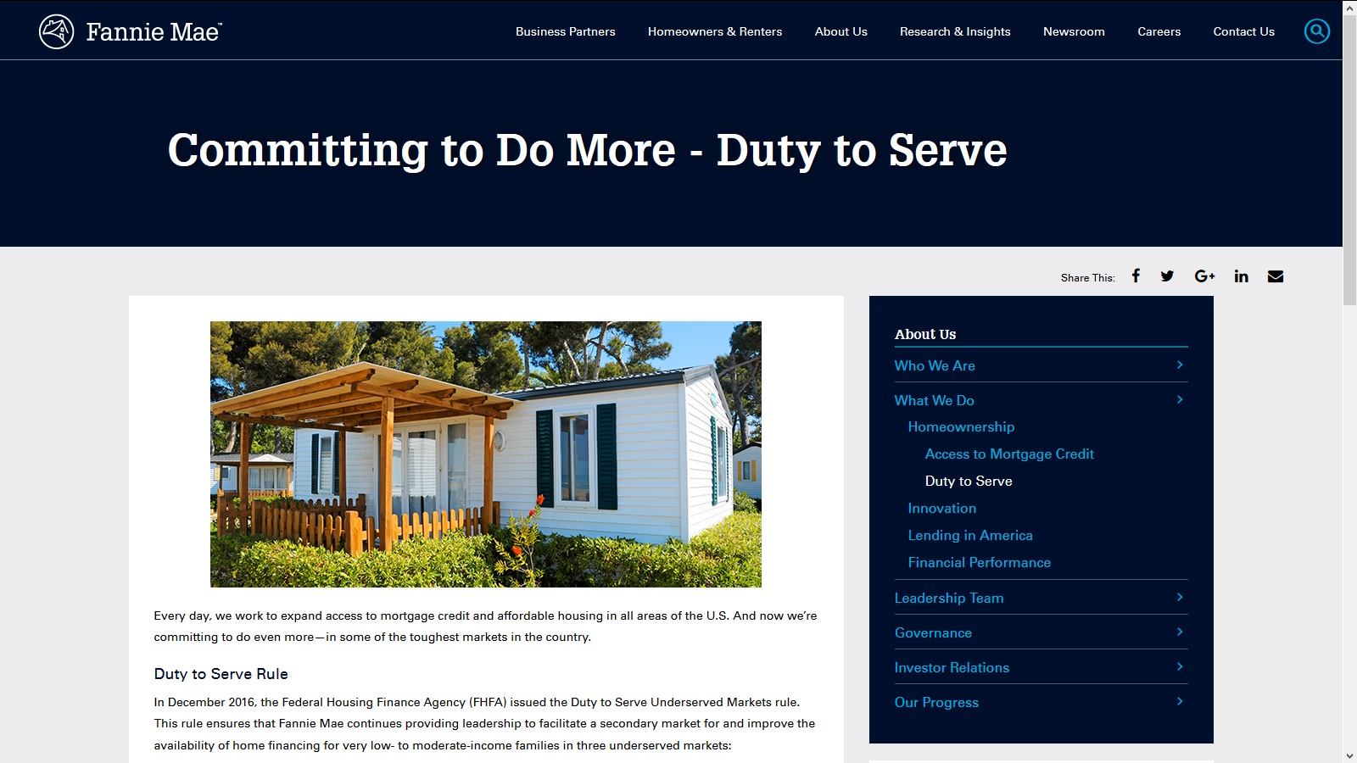
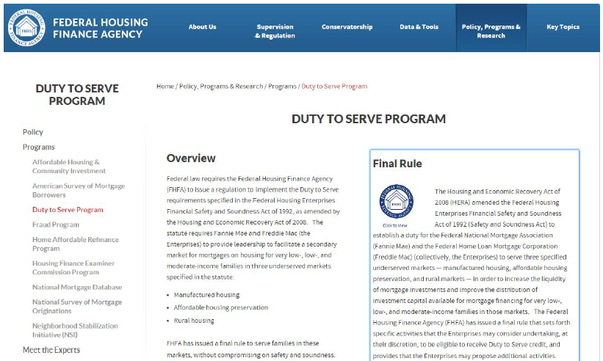
Where can you get more information?
fanniemae.com/dutytoserve
www.fhfa.gov/dts

Slide 11
Rural market: Middle Appalachian region

Slide 12
Rural market: Lower Mississippi Delta region

Slide 13
Rural market: Persistent poverty counties

Slide 14
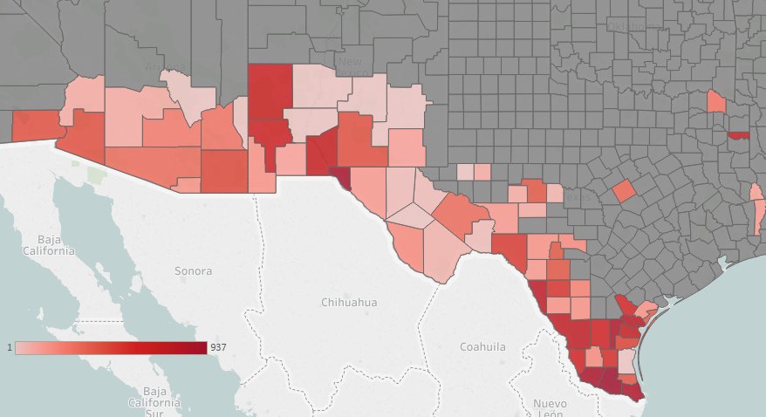
Rural market: Example of the colonias region*
Under the DTS rule, a colonia must be a community identified under a federal, State, tribal, or local program. Colonia information shown on the map above is courtesy of the State of Texas and the University of New Mexico.

