Slide 1
Overview of the Section 514/516 Farm Labor Housing Program

Slide 2
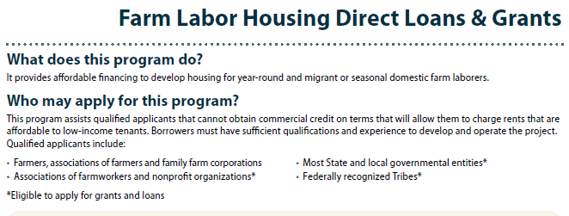
Multi-Family Farm Labor Housing Loans & Grants

Slide 3
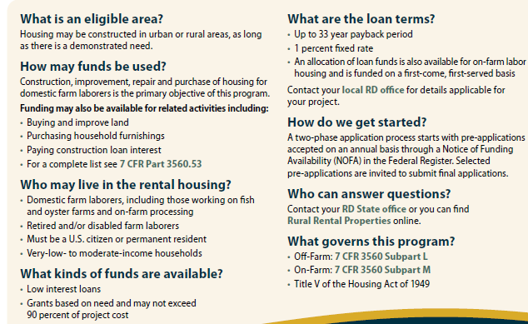
Multi-Family Farm Labor Housing Loans & Grants Continued…
https://www.ecfr.gov/cgi-bin/text-idx?SID=5a46e4158b427982721e2b125cd65433&node=pt7.15.3560&rgn=div5#se7.15.3560_153

Slide 4
Labor Housing National Portfolio
552 apartment properties
16,823 apartment units
3.4% delinquency
All data as of 12/31/2017

Slide 5
Labor Housing Texas Portfolio
17 apartment properties
1,123 apartment units
0.0% delinquency
All data as of 12/31/2017

Slide 6
Labor Housing National Portfolio Compared to the Texas Portfolio
552 National vs. 17 Texas apartment properties
16,823 National vs. 1,123 Texas apartment units
3.4% National vs. 0.0% Texas delinquency
All data as of 12/31/2017

Slide 7
Diminished Needs Waivers
These waivers are requested from borrowers in order to rent their FLH apartments to non-farm workers as a result of there no longer being a need for FLH in the area or they are unable to fully rent all units to eligible farm workers.
Of the 17 FLH properties in Texas, 7 currently have a waiver or are currently in the
process of requesting a waiver.
Definition of a domestic farm laborer:
“...any person (and the family of such person) who receives a substantial portion of his or her income from primary production of agricultural or aquacultural commodities or the handling of such commodities in the unprocessed stage, without respect to the source of employment, except that (A) such person shall be a citizen of the United States or a person legally admitted for permanent residence; (B) such term includes any person (and the family of such person) who is retired or disabled, but who was domestic farm labor at the time of retirement or becoming disabled;…”

Slide 8
Labor Housing NOSA
The most recent FLH NOSA was published on 7/26/17 in the Federal Register and expired on 9/11/2017
The NOSA included the availability of loan funds, grant funds, and Rental Assistance

Slide 9
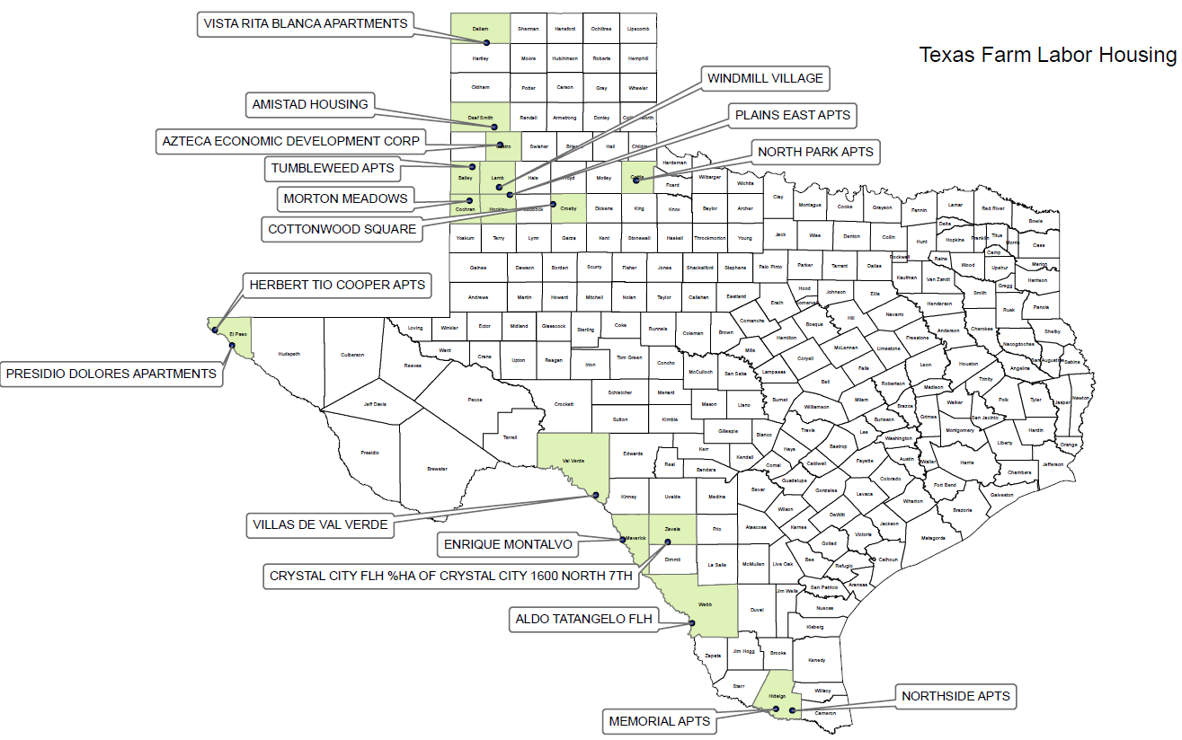

Slide 10
Questions
Any Questions?

