Slide 1
Preserving Rural Rental Housing Using USDA Section 514/516 Funding

Slide 2
Tierra del Sol Housing Corporation
has provided technical assistance for the development of farm labor housing since 2002, and is currently serving as the Lead Agency providing these services under grant agreements with USDA Rural Housing Services in the Central and Eastern Regions of the US. Tierra del Sol’s goal is to empower nonprofit providers by advancing their capacity to develop, own and manage housing for low income persons.
As a leading producer of affordable housing in the Southwest, Tierra del Sol has overseen the preservation of numerous rural rental housing sites that were financed with USDA Section 514/516 and Section 515 funding, HUD 202 or Section 811, or Low Income Housing Tax Credits. This is accomplished through technical assistance services provided to current project owners, or assisting new project sponsors to assume ownership, or becoming project owner itself when there are no other options for preserving the property.
Tierra del Sol has an impressive development record, producing more than 6,000 rental and homeownership units since 1973. TDS has owned and managed affordable rental housing in New Mexico and Texas for more than 45 years, and currently owns 1,059 rental housing units that includes 299 units for farm workers.

Slide 4
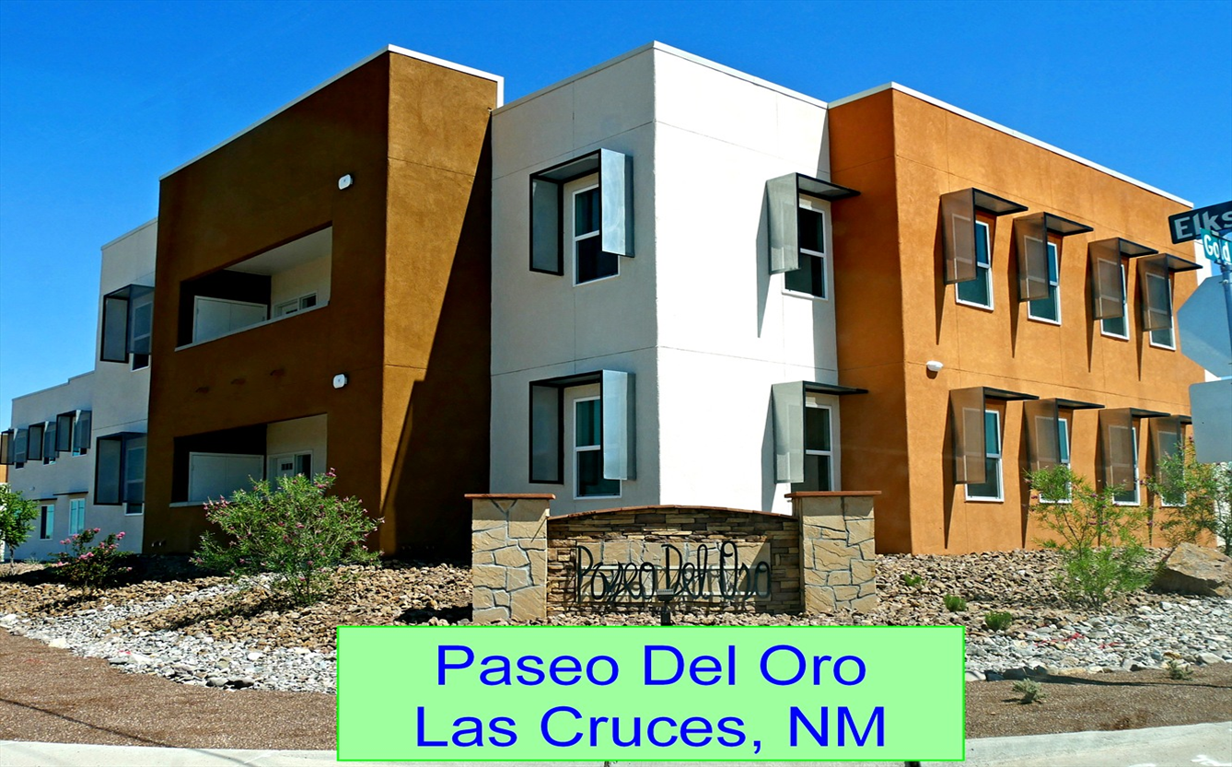
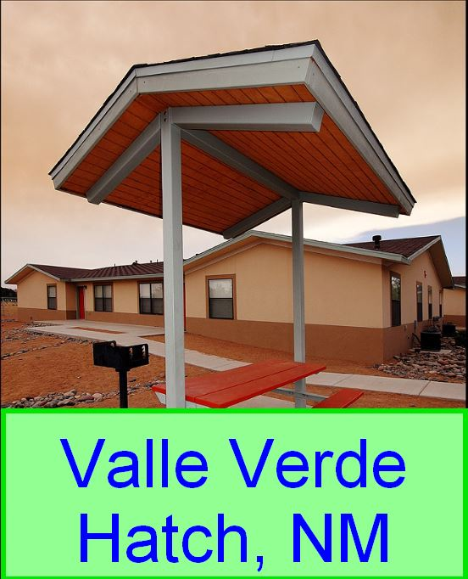

Slide 5
TECHNICAL ASSISTANCE SERVICES
Orientation on the Section 514/516 Program
Organizational capacity to ensure the skills and abilities of Board and staff to develop, own and manage farm labor rental housing
Analysis of financial statements and management practices
Preparation of the Market Analysis
Site Selection and Analysis
Environmental review and State Historic Preservation Office (SHPO) requirements
Guidance on land development and infrastructure needs
Assembling the development team
Construction Design Requirements and Preliminary Plans

Slide 6
TECHNICAL ASSISTANCE SERVICES (continued)
Incorporating Energy Efficiency Features
Affirmative Fair Housing Marketing Plan
Supportive Services Plan
Guidance on construction management
Guidance on property management practices
Leveraging other loan or grant sources to close funding gaps
Analysis of financial feasibility:
Estimating Project and Operating Costs
Preparation of the Development Budget
Preparation of the Operating Budget
Need for Section 521 Rental Assistance
Preparation of the Section 514/516 Pre-application

Slide 7
Funding availability for USDA’s Section 514/516 FARM LABOR HOUSING PROGRAM is announced through a Notice of Solicitations for Applications This competitive funding is awarded through a national selection process.

Slide 8
What is Section 514/516?
USDA Rural Development Section 514 is a grant
USDA Rural Development Section 516 is a loan that offers terms of 1% interest amortized over 33 years.
Projects can request up to $3,000,000 using a mix of loan and grant funding
Section 521 Rental Assistance or Operating Assistance is also available and can be awarded upon request.

Slide 9
ELIGIBLE USES OF 514/516 FUNDS
Buy, build, improve or repair Farm Labor Housing
Purchase land and install site improvements
Install or improve water and sewer systems, roads, lighting and off-site facilities
Furnish refrigerators, stoves, dishwashers, window coverings and furniture
Laundry room equipment
Provide related community facilities (community rooms, cafeterias, child care facilities, recreational facilities, maintenance and storage facilities)
Legal, architectural, and engineering fees
Construction loan interest and fees
Temporary relocation costs

Slide 10
Project Sponsor Eligibility Requirements
A broad-based nonprofit organization that has a membership reflecting the community where the housing is located.
A nonprofit organization of farmworkers, with local farmworkers on the Board of Directors. The Board may include non-farmworkers that are experienced in finance, property management, or related businesses, provided farmworkers make up the majority of the Board.
A limited partnership with a nonprofit general partner that meets 7 CFR 3560.55(d).
A Federally recognized Indian tribe.
An agency or political subdivision of the State or local government.
Applicants must be able to contribute at least 10% of the Total Development Costs from Non-Rural Development resources

Slide 11
Who is eligible to live in property?
Any person (or family member) who is a ‘‘domestic farm laborer’’ (defined in 7 CFR 3560.11) and receives a substantial portion of his or her income primarily from the production of:
agricultural or aqua-cultural commodities, or
the handling of agricultural or aqua-cultural commodities in the unprocessed stage, or
the processing of agricultural or aqua-cultural commodities, without respect to the source of employment.
Includes any farmworker (or family member) who is retired or disabled, but was employed in domestic farm labor at the time of retirement or upon becoming disabled
The eligible farmworker must be a citizen of the United States or a person legally admitted for permanent residence.

Slide 12
Types of Eligible Farm Work
Cultivating the soil, or
Raising or harvesting any agriculture or aqua-culture commodity; or
Catching, netting, handling, planting, drying, packing, grading, storing, or preserving in its unmanufactured state any agriculture or aqua-culture commodity; or
Delivering to storage, market or a carrier for transportation to market, or
Processing any agricultural or aqua-culture commodity.
The farmworker in the household must work in agriculture and earn a minimum of $5,753/year from agriculture or farm employment.

Slide 13
Is there a need for Farm Labor Housing where the project that needs to be preserved is located?
Evaluate the need for off-farm rental housing for farm workers by considering the market area served by the project and the current supply, condition, vacancy rate and affordability of existing housing available to serve farmworkers
Clearly identify the area where eligible farmworkers will be recruited from to reside in the proposed project.
Consider farmworkers that are employed year-round, seasonally or that migrate into the area.
Have a clear understanding of the annual income level of farmworker families in the area and the probable income of those who will likely occupy the proposed housing.

Slide 14
Site Assessment
Zoning that allows multi-family rental housing, or can be rezoned
Environmental issues:
Floodplain
Noise zones that are close to highways, railroad tracks or other sources
Proximity to airport clear zones, contaminated sites, historic sites, or will have an impact on the water supply, etc.
Will the project be supported by the local community?
Proximity to services and amenities (schools, shopping, supportive services)
Is there sufficient land area to expand the project if desired?

Slide 15
Estimate Revenue and Operating Expenses
Revenue from rent and miscellaneous fees (laundry, etc.)
Will the Project need Rental Assistance in order to properly cash flow?
Vacancy rate
Operating costs including Utilities, Trash Removal, Maintenance, Marketing Expenses, Property Management Salaries or Fees, Insurance, Real Estate and other Taxes, etc.
Operating Reserve
Replacement Reserve
Debt service

Slide 16
Estimate Development Costs
The importance of using an experienced development team
Architect
Engineer
Energy consultant
Project manager
General Contractor

Slide 17
Scoring Criteria
Additional points are awarded by USDA based on:
Construction cost savings (leveraged funds, donated land, waived permit fees, equity, etc.)
Operational cost savings (tax abatements, non-Rural Development funded tenant subsidies, donated services, etc.)
Location in counties that have persistent poverty
Tenant services
Energy Initiatives such as energy conservation, energy generation, water conservation, green property management, etc.

Slide 18
Is there a funding gap?
Section 514/516 funding can be leveraged with:
HOME
CDBG
Housing Trust Funds
Federal Home Loan Bank Affordable Housing Program funds
Low Income Housing Tax Credits
Donations of city-owned land, waived fees for sewer and water taps, building permit fees, etc.
Private Foundations

Slide 19
Technical Assistance services
are available through
Tierra del Sol Housing Corporation
to assist project developers
in preserving
existing Section 514/516 projects, or to redevelop existing projects to serve farmworkers.

Slide 20
Tierra del Sol Housing Corporation Contact Information
Rose Garcia
Phone: (575) 541-0477
Email: roseg@tdshc.org
Sal Estrada
Phone: (575) 541-0477
Email: tdsestrada@msn.com
Jeanne V. Shaw
Phone (520) 307-2654
Email: jvshaw@cox.net

