Slide 1
Ideas for RD to help address MFH Mortgage Maturity thru Preservation:
Develop a preservation plan
Support making vouchers and RA available after mortgage maturity, or propose alternatives
Use available RA funding to preserve and service properties vulnerable to mortgage maturity
Prioritize maturing mortgage properties for preservation efforts
Encourage a “two step” transfer process to help small purchasers to buy a vulnerable project first and rehabilitate it later
Coordinate closely with state housing finance agencies to increase the number of projects preserved using LIHTC and other state resources
Require preservation purchasers to include smaller projects along with larger ones
Establish 50 year terms for all new or amortize Section 515 loans
Make information public to improve stakeholder ability to help preserve properties
Extend preservation efforts to include Section 514 FLH properties
Provide a written response to GAO report (no response yet)
Ideas generated by the Rural Preservation Working Group

Slide 2
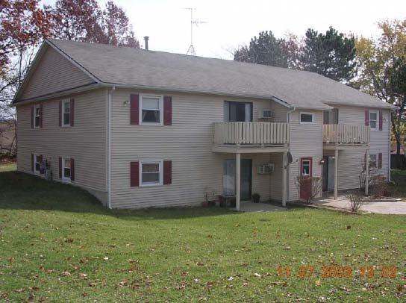
Get RD Done Right!
Contact: Larry Anderson 571-296-4746 or landerson32@cox.net

