Slide 1
Putting It All Together
Texas Rural Rental Housing Preservation Academy Session 5 & 6 September 11-12 2018
Notes:
Start w/ brief overview of Greystone – who we are and what we do. And more importantly, what my team does in ways of preservation of affordable housing in the rural space across the country …
Also hope it will put into context a little about us and our mission, our passion.

Slide 2
Putting It All Together
Rural Development, by the Numbers
The Need, The Opportunity - Preservation
Deal Structure – Pros, Cons, Benefits
Georgia Preservation Transaction
The Goods – Visuals!
Keys to Success
Final Thoughts

Slide 3
Rural Housing
Rural Development, by the Numbers
Properties - 13,961
Texas, 662 (4.7%)
Units - 425,705
Texas, 23,391 (5.6%)
Properties Removed from Program, 2012 -2016
38 Properties
816 units
953 Households
Notes:
Housing Crisis Across the country, RD Peak Funding Years 1975 – 1985 (1000 loans each year); “Seasoned” – need rehab; Focus on Preservation

Slide 4
The Need, The Opportunity: Preservation
Funding Sources
HOME
FHLB – AHP
CDBG – DR
Debt (538, FNMA, MF Bonds)
Equity - Tax Credits
9% competitive credits
4% non-competitive credits (with tax-exempt bonds)
Notes:
Policy and Advocacy secure dollars. LIHTC – leverage private investment; Limited Resources - 9% uber competitive, 4% with bonds allows for volume

Slide 5
Deal Structure: Portfolio Transactions
Greater Reach, Greater Impact!
Pooled Bond Issuance (not cross collateralized)
Scattered Sites
Single State
Debt
Equity - 4% Tax Credits (with Tax-Exempt Bonds)
Additional Funding Sources

Slide 6
Portfolio Transactions with Bonds & 4% Credits
Pros
Volume of Preservation Activity
Transaction Costs, Multiple Sites
Economic Impact, Rural Communities
Outstanding Capital Needs Addressed
Removed from 9% Funding Round
Transfer of Ownership
Cons
Costs
Volume of Work
Complexity, Multiple Agencies
Less Funding Sources (Larger GAP)
In-Place Rehab
Extended Timelines
Notes:
Properties that would never be rehabbed; too small to attract debt / equity or would not meet QAP requirements

Slide 7
Portfolio Transactions, The Direct Benefit
Marketability
Resident Retention
Resident Attraction
Operations
Reduced Expenses
Reduced Maintenance
Decreased Liabilities and Capital Calls
Increased Realization of Return-to-Owner
Preservation of Much Needed Affordable Housing
Notes:
Timeline -12 to 24 months

Slide 8
Portfolio Transactions, The Preservation Process
Identify Potential Properties (cooperative sellers)
Initial Financial Feasibility Analysis
Develop Scope of Work, Pricing Hard Costs, Design Standards
Source Debt and Equity
Validate Assumptions
Applications – Tax Credit, Bond, RD Transfer, etc.
Initial Closing
Construction Period
Construction Completion
Place in Service
Notes:
Timeline -12 to 24 months

Slide 9
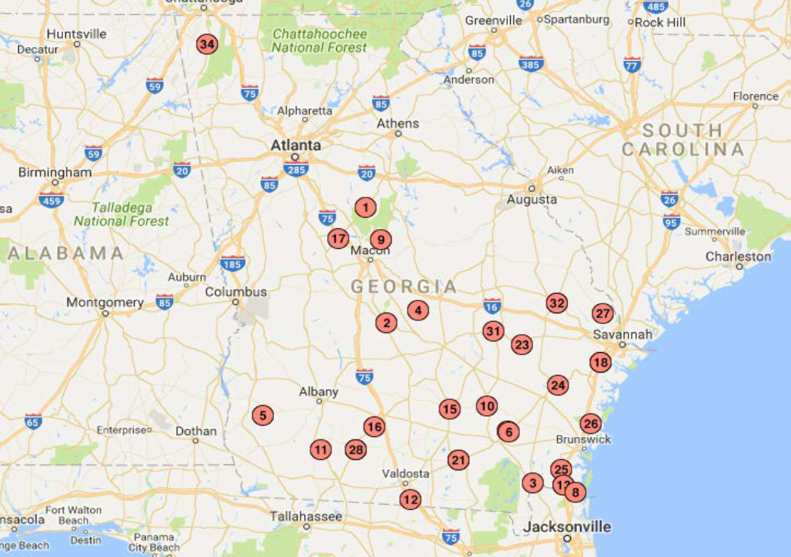
Hallmark Georgia Preservation Portfolio
26 Properties (23 Post closing)
1,310 units

Slide 10
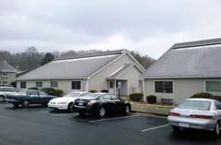
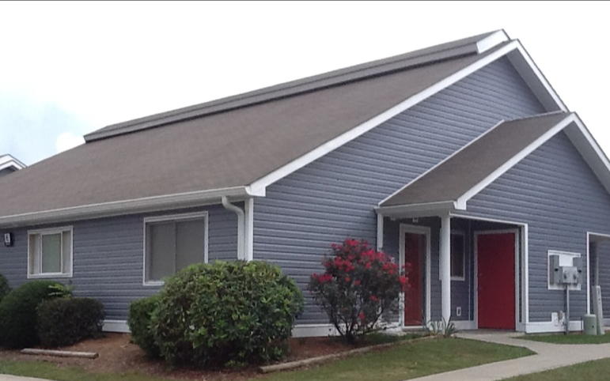
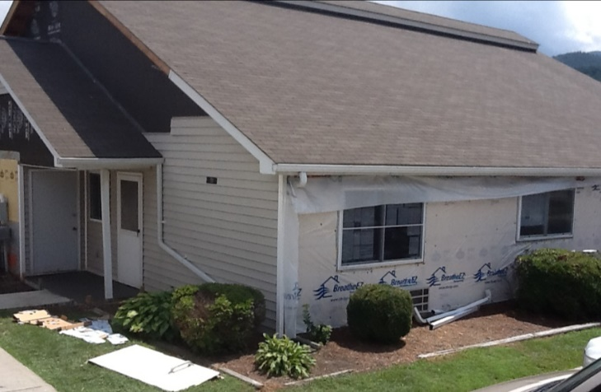
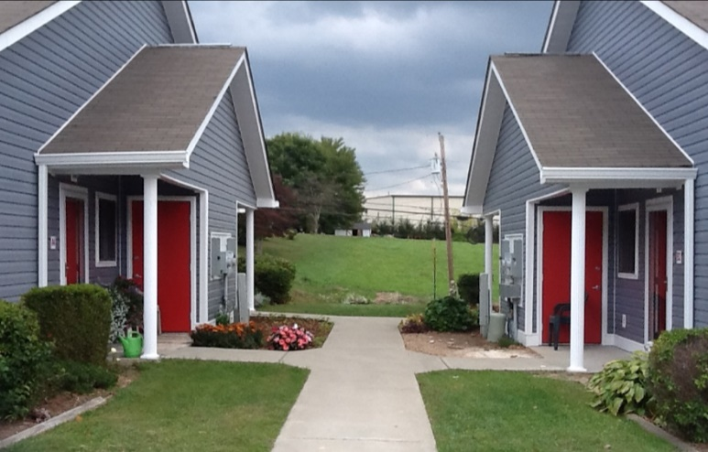
Sample Renovation: Before, During, After

Slide 11
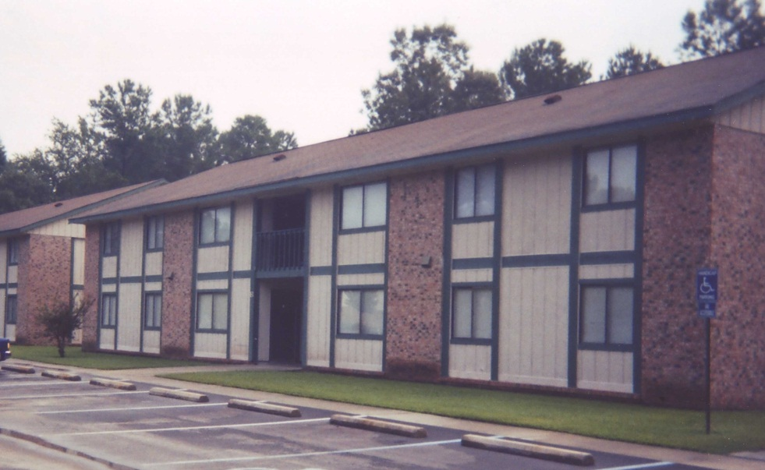
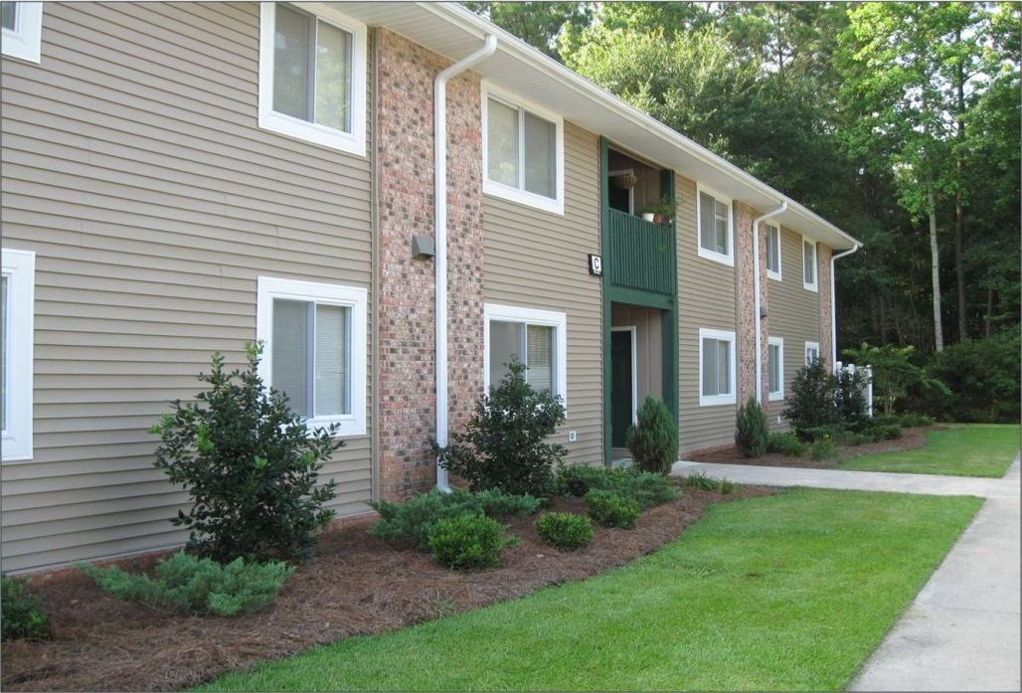
Sample Renovation: Typical Exterior Upgrades

Slide 12
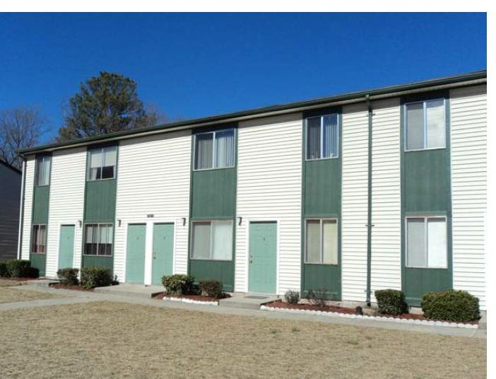
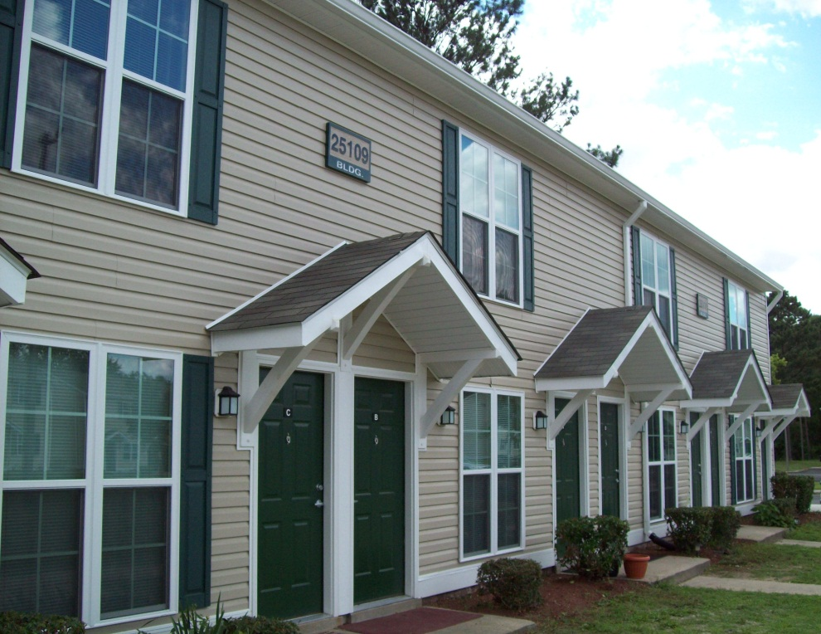
Sample Renovation: Typical Exterior Upgrades

Slide 13
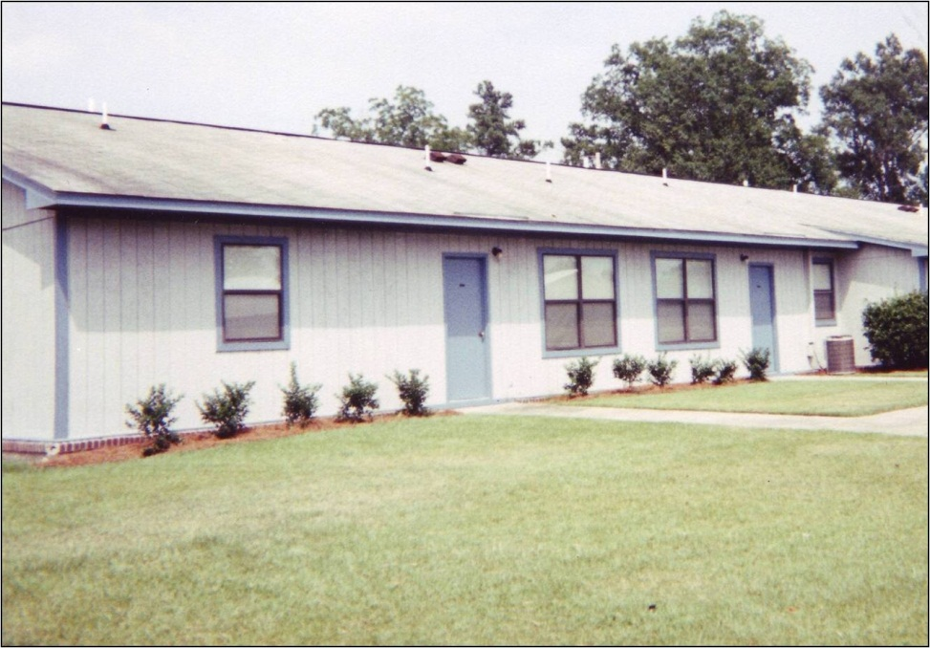
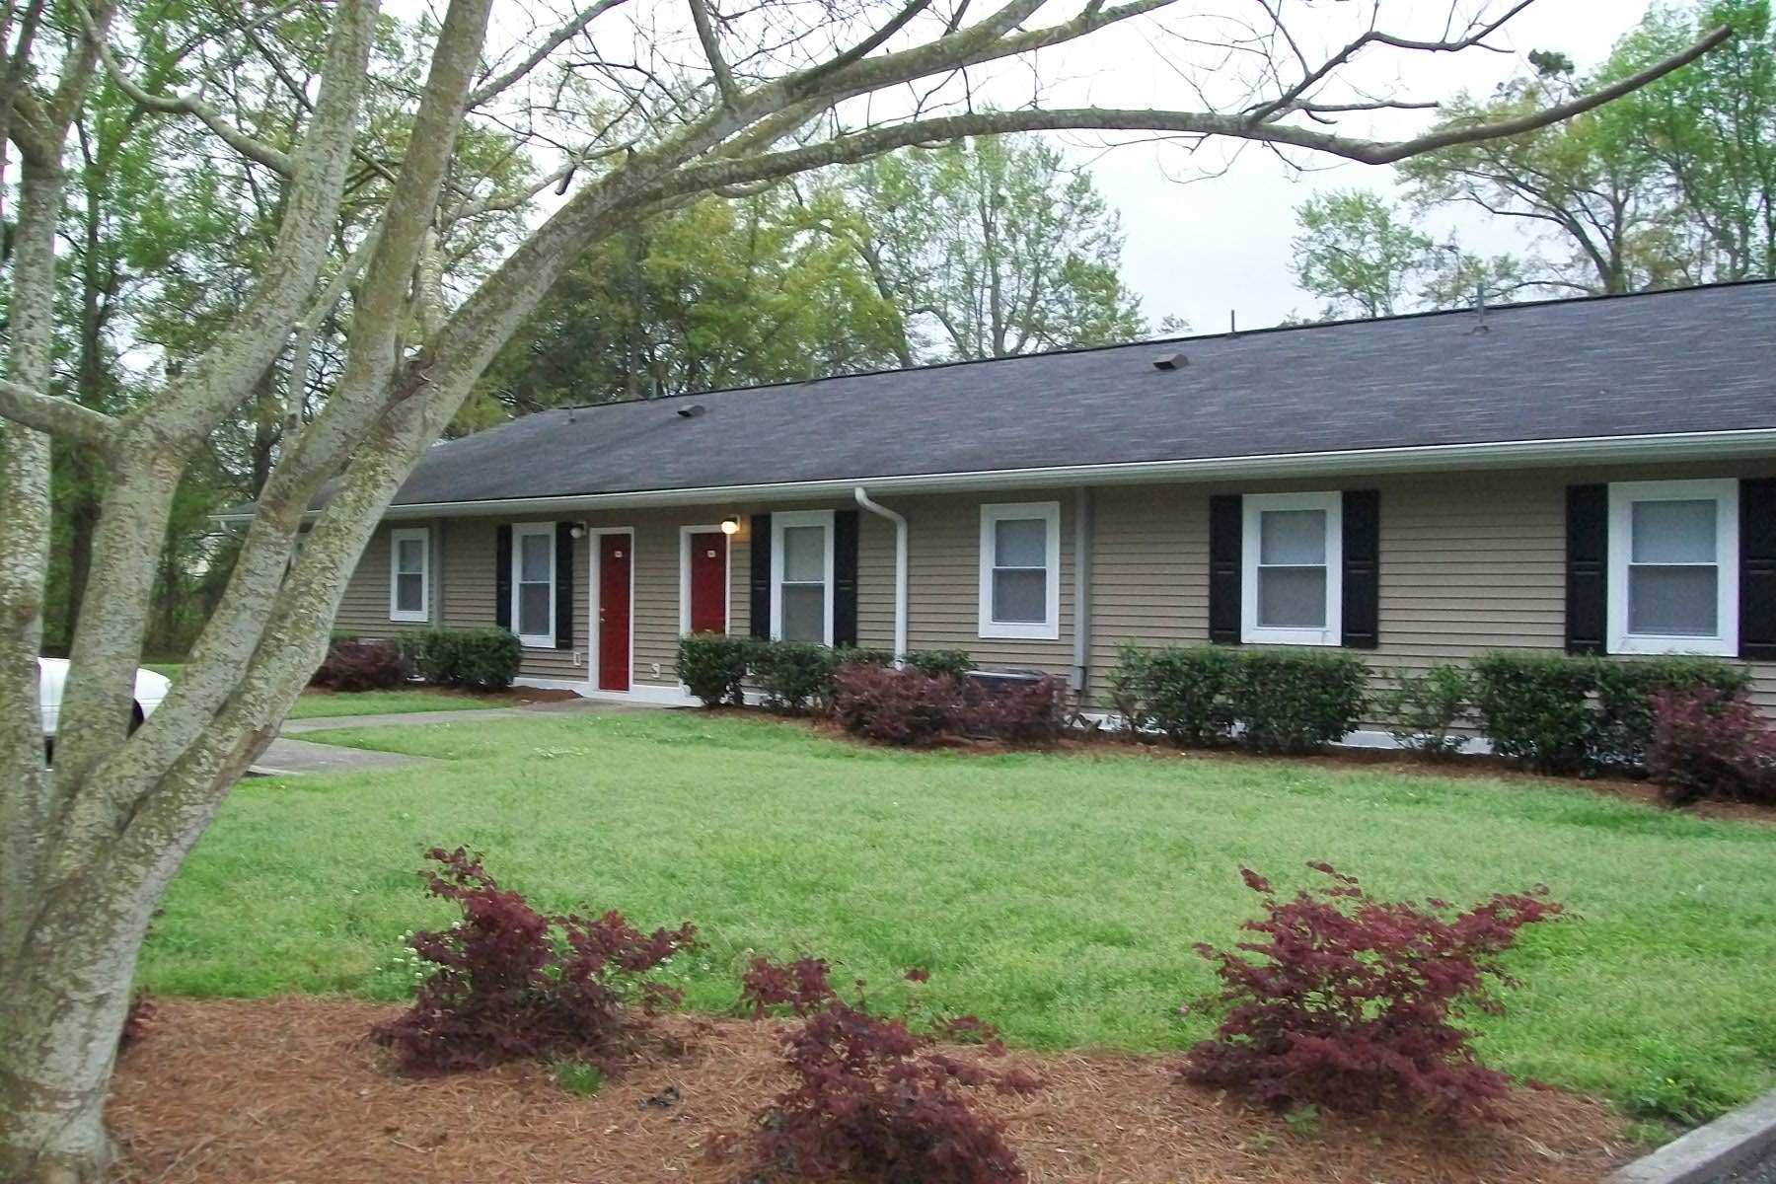
Sample Renovation: Typical Exterior Upgrades

Slide 14
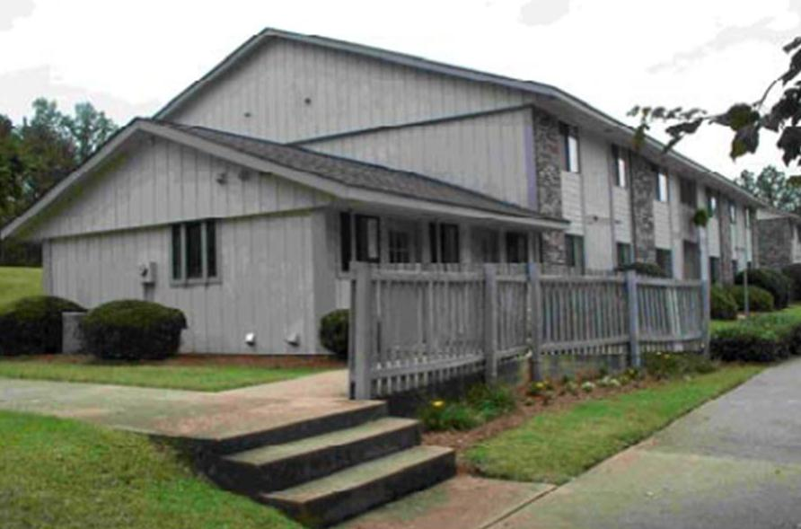
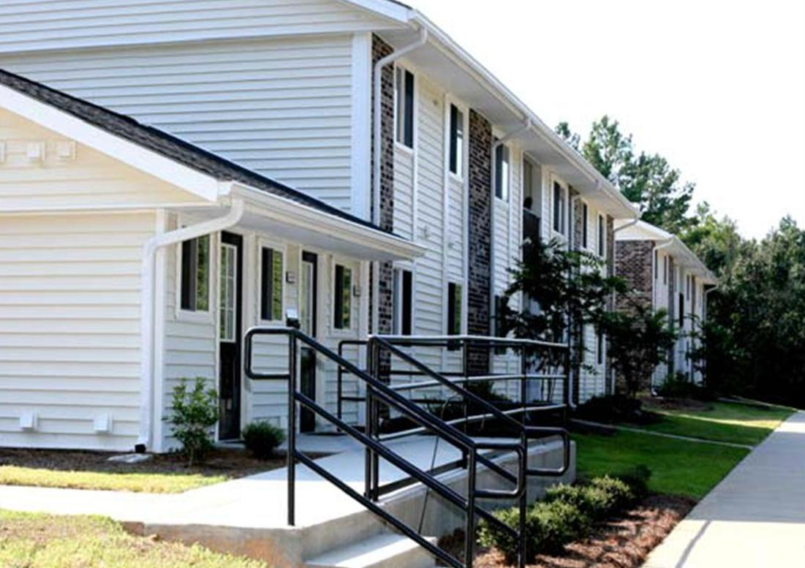
Sample Renovation: Typical Exterior Upgrades

Slide 15
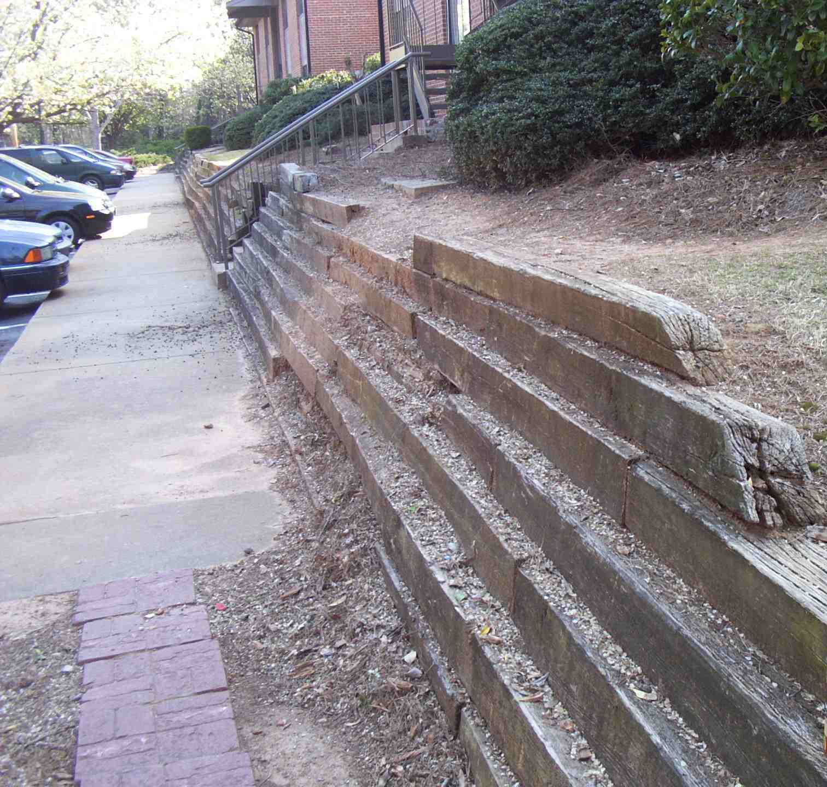
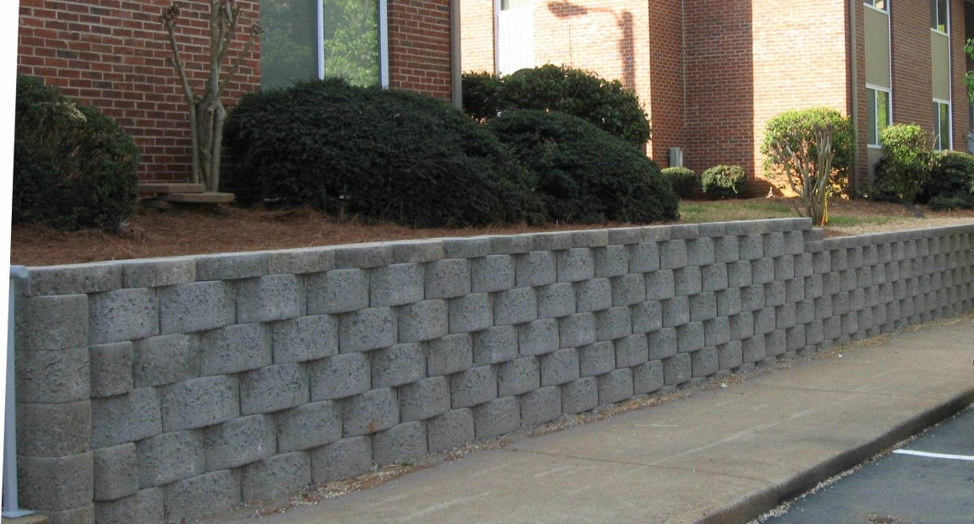
Sample Renovation: Retaining Wall

Slide 16
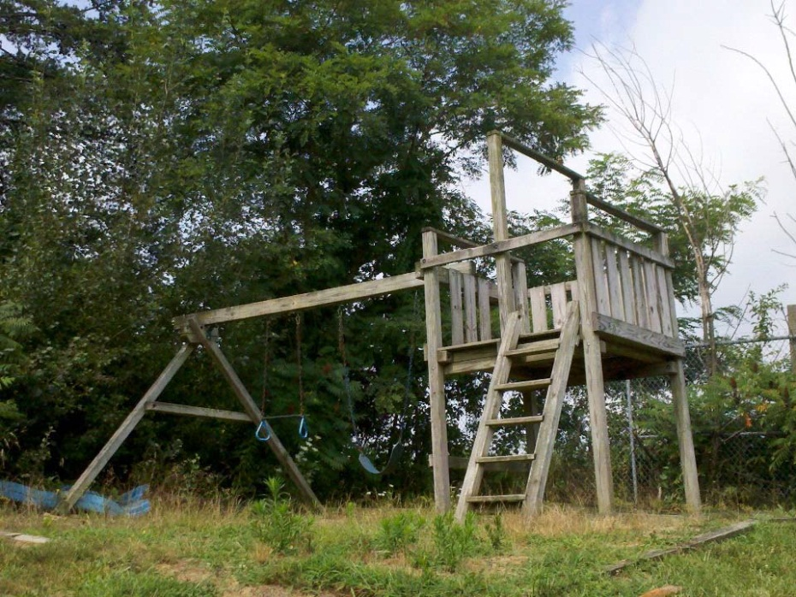
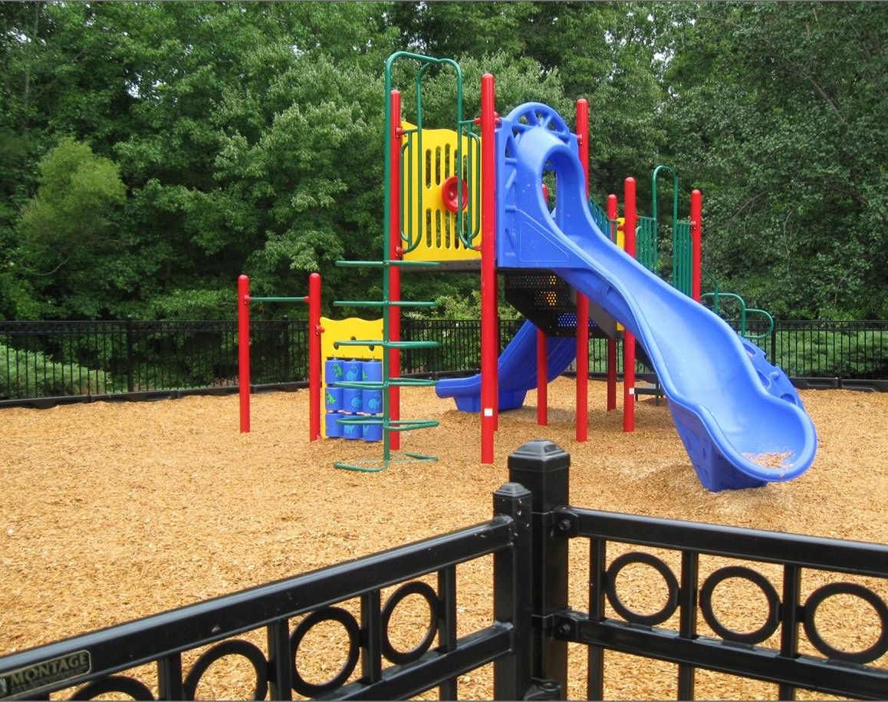
Sample Renovation: Playground Upgrades

Slide 17
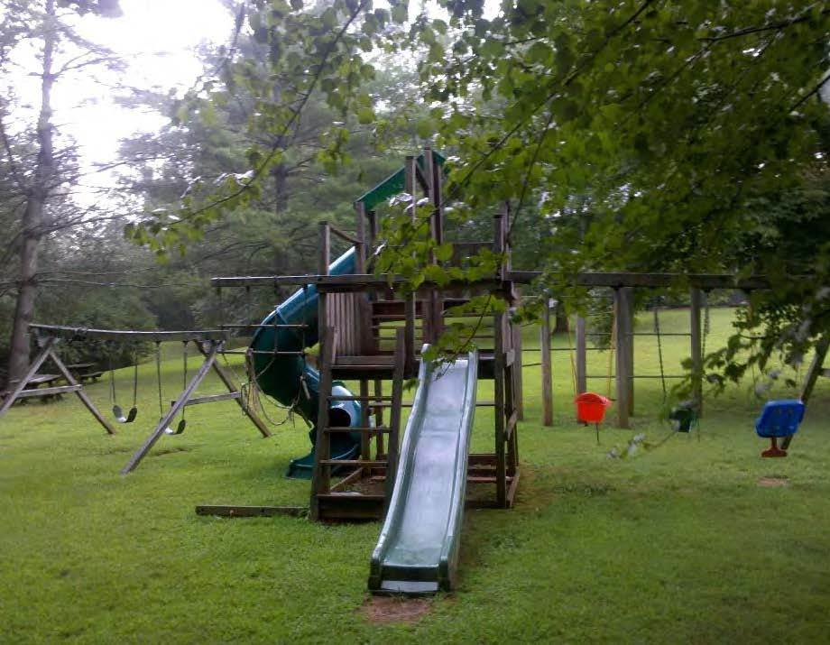
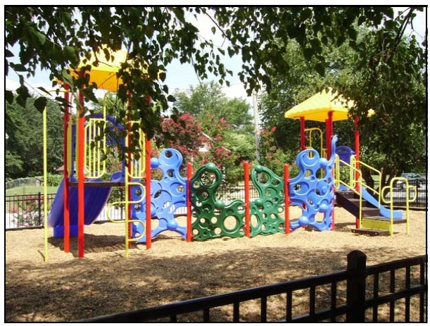
Sample Renovation: Playground Upgrades

Slide 18
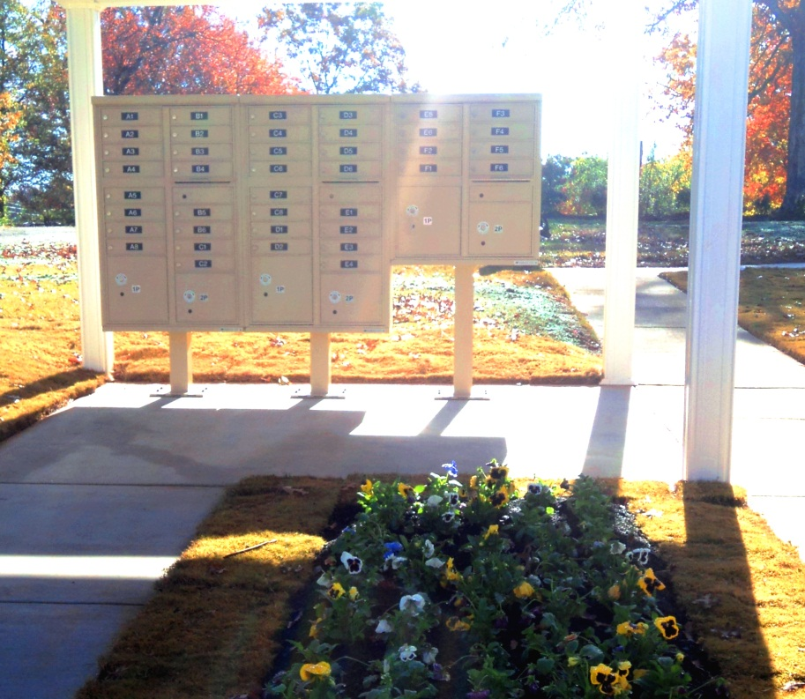
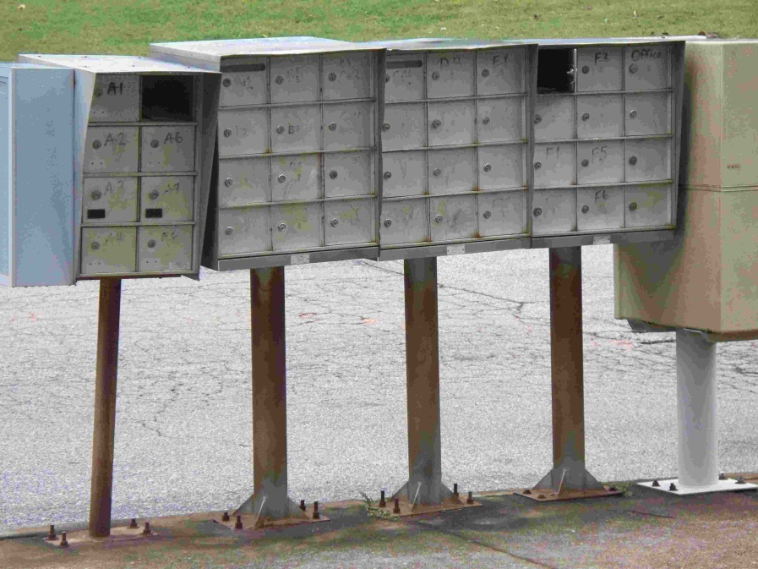
Sample Renovation: Mail Facility

Slide 19
Portfolio Transaction: Key to Success
Strong Development Team
Long-Term Owner
Manager / Operator (Self or Third-Party)
Developer & Development Partner / Consultant
Counsel – Developer / Borrower’s Counsel
Syndicator / Equity Investor & Lender
General Contractor & Architect
Investment Banker / Underwriter & Bond Issuer
Trustee
Rural Development
State HFA
Notes:
Timeline -12 to 24 months

Slide 20
Development Team: Development Partner / Consultant
The “Quarterback”
Add Expertise & Capacity
Development Experience
Financial Strength
Human Capital
Specific Skill Sets
Underwriting
Applications
Construction Management etc.
Consider All Options, Determine Best Fit, Choose Wisely!
Notes:
Timeline -12 to 24 months

Slide 21
Development Team: Development Partner / Consultant
Typical Terms Negotiated
Roles & Responsibilities
Pre-Development, Post-Closing
Ownership
Long-Term v. Short-Term
Economics
Exit Strategy
Financial / Economic
Guarantees
Notes:
Timeline -12 to 24 months

Slide 22
Portfolio Transaction: Final Thoughts
Strong Development Team
Communication, Communication, Communication
Macro Economic Environment
Tenant Education
Flexible, Realistic Timelines
Full Rehabilitation
Enthusiasm & Persistence
Notes:
Timeline -12 to 24 months

Slide 23
Thank you
Will Eckstein
Senior Vice President
Greystone Affordable Development
4025 Lake Boone Trail, Suite 209
Raleigh, NC 27607-2986
(919) 573.7516
Will.Eckstein@greyco.com

