Slide 1
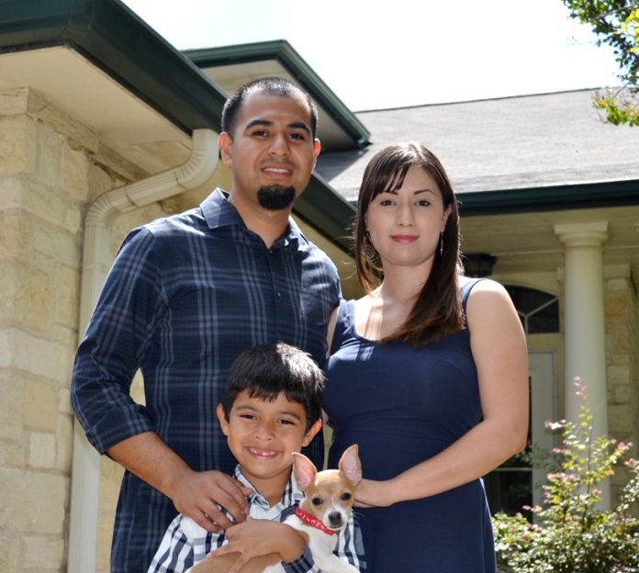
Third Party Reports
Presented by:
David Danenfelzer, Senior Director
Texas State Affordable Housing Corporation

Slide 2
Third Party Reports
Capital Needs Assessment (CNA) or (PNA, PCNA, etc.)
Environmental Site Assessment Phase I (sometimes Phase II)
Market Analysis / Market Study
Accessibility Assessment (ADA and 504 compliance)
Appraisals

Slide 3
Third Party Reports
"Surround yourself with experienced professionals, consultants, loan and credit packagers. As many as possible."
"...talk to the state office before deciding. They of course cannot tell you who to use but they can help you qualify them"
Don't pick a consultant just because you heard them speak at a conference. Make sure they've been successful (closed deals) in the past 5 or more deals.
Beware of inspectors' whose report is "too much" a boilerplate.

Slide 4
Third Party Reports
Accessibility consultants always under estimate the cost of rehab and updates.
Don't just plan to fix what appears to be "bad". Plan on replacing major items (HVAC, stoves, fridges, water heaters, etc..) now because you'll be judged on that during final inspections.
"Some of the market analysts just write a good report for every deal expanding the market area as needed. That’s not what I want."
My first tip for someone completely new to tax credit and 515 considering buying a 515 property is "don't do it".

Slide 5
Third Party Reports
TDHCA Approved Market Analysts
- https://www.tdhca.state.tx.us/rea/approved-analysts.htm
Housing Consultants List
- https://www.tdhca.state.tx.us/multifamily/htc/docs/consultants.pdf

Slide 6
Questions?

