Slide 1
NALCAB Rural Capacity Building Program
Laura Furst, Program Manager
lfurst@nalcab.org • (210) 625-4074
Texas Rural Rental Housing Preservation Academy, 6/7/18
Texas State Affordable Housing Corporation

Slide 2
Mission & Program Areas
“Our mission is to build assets for Latino families, communities and organizations. NALCAB’s work advances economic mobility for low- and moderate- income people.”
Equitable Neighborhood Development
Small Business Development
Family Financial Capability
Notes:
First, just a bit of information on who we are as an organization:
NALCAB is a national membership organization that represents and serves a geographically and ethnically diverse group of more than 100 community development and asset building organizations that are anchor institutions in our nation’s Latino communities in more than 40 states and Washington, D.C. We are based out of San Antonio and we have a policy office in D.C. We have experience in working in both urban and rural markets.
Our mission is to build assets for Latino families, communities and organizations. NALCAB’s work advances economic mobility for low and moderate income people.
NALCAB helps to increase those opportunities through our policy efforts and program work which includes the areas of:
-equitable neighborhood development, and
-small business investment
-family financial capability

Slide 3
Lines of Business
Building Organizational Capacity
Investing in Leadership
Policy and Research
Investing Capital
Grant Making
Technical Assistance
Member Collaboration
Culturally-Relevant Training
NALCAB Pete Garcia Fellowship
Engaging Members
Research
Influencing Policy-Makers
Lending
Equity Investments
Notes:
NALCAB has several lines of business that span these three key areas, including:
-building organizational capacity, such as this Rural Capacity Building Program
NALCAB has been a HUD provider since 2010.
-building leadership and community-based expertise that are culturally relevant
-Shaping policy through research and member engagement, and
-directly investing capital in communities of need through lending and equity investments
*In order to build assets in Latino families, communities and organizations, NALCAB works with its members to increase the flow of capital into low-and moderate-income communities through responsible, market-based and culturally relevant business models.

Slide 4
Rural Capacity Building (RCB) Program
Technical Assistance

Slide 5
NALCAB RCB Program Basics
Purpose is to build the capacity of rural serving organizations to create affordable housing and community and economic development opportunities for LMI populations
NALCAB provides technical assistance and loan capital
Funded through HUD Rural Capacity Building for Community Development and Affordable Housing Grants
Notes:
Our RCB Program is designed to provide technical assistance and loans to rural nonprofits that are engaged in creating community economic development opportunities and affordable housing for low income communities in rural areas. In acknowledging the diversity of rural settings, the program is focused on developing the capacity of local nonprofit organizations to help the communities they know by engaging in one-on-one customized technical assistance. As a membership organization, NALCAB also facilitates connections and peer learning experiences with other organizations doing similar work.
This program is funded through HUD’s Rural Capacity Building for Community Development and Affordable Housing Grants and if you would like to look up more information about these funds please check out the HUD link provided.

Slide 6
Program Eligibility
Rural 501(c)3s, CDCs, CHDOs, RHDOs, local governments, Tribal governments that work in affordable housing and community and/ or economic development for LMI populations
Rural: non-Urbanized Area delineated by the Census Bureau with a population less than 50,000
Low- and moderate- income: a household with income that does not exceed 80% of the AMI
Located in AZ, CA, CO, FL, HI, IN, NM, NC, OH, OR, TX, and WA
Open to NALCAB non-members and all eligible rural communities
Open to organizations of varying experience and capacity, especially small, newly-established organizations
Notes:
The basic program eligibility requirements for both technical assistance and loan fund applications are:
-Your organization must be a nonprofit, community development corporation. Community housing development organization, local government or tribal government in a rural area with a focus on community and or economic development, and/ or affordable housing that is located in one of these 12 states.
-Both TA and lending capital are available to non-NALCAB members and communities that serve a variety of demographic profiles in rural areas. As a Latinx focused organization, we ensure that our services are culturally relevant for our communities, however our rural program is intended to support all.
-Finally, we recognize that organizations have different capacity building needs a various stages of growth and experience, so we encourage established nonprofits as well as small nascent organizations to apply.
Laura: Here I want to pause and clarify what NALCAB considers “rural” because as a rural-serving organization you are already aware f the varying definitions of what is considered “rural” and what is not. So, in determining an applicant’s rural eligibility for our program, NALCAB generally uses the USDA property eligibility tool (linked here in the slide) and may also refer to the U.S. Census Bureau’s definition non-urbanized areas with populations of less than 50,000.
However, we are aware that many, more experienced nonprofits, with a rural-focused mission may have main offices located in smaller urbanized areas that would not qualify as rural by the USDA tool or the census bureau’s definition. Even though a majority of their services and programs are located in rural counties.
For example your organization may be located in the rural college town of Nacogdoches, in Easter Texas which has a population of approximately 35,000. The USDA tool does not consider this town an eligible area, however your organization is focused on supporting small business in agriculture and manufacturing sectors in the surrounding rural counties. Therefore, if your organization does not immediately qualify due to your head office locations as in this case, but a majority of your programming is targeted to rural eligible counties and towns, you may still qualify for our program. We determined this on a case by case basis and will ask for information about your activity in eligible rural areas.
Now, we do limit this rule when an ineligible urban-based organization shows no experience in working with rural communities and does not have a rural-focused mission. We do not support the expansion of non-rural organizations into rural areas through this TA. These rural condition are for both technical assistance and our rural loan program. If you have a question on your qualification, please contact me or Chris. We will share our contact information at the end.

Slide 7
Areas of Technical Assistance
Organizational assessments
Sustainability planning
Strategic planning
Mapping and GIS services
Community needs assessments
Project financing and development
Program design and development
Resource development
Staff and/or board member training
Leadership development
Grant management
Outcome measurement
Risk management
Stakeholder engagement
Partnership and coalition building
Notes:
We offer both organizational and project-based technical assistance. Some of our more popular TA services include helping organizations identify and pursue funding opportunities, assisting in program design and management, project financing, leadership and staff development, and sustainability planning for the organization.
In the areas of affordable housing we have more experience in Low Income Housing Tax Credits (LIHTC), HOME, CDBG, and more in the areas of grant writing for Section 502,
Please not that this is not an exhaustive list. We always welcome organizations to contact us if they have other needs that are not as advertised.

Slide 8
Technical Assistance Delivery
Free project-based or organizational TA
Customized to the specific needs of the recipient
Delivered by NALCAB staff and consultant partners
Delivered both in-person and remotely
Engagements range from 6 to 12 months
Subsequent TA engagements allowed
Applications currently accepted on a rolling basis
Notes:
Technical assistance through this program is completely free to the recipient organization and is customized to the specific needs of each recipient. We may connect you with general training opportunities that we hear of from other organizations and agencies during the TA engagement, but generally, the NALCAB team tailors trainings and guidance to your specific needs.
The technical assistance can be focused to build the capacity of the whole organization or a particular line of business, program or project. For example if you are an organization that has primarily worked in affordable housing development and property management but wants to expand your services to offer financial capability programming (such as credit-building education) for residents, we can help you build your capacity to plan, fund, implement, and effectively track your new program.
The way we work with you organization is by delivering technical assistance through both in-person or remote trainings and calls. Our team includes staff and expert consultant partners provided by NALCAB. And it’s important to note that we do not provide the recipients with grant funds for the TA, we disburse funds for consultant and NALCAB staff services, travel, and materials, directly to each. So the recipient does not have to concern themselves with administering funds for this TA.
Also, please notes, that at this time, we do not provide supporting grants or funding to TA recipients.
Typically technical assistance engagements last from 6 to 12 months. However it may be shorter if the organization has a quick project based need, or more long-term, warranting two phases of technical assistance. At this time we do allow organizations to apply for subsequent technical assistance.
Finally, right now we are accepting applications on a rolling basis for technical assistance, however we encourage your organization to submit a Request for Technical Assistance as soon as possible before our funds are exhausted.

Slide 9
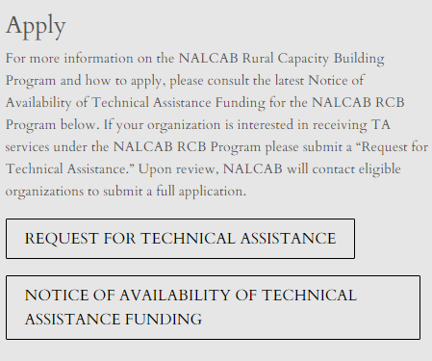
How to Apply
Submit a Request for Technical Assistance at:
https://www.nalcab.org/nalcab-rural-capacity-building-program/
Go to the “Apply” section. Consult the Notice of Availability of Technical Assistance Funding before submitting a Request for Technical Assistance.
Notes:
As we are currently accepting applications, I will quickly go over the application process for TA.
First we ask all applicants to submit a simple Request for Technical Assistance form, found on our website under the Apply section. The main purpose of this form is to vet your organization and project’s eligibility before proceeding with a full application. For the latest information about our program requirements, be sure to always to take a look at the Notice of Availability of Technical Assistance Funding, located in the same Apply section.

Slide 10
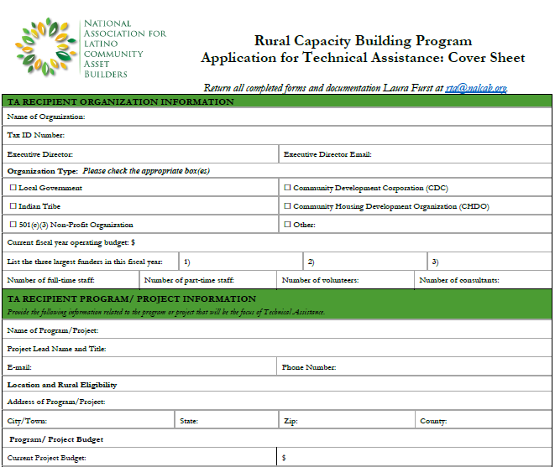
How to Apply
NALCAB will notify your organization via e-mail, if eligible to proceed with a full Application for TA.
Full Application requires:
Program/ Project Narrative
Budget and Financial Statements
Copy of Entity Documents
Board of Directors and Staff Information
Notes:
Once NALCAB receives your request, and reviews your eligibility and need for TA, we will notify you within 7 business days if your organization is eligible to proceed with a full application.
Please note that this application is not available online, if your organization is eligible, NALCAB will e-mail you an application cover sheet (shown here on the slide) and application instructions. We do require a project narrative of no more than 4 pages, in addition to your organization’s budget and financial statements, copy of documents verifying your nonprofit status, and brief bios of your board and key staff for this project.
Please be aware that being invited to submit a full application does not guarantee approval.

Slide 11
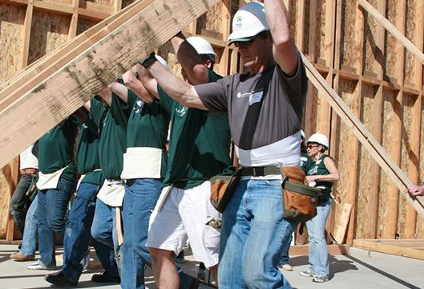
Evaluation Criteria
Demonstrates need to build capacity in a specific area and clearly connects requested TA to furthering its mission in rural areas.
Provides a thorough analysis of community needs in target service area and alignment of work with other efforts.
Articulates clear and measurable outputs and outcomes
Demonstrates readiness of organization and its partners to engage in TA
Commits to performance and reporting requirements
Notes:
We draw on several factors to approve a technical assistance engagement with a rural organization or government. These include:
Assessing the organization’s need for technical assistance. The organization must demonstrate either by a history of planning or in some instances mandated actions by an agency, that they require assistance to sustainably pursue their mission. Sometimes prioritizing your organization’s TA needs can be difficult task, therefore we might engage in an organizational assessment at the beginning of the engagement in order to help develop a second phase of more targeted TA.
In the application, we want to know your communities’ needs for low and median income families and how your organization is helping address these. This might include data on unemployment, low access to credit, housing affordability data, in areas where data is scarce, first-hand knowledge of changes in poverty levels, quality of life, health indicators, etc. The alignment of your work and broader community efforts should be clear, possibly including reference to your Consolidated plan, recent local government initiatives, etc.
We ask for clear listing of outcomes that can be achieved within a short 3-year timeframe time frame following the TA, in addition to more long-term outcomes, is required. The organization must be committed to tracking these outcomes and delivering reports to NALCAB.
4) The readiness of the applicant and any partners. Meaning your TA request must be endorsed by an executive officer, you must demonstrate that you have a team in place to work with the consultant and NALCAB, and same for any of your supporting partners. A commitment to performance and responsiveness indicating that you understand your performance standards as a TA recipient and you are willing to attain these standards. Also, evidence that your organization has made, or is making efforts to address any challenges at hand, but is in need of additional assistance. We ask each organization to assign a point of contact for the TA.

Slide 12
Rural Capacity Building (RCB) Program
Rural Revolving Loan Fund
Notes:
I will also mention that organizations may apply for both TA and the loan fund at the same time. Organizations may even apply for technical assistance not related to their lending request. However, organizations who are applying for loan capital may also want to receive technical assistance related to their lending activity. Both circumstances are allowed by our program.

Slide 13
Rural Revolving Loan Fund Terms
0% interest rate, no fee
$50,000 minimum - $400,000 maximum
24 to 84 month terms
Payment schedule determined on a case by case basis
Borrowers are expected to pay the legal costs associated with developing the loan documents specific to their state
No prepayment penalties
Notes:
The NALCAB Rural Revolving Loan Fund is a source of loan capital that helps support rural organizations in community economic development and affordable housing projects, benefitting low-and moderate-income rural families.
The following are our current loan terms:
0% interest rate, no fee
$50,000 minimum - $400,000 maximum
24 to 84 month terms
Payment schedule determined on a case by case basis
Borrowers are expected to pay the legal costs associated with developing the loan documents specific to their state
Provision for one 6 month 0% deferral period
Penalty payments are incurred after 15 days of nonpayment
No prepayment penalties

Slide 14
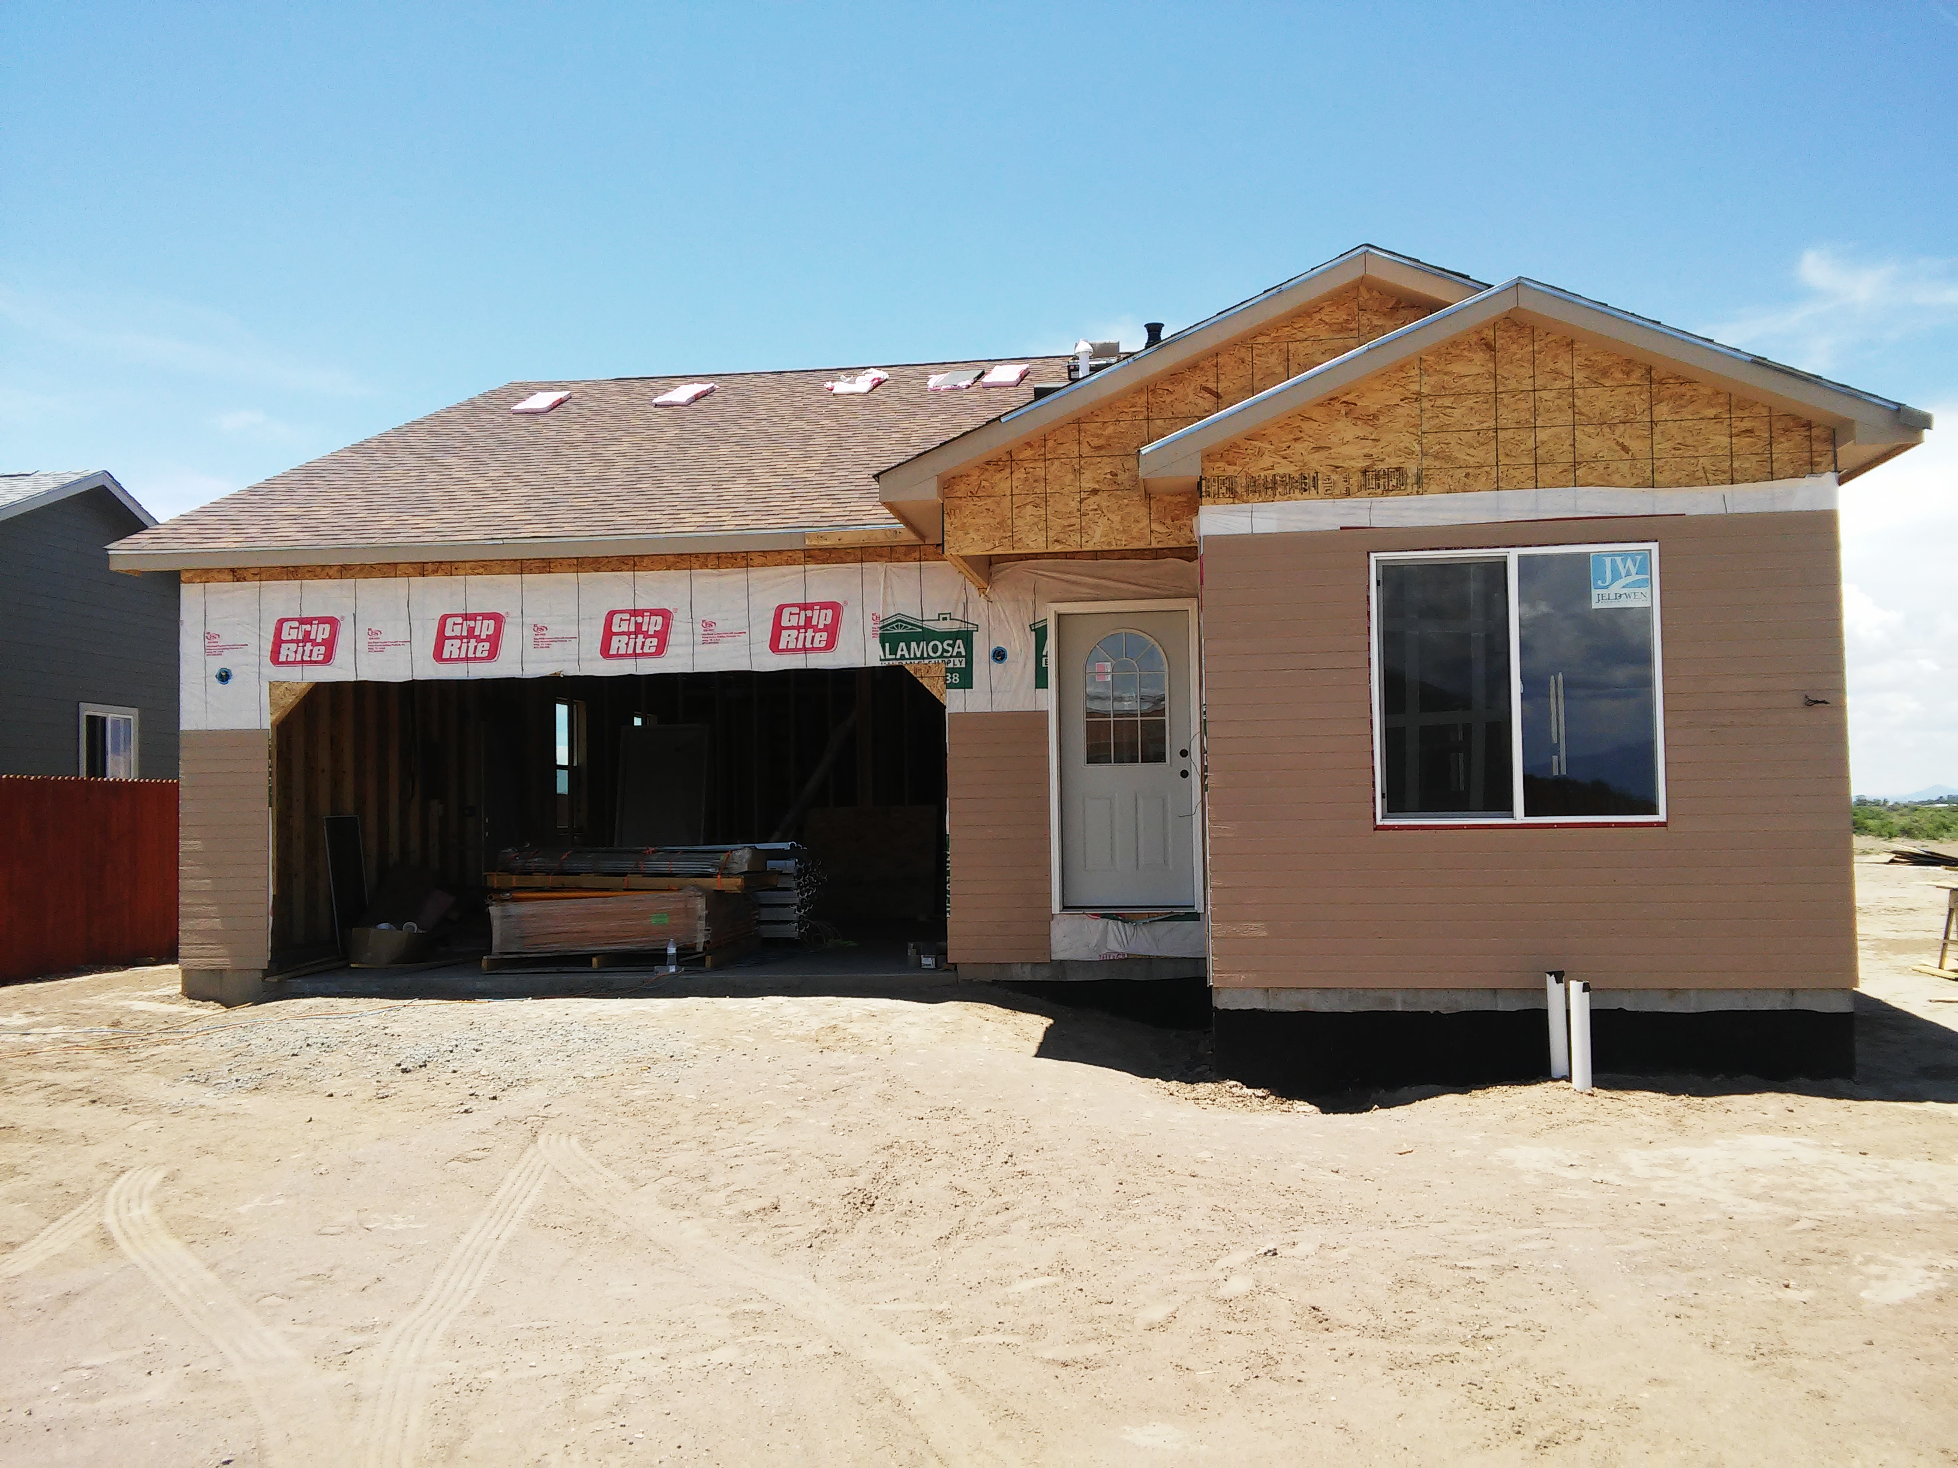
Eligible Uses
Pre-development funds for planning, design, market analysis, legal, and engineering costs
Gap Financing
Loans for Organizational Operations
Short-term debt capital to assist community lending programs, including Small Business Loans, Micro Loans, Lending Circles, Consumer Loans
Capital to serve as Loan Loss Reserves
Notes:
We have a variety of eligible uses including:
Short-term debt capital to assist community lending programs, including Small Business Loans, Micro Loans, Lending Circles, Consumer Loans, DPA Loans
Pre-development funds for planning, design, market analysis, legal, and engineering costs
Capital to serve as Loan Loss Reserves
Gap Financing
Loans for Organizational Operations (however, especially for this category, organizations must demonstrate the ability to repay.)

Slide 15
Examples of Ineligible Uses
Using funds to subsidize interest payments on an existing loan
Refinancing or consolidation of existing debt
To acquire an equity position in a private business
Pay taxes
Purchase stock in another business or investments
Pay for legal costs associated with developing the loan
Notes:
Using funds to subsidize interest payments on an existing loan
Refinancing or consolidation of existing debt
To acquire an equity position in a private business
Pay taxes
Purchase stock in another business or investments
Pay for legal costs associated with developing the loan

Slide 16
Borrower Eligibility
Rural 501(c)3s, CDCs, CHDOs, local governments, Tribal governments
Located in AZ, CA, CO, FL, HI, IN, NM, NC, OH, OR, TX, and WA
Must possess at least one year of loan preparation and servicing experience
Must demonstrate the project is financially feasible and benefits low-and moderate-income rural communities
Notes:
In keeping with our RCB program, we are currently limited to lending to rural organizations in these 12 states.
As a borrower, we require that your organization demonstrate at least one year of loan preparation and servicing experience and that your proposed project is financially feasible.

Slide 17
Submit a Loan Inquiry
Contact Chris Sanchez at ruralloans@nalcab.org with the following information:
Organization information
Service area and target population information
Brief summary of loan request
Indication of whether your organization plans to apply for technical assistance as well
Notes:
At this time we do not maintain loan applications on our website, however you may e-mail Chris at ruralloans@nalcab.org with the following information:
Organization information
Service area and target population information
Brief summary of loan request
Indication of whether your organization plans to apply for technical assistance as well

Slide 18
Contact NALCAB
Visit the NALCAB Rural Capacity Building Program page for more information
https://www.nalcab.org/nalcab-rural-capacity-building-program/
Rural Capacity Building Program: Laura Furst at lfurst@nalcab.org or (210) 625-4074.
Rural Revolving Loan Fund: Christopher Sanchez at ruralloans@nalcab.org.

