Slide 1
Homes for Texas Heroes is a program of the Texas State Affordable Housing Corporation.
Notes:
Welcome to Texas State Affordable Housing Corporation’s Home Buyer programs presentation. I am _________________ and I have been trained and certified by TSAHC to provide you with information regarding their programs. (Provide an introduction of yourself here and what you hope to accomplish by giving this training.)
Any modification to the slides must be approved by TSAHC. Please email Joniel LeVecque at jlevecque@tsahc.org for approval.

Slide 2
About TSAHC
TSAHC is a 501(c)3 nonprofit organization. Our mission is to serve the housing needs of low-income Texans and other underserved populations. We fulfill our mission through our concept of:
Notes:
For those of you who are not familiar with the Texas State Affordable Housing Corporation, they are a statewide non-profit created at the direction of the Texas Legislature. Their mission is to serve the housing needs of low-income and moderate income Texans.
They have several programs including home buyer programs to help individuals and families buy a home in Texas. Those programs include the Homes for Texas Heroes Home Loan Program and the Home Sweet Texas Home Loan Program. The main difference between the two programs are the eligible professions. The Home Sweet Texas Home Loan Program is open to anyone regardless of profession. Both programs require the individual or family to meet certain income limits for the county they are purchasing the home.
Through these programs they help nearly 10,000 families buy a home each year.

Slide 3
Home Buyer Programs
Notes:
The Homes for Texas Heroes Home Loan Program is open to k-12 public school teachers, corrections officers, EMS personnel, fire fighters, police officers, public school librarians, public school counselors, public school nurses, and veterans/active military . These professions were selected by the Texas Legislature as professions for which the state wanted to make home buying programs available.

Slide 4
Who Qualifies?
Public School Teachers
Public School Teacher Aides
Public School Librarians
Public School Counselors
Public School Nurses
Notes:
Professional Educator means a full-time, public school kindergarten through 12th grade:
• classroom teacher,
• teacher aide,
• school librarian,
• school counselor certified under Subchapter B, Chapter 21, Education Code, or
• school nurse.
(This slide may be deleted if presenting to a specific profession)

Slide 5
Who Qualifies?
Peace or Police Officer
Public Security Officer
Notes:
Peace or Police Officer means a person elected, employed, or appointed as a full-time peace/police officer under Article 2.12, Code of Criminal Procedure, Section 51.212 or 51.214, Education Code, or other law. Peace officers are licensed through the Texas Commission on Law Enforcement (TCOLE).
Public Security Officer means a person employed or appointed full-time as an armed security officer by this state or a political subdivision of this state. The term does not include a security officer employed by a private security company that contracts with this state or a political subdivision of this state to provide security services for the entity. Public security officers must be licensed through the Texas Commission on Law Enforcement (TCOLE).
(This slide may be deleted if presenting to a specific profession)

Slide 6
Who Qualifies?
Corrections Officer
Juvenile Corrections Officer
County Jailer
Notes:
Corrections Officer means all full-time employees of the Texas Department of Criminal Justice (TDCJ) who receive hazardous duty pay. Hazardous duty pay employees must have a VOE through TDCJ.
Juvenile Corrections Officer means all full-time employees of the Texas Juvenile Justice Department (TJJD) who receive hazardous duty pay. Juvenile corrections officers must have a VOE through TJJD.
County Jailer means a person employed full-time as a county jail guard under Section 85.005, Local Government Code. County jailers must be licensed through the Texas Commission on Law Enforcement (TCOLE).
(This slide may be deleted if presenting to a specific profession)

Slide 7
Who Qualifies?
Fire Fighter
Emergency Care Attendant
Emergency Medical Technician
Licensed Paramedic
Notes:
Fire Fighter means a member of a fire department who performs a function listed in Section 419.021(3)(c), Government Code. Permanent, full-time fire department employees who are not secretaries, stenographers, clerks, budget analysts, or similar support staff persons or other administrative employees and who are assigned duties in one or more of the following categories:
• fire suppression;
• fire inspection;
• fire and arson investigation;
• marine firefighting;
• aircraft rescue and firefighting;
• fire training;
• fire education;
• fire administration; and
• Any other position necessarily or customarily related to fire prevention or suppression.
Emergency Medical Services Personnel has the meaning assigned by Section 773.003, Health and Safety Code. Emergency medical services personnel means a full-time:
• emergency care attendant;
• emergency medical technicians;
• emergency medical technicians-intermediate;
• emergency medical technicians-paramedic; or
• licensed paramedic.
(This slide may be deleted if presenting to a specific profession)

Slide 8
Who Qualifies?
Veteran
Active Military
Notes:
Veteran means a person who was honorably discharged and who:
•served more than 90 days on active duty in the Army, Navy, Air Force, Coast Guard, United States Public Health Service or Marine Corps of the United States, or
• has enlisted or received an appointment in the Texas National Guard, or
• served in the armed forces of the Republic of Vietnam between February 28, 1961 and May 7, 1975;
Veteran’s under this definition also qualify for exemption from the first time home buyer requirement on the bond DPA or the MCC programs.
Active Duty Military means a person who is serving on active duty, at the time of application and assigned to a military base or facility in Texas, and has officially designated Texas as the applicant’s home of record.
Active Duty Military do not qualify for exemption from the first time home buyer requirement on the bond DPA or the MCC programs.
(This slide may be deleted if presenting to a specific profession)

Slide 9
Home Buyer Programs
Two types of assistance are offered to home buyers through the Homes for Texas Heroes Program STATEWIDE.
Notes:
TSAHC offers two types of assistance to help home buyers under the Homes for Texas Heroes home loan programs statewide with no limitation on location.
The first type of assistance, is a low interest rate mortgage loan with down payment assistance attached to the loan. The loan is a 30 year fixed rate mortgage loan and may be an FHA, VA, USDA or Conventional mortgage loan. The assistance may be used for your down payment and/or to help cover your closing costs.
The second type of assistance, is a special mortgage interest income tax credit. This income tax credit will help reduce the amount of income taxes you owe the IRS by as much as 20% of the interest you paid that year, and every year, as long as you live in the home. By reducing the amount of income taxes you owe, this increases your take home pay which may be used to help you pay for your mortgage payment.
This tax credit may be combined with the non-bond down payment assistance, too. So, not only does TSAHC help you get into your home with the down payment assistance but they also provide an income tax credit which may help you pay your monthly payments.
I will provide more detail for both types of assistance on the next slides.

Slide 10
Loans with Down Payment Assistance
Several options are available to your borrower:
Assistance % is based upon total loan amount
(i.e.: 5% of $100,000 = $5,000)
Can be used to cover down payment and/or closing costs
Fixed interest rate determined by DPA assistance amount
No need to be first-time buyer (Unless using Heroes Bond)
3% Assistance | 4% Assistance | 5% Assistance
Notes:
You will have an option of anywhere from 3%-5% of down payment assistance available to you, depending on how much you need. The assistance amount is calculated based upon the total loan amount. As an example, if you are borrowing $100,000 then you could get $5,000 when choosing the 5% DPA option. This can be used to cover your down payment and/or closing costs. The amount of assistance you choose, determines the interest rate on your mortgage loan. If you choose the 3% down payment assistance option, then your mortgage loan interest rate will be lower than it would be if choosing the 6% down payment assistance option. Also, the best part is, you don’t have to be a first time home buyer which is required with most down payment assistance programs.

Slide 11
Loans with Down Payment Assistance
Option 1: Grant | Option 2: 3-year Deferred Forgivable 2nd Lien
FHA, VA, USDA only True gift that never needs to be repaid 3% , 4% or 5% DPA options | FHA, USDA, VA or HFA Conventional Loan (HFA Preferred or HFA Advantage) 0% interest on 2nd Lien No monthly payments on 2nd Lien- Fully forgiven 3 years from closing Lower interest rates than grant 3%, 4%, or 5% DPA options
Notes:
The down payment assistance comes in two forms. The grant assistance that they receive never needs to be repaid. There are no strings attached. They don’t have to purchase in any certain areas of Texas nor do they need to stay in the property for any period of time. It is a TRUE gift.
The 3-year deferred forgivable 2nd lien is a great new option that became available on 12-2-19. This allows for someone to choose any of our loan types and any assistance level. It will provide a lower interest rate on the first lien than the grant options and it becomes a grant after 3 years.

Slide 12
Loans with Down Payment Assistance
Homes for Texas Heroes Bond (Limited Availability)
TSAHC is currently offering a low interest rate Homes for Texas Heroes Bond. It is limited to Texas Heroes and offers 4% assistance similar to the grant, EXCEPT:
Government loans only
Offers a lower interest rate
4% assistance is a grant with recapture tax implications
This cannot be combined with an MCC
This is available for a limited time only and offered solely to Texas Heroes purchasing their first home
Only currently available in targeted areas
Notes:
Currently, TSAHC is offering a limited time only Texas Heroes Bond program. This program offers a Hero a 4% DPA grant and a 5.05% interest rate on the mortgage loan which is the lowest interest rate of all of the government loan grant options available. Please note that you do have to be first time home buyer for this program. The definition of a first time home buyer is anyone who hasn’t had ownership interest in a primary residence in the last 3 years.

Slide 13
Loans with Down Payment Assistance
HFA Conventional Loan
TSAHC offers an HFA Conventional loan that have all the benefits of a traditional conventional loan with some added perks:
Only 3% down payment required
You can use either:
Fannie Mae’s HFA Preferred
Freddie Mac’s HFA Advantage
AUS Requirements: DU required on Fannie -- LPA required on Freddie
No upfront Mortgage Insurance (MI) premium
MI can be cancelled
Notes:
For those wanting a conventional loan product, TSAHC offers a Fannie Mae conventional loan called the “HFA Preferred” which stands for “Housing Finance Agency Preferred” as well as a Freddie Mac product that is called HFA Advantage or “Housing Finance Agency Advantage”. These special conventional loans are only available to housing finance agencies like TSAHC.
It is interesting to note the special perks it provides compared to FHA and a traditional conventional loan.
The monthly mortgage insurance rates are much lower, no upfront mortgage insurance premium unlike FHA – saving your borrower on upfront closing costs or an increased loan amount, and no LLPAs unlike traditional conventional mortgages. Best of all, as you can see in this example, your borrower is able to cancel their MI saving them thousands of dollars compared to the “Life of Loan” mortgage insurance premium with an FHA loan.
Yes, the interest rate on this loan product will be a bit higher than that of a FHA loan, however, please keep in mind that their monthly payment may not be much different given the lower monthly MI rates. The comparable monthly payments make this a competitive alternative to FHA.

Slide 14
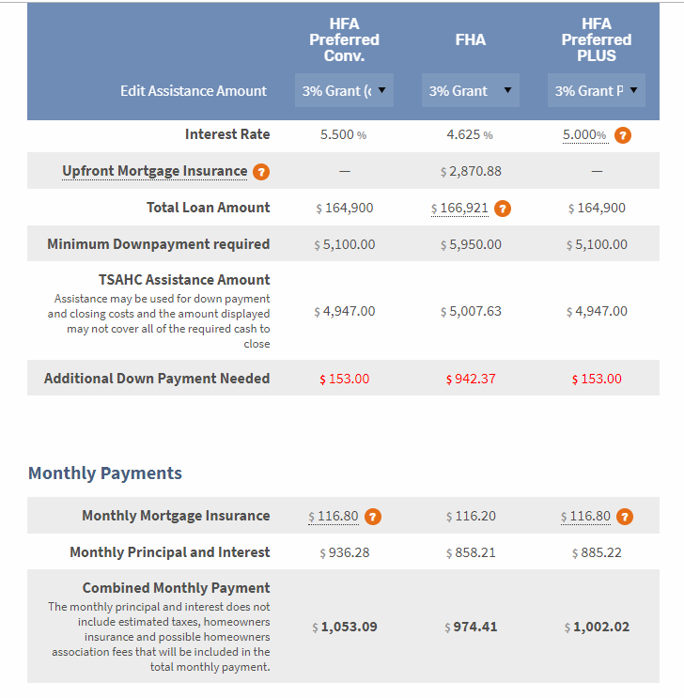
TSAHC Loan Comparison Calculator
Example: 680 FICO, $170,000 sales price, 3% DPA
Compare difference in down payment
Compare Monthly MI differences
Compare monthly payments
Notes:
To help you compare all of the different assistance and loan options you have with TSAHC, we created a Loan Comparison calculator. You can compare up to 3 loans at once and it will demonstrate:
Minimum down payment required
TSAHC assistance amount
Additional/Surplus down payment needed
Monthly mortgage insurance premium
Combined monthly payment
Looking at all of these things will help you make an educated decision on what is best for the buyer.

Slide 15
Mortgage Interest Tax Credits
Mortgage Credit Certificate (MCC)
First-time buyers only
(Waived for Qualified Veterans and Targeted Areas)
Annual tax credit with no maximum value
Must occupy the home as principal residence
Debt-to-income ratio reduced so buying power increased
FREE for Texas Heroes using our non-Bond government DPA products
Notes:
The second form of assistance is my personal favorite and I like to call it the gift that keeps on giving. This special mortgage interest tax credit is called a Mortgage Credit Certificate or MCC. This is a first-time home buyer program only, with the definition of a first-time home buyer being anyone who hasn’t had ownership interest in a primary residence for the last 3 years. Keep in mind that if you are a Qualified Veteran or buying in a targeted area, you don’t have to be a first time home buyer!
Get the credit you deserve with TSAHC’s MCC!
As we discussed before, an MCC gives a homeowner the ability to claim an income tax credit equal to 20% of the mortgage interest paid each year. This credit may be used every year for the life of the loan, as long as you occupy the home as your principal residence.
Remember, this tax credit may be combined with TSAHC’s down payment assistance at the same time.
Plus, its free for Texas Heroes who are also using TSAHC’s non-bond government loan down payment assistance!

Slide 16
Mortgage Interest Tax Credits
Mortgage Credit Certificate (MCC):
Equal to 20% of the mortgage interest paid per year.
Credit Example
Loan Amount $200,000
Interest Rate x 5.75%
Interest Paid in 1st Full Year $11,500
20%=$2,300*
*No Longer Limited to a Maximum Amount
Notes:
In this example, the loan amount is 200k with a 5.75% interest rate. The amount of interest they’d spend in the first year is $11,500. 20% of $11,500 is $2,300. Therefore, their tax credit that first full year is equal to $2,300.

Slide 17
Mortgage Interest Tax Credits
What’s the difference between a tax credit
and a tax deduction?
Tax Credits = Reduction of tax liability
or taxes owed
Tax Deductions = Reduction of taxable income
Notes:
Some folks may be thinking that, everyone benefits from mortgage interest on your income taxes so why do I need an MCC? This is true but only holders of an MCC benefit from the dollar for dollar credit that an MCC provides.
What’s the difference between a tax credit and a tax deduction? Tax credits provide a dollar-for-dollar reduction of income tax liability or taxes owed, while tax deductions allow one to lower the amount of taxable income by the amount of the mortgage interest. As an example, if you pay $5,000 in mortgage interest and your income is $50,000, you can reduce the amount of your taxable income by the amount of interest you paid, which would reduce your taxable income to $45,000. This is the amount of income you will pay income taxes on. A $2,300 deduction, for example, might reduce your tax bill by only $300 to $400. A $2,300 tax credit cuts your tax bill by $2,300.

Slide 18
Mortgage Interest Tax Credits
An MCC allows you to take
advantage of both forms of savings:
All home owners may take
deductions but tax credits are only
available to holders of an MCC.
In this example, they can take the remaining mortgage interest in the amount of $9,200 ($11,500 - $2,300 credit) plus any property taxes, etc.
as a deduction.
Notes:
An MCC allows you to take advantage of both forms of savings: Using the previous example, you can take the remaining mortgage interest in the amount of $9,200 ($11,500 - $2,300 credit) plus any property taxes, etc. as a deduction. An MCC is still better, let’s see what a dollar for dollar reduction of your tax liability can do for you on the next slide.

Slide 19
Mortgage Interest Tax Credits
Home buyer receives a refund every year? They may still benefit.
Payroll Income
Tax Withholding
Annual Tax Liability
$10,000
Paid too much
so they get a refund
Notes:
Let’s go over some fun examples on how the MCC works and how you might benefit from having an MCC. We have a lot of folks who say that they already receive a refund every year and they don't think they can benefit from the MCC. Well that's not always true, and I'll show you how. Let's say that this bucket represents our homebuyer Sally's income tax liability which happens to be $10,000 a year. Like most of us, Sally's employer has a portion of her paycheck set aside through her payroll income tax withholding, so that hopefully by the end of the year Sally will be able to cover her entire income tax liability. Fortunately for Sally, she had more than enough taken in payroll deductions to cover her $10,000 income tax liability. As you can see, once her bucket had $10,000, her remaining payroll deductions started over filling the bucket which resulted in a tax refund. In this example, Sally paid too much and gets her own money back as a tax refund. Let's see how an MCC could help Sally.

Slide 20
Mortgage Interest Tax Credits
Effect of an MCC on income tax liability
Payroll Income
Tax Withholding
stayed the same
The $2,300 MCC goes in the bucket
before payroll deductions
Borrower refund
increased by $2,300!
Remaining Tax Liability
$7,700
Annual Tax Liability
$10,000
Notes:
Let's say that Sally, again, has an income tax liability of $10,000 a year but this time she bought a new house as a first time home buyer and took advantage of the benefits of an MCC. Because Sally had an MCC, the $2300 MCC went into the bucket before any of her payroll deductions. Now, her remaining tax liability is only $7700. It directly reduced what she owed dollar for dollar. Let's assume Sally has the same amount taken out of each paycheck from her employer. Remember the bucket started off with the $2300 from the MCC in it first, so it's $2300 fuller now and more of the money that is being deducted from her paycheck is falling out of the bucket. Sally has more than covered her remaining tax liability of $7700 because she kept her payroll deductions the same, which means her tax refund has also increased by $2300. So, in this example Sally paid too much and gets her own money back as a tax refund which is now $2300 higher because of the MCC credit. Sally, instead, could update her W-4 form with her employer to reduce the amount of her payroll deductions by $191.67 a month. This is the $2,300 credit divided by 12. If Sally adjusts her W-4, then she will realize the credit every month by increasing her take home pay in the amount of $191.67.

Slide 21
Mortgage Interest Tax Credits
It’s your responsibility to claim the mortgage interest credit.
Claimed on federal income tax return
The credit cannot be greater than your income tax liability.
Any unused credit can be carried forward up to three years.
Notes:
It is important that you check with a CPA to confirm that an MCC will benefit you. And, you will also need to claim this credit every year on your tax return. However, it will likely benefit you if you have a tax liability. The credit cannot be greater than your income tax liability but any unused tax credit can be carried forward up to three years.
A tax liability simply means that you owe taxes on your annual income. Most folks pay federal income taxes on their income, whether it is deducted from each pay check or paid at tax time on the tax return.
This program is a great benefit to first time buyers. Essentially, its as if you are getting a lower interest rate on the mortgage because you are getting some of the interest money back in the form of this tax credit!

Slide 22
Important Takeaways
Borrower can purchase anywhere in Texas.
FREE MCC for Texas Heroes using non-bond DPA
Turnaround times are fast!
No need to be a first-time buyer to use TSAHC non-bond DPA
2 DPA Options: TRUE GRANT or 3-yr Deferred Forgivable 2nd Lien
Not required to stay in the home any number of years
Notes:
No need to be a first-time buyer to use TSAHC non-bond DPA
2 DPA options, one is a TRUE GRANT, with no need to be repaid – EVER! Or the 3-year Deferred Forgivable 2nd Lien.
There is NO requirement to stay in the home any number of years
A home buyer can purchase anywhere in the state of Texas because TSAHC is available STATEWIDE
There is no minimum time on the job required for Texas Heroes to get the free MCC
Turnaround times are fast! TSAHC’s turn time is 2 business days to review a file so it likely will not take any longer than a traditional loan.

Slide 23
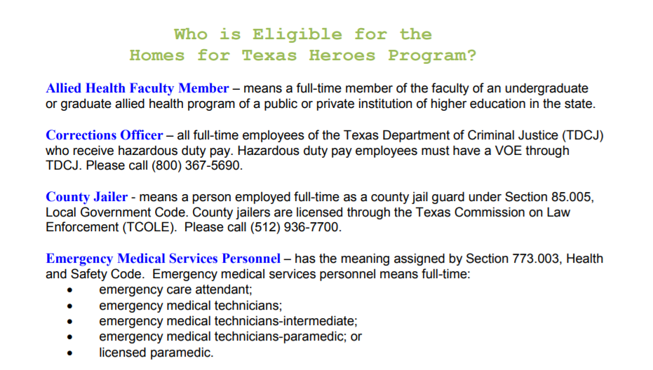
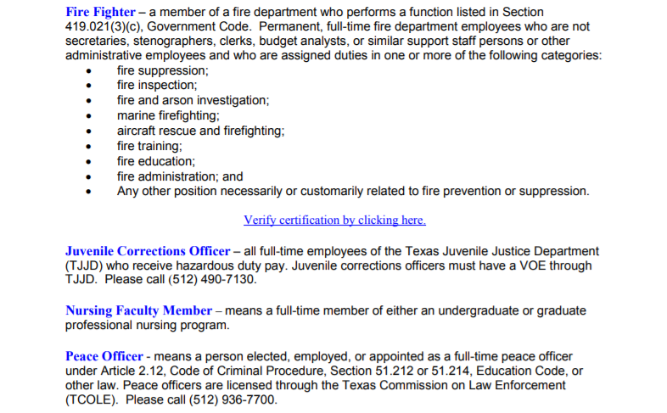
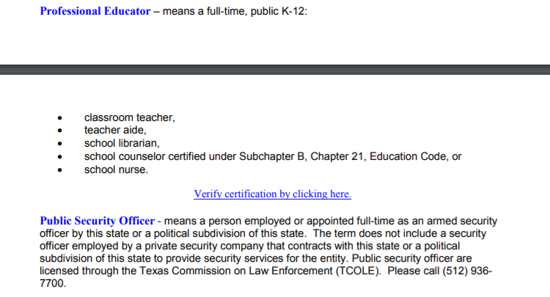
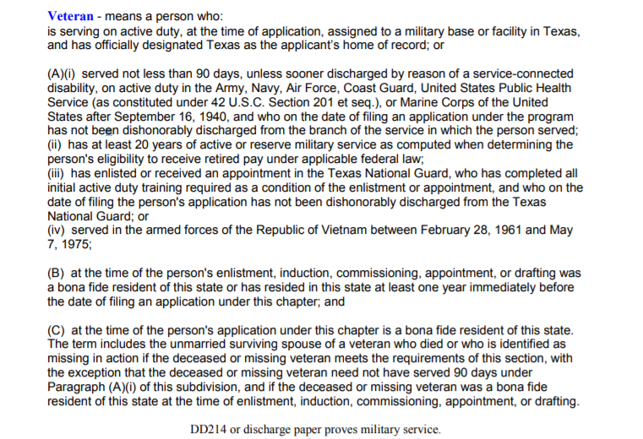
How to Get Started
Notes:
LOAN OFFICERS: This script or slide may be modified to promote you and your company.
REALTORS: This script or slide may be modified to promote your preferred loan officer.
Any modification to the slides must be approved by TSAHC. Please email Joniel LeVecque at jlevecque@tsahc.org for approval.
So how do you determine if you can use one or both of these programs?
First, Determine if your profession meets the Heroes definitions listed here. Although, keep in mind, you may also qualify even if you don’t meet one of the Heroes professions.

Slide 24
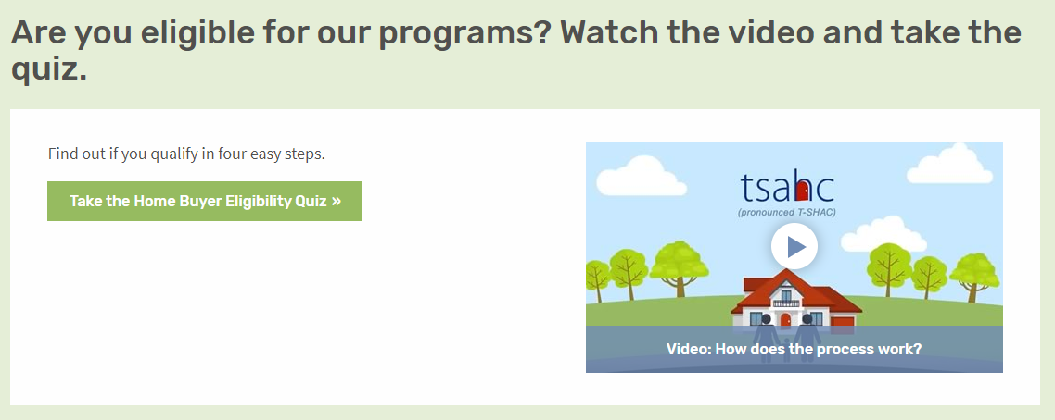
How to Get Started
Visit www.ReadyToBuyATexasHome.com to take the following steps:
1. Take the Eligibility Quiz
Notes:
LOAN OFFICERS: This script or slide may be modified to promote you and your company.
REALTORS: This script or slide may be modified to promote your preferred loan officer.
Any modification to the slides must be approved by TSAHC. Please email Joniel LeVecque at jlevecque@tsahc.org for approval.
Next, visit www.ReadyToBuyATexasHome.com.
Click on the “Home Buyers & Renters” tab at the top of the page.
You will see ‘Take the Eligibility Quiz’.
This will walk you through the eligibility criteria with 4 easy questions.
Should you not see your job title listed, no worries! Just choose “my job title is not listed”.
You can also watch a short video about the programs!

Slide 25
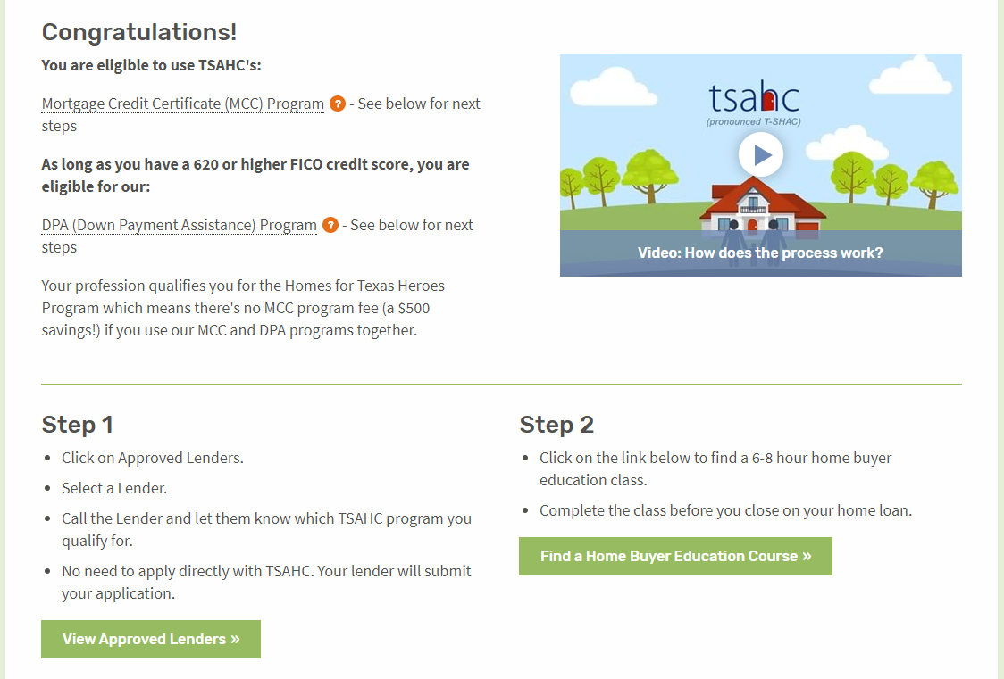
How to Get Started
Visit www.ReadyToBuyATexasHome.com to take the following steps:
2. Carefully read your quiz results for additional details and next steps.
Notes:
LOAN OFFICERS: This script or slide may be modified to promote you and your company.
REALTORS: This script or slide may be modified to promote your preferred loan officer.
Any modification to the slides must be approved by TSAHC. Please email Joniel LeVecque at jlevecque@tsahc.org for approval.
Next, should you qualify, your quiz results will tell you what your next steps will be in order to move forward. Please note that for the Down Payment Assistance program, certain credit scores and debt to income ratios are required. To learn more about them, click on the link provided.
Step 1:
You will need to contact a preferred loan officer by clicking on the “View Lenders In Your Area” button. Choose a preferred loan officer from the list.
Then, simply inform the loan officer that you would like to use one or both of TSAHC’s programs. The loan officer will walk you through the remainder of the process, ensuring that you qualify and will also submit an application for the assistance on your behalf. No direct application to TSAHC is required. Everything is done by the loan officer.
Step 2:
Before closing on your home, you will need to complete a homebuyer education class. This class is extremely beneficial to you as a homeowner and will teach you all about the home buying process. You can find one in your area or online by clicking on the “Find a Home Buyer Education Course” button.

Slide 26
How to Get Started
Visit www.ReadyToBuyATexasHome.com to take the following steps:
3. Contact an Approved Lender to Apply.
Notes:
LOAN OFFICERS: This script or slide may be modified to promote you and your company.
REALTORS: This script or slide may be modified to promote your preferred loan officer.
Any modification to the slides must be approved by TSAHC. Please email Joniel LeVecque at jlevecque@tsahc.org for approval.
When choosing a loan officer, know that TSAHC highlights loan officers who are knowledgeable and experienced in both the DPA and MCC programs.
The “Statewide Top Performing” section highlights loan officers who have done the most business with TSAHC statewide. Because of their extensive use of both the MCC and DPA programs, they are very knowledgeable about the process - providing a sense of confidence that a home buyer will have a good experience using either of TSAHC’s programs when working with them.
The same applies to the “Regional Top Performing Loan Officers” section that highlights loan officers who have done the most business with TSAHC in their particular region of Texas.
Also, in the “Preferred Loan Officers by County” section, you can find a list of loan officers that are approved in your county. These folks have helped at least four families use our programs in the past year.
And finally, the “Approved Mortgage Companies” section will help you see the companies that have been approved to use our programs in the state of Texas. Any loan officer working for one of these companies may help you purchase a home using TSAHC’s programs. If the loan officer is not yet familiar with TSAHC’s programs, simply put them in touch with TSAHC.

Slide 27
How to Get Started
Visit www.ReadyToBuyATexasHome.com to take the following steps:
4. Take a Home Buyer Education Course (Online or In Person)
Notes:
Home buyers need to complete a homebuyer education course prior to closing on the home loan.
When choosing a Home Buyer Education class, you have the option of taking an “Online Class” or an “In-Person Class”. The 3 online options that TSAHC allows are listed in the “Online Classes” section. Please just choose one to take and that will suffice. Should you like an “In-Person” class, you can find one near you by clicking on the “Find a Class Near You” button.

Slide 28
How to Get Started
Visit www.ReadyToBuyATexasHome.com to take the following steps:
4. Find a Participating Realtor
Notes:
LOAN OFFICERS: This script or slide may be modified and additional slides added to promote your preferred Realtor.
REALTORS: This script or slide may be modified and additional slides added to promote you and your company.
Any modification to the slides must be approved by TSAHC. Please email Joniel LeVecque at jlevecque@tsahc.org for approval.
TSAHC does not require you to work with a REALTOR® that has been approved by TSAHC. However, if you are looking for a REALTOR®, TSAHC offers several resources to help you find one familiar with TSAHC’s down payment assistance and mortgage tax credit programs. Use this search tool to find a REALTOR® in your area that has participated in trainings offered by TSAHC.

Slide 29
www.ReadyToBuyATexasHome.com
Notes:
Again, when visiting the Home Buyers and Renters section of www.ReadyToBuyATexasHome.com, you will find:
The Eligibility Quiz
Information for the Loans with Down Payment Assistance program
More information about the Mortgage Credit Certificate program
Many consumer resources including a “Steps to Buying a Home” page and webinar and the Texas Mortgage Calculator

Slide 30
Questions
ENTER YOUR CONTACT INFORMATION HERE
Visit www.ReadyToBuyATexasHome.com
Call TSAHC’s Homeownership Hotline: (877) 508-4611
Email Homeownership@TSAHC.org
Notes:
I want to thank you for your time today. I hope you are excited about the opportunity these programs may provide you to become a homeowner. I’m happy to answer any questions you might have for me at this time. If you have further questions, feel free to contact me with the following contact information. Should you want to talk to TSAHC directly, they may be contacted at the homeownership hotline, (877) 508-4611 or you may email them at Homeownership@tsahc.org.

