Slide 1
Help Your Clients Buy a Texas Home
Notes:
Welcome to Texas State Affordable Housing Corporation’s “Help Your Clients Buy a Texas Home” presentation. I am _________________ and I have been trained and certified by TSAHC to provide you with information regarding their programs. (Provide an introduction of yourself here and what you hope to accomplish by giving this training.)
Any modification to the slides must be approved by TSAHC. Please email Joniel Crim at jcrim@tsahc.org for approval.

Slide 2
About TSAHC
The Texas State Affordable Housing Corporation (TSAHC) is a housing nonprofit created at the direction of the Texas Legislature to serve the housing needs of low and moderate income Texans.
Home Buyer Programs:
Homes for Texas Heroes Home Loan Program
Home Sweet Texas Home Loan Program
Notes:
For those of you who are not familiar with the Texas State Affordable Housing Corporation, they are a statewide non-profit created at the direction of the Texas Legislature. Their mission is to serve the housing needs of low-income and moderate income Texans.
They have several programs including home buyer programs to help individuals and families buy a home in Texas. Those programs include the Homes for Texas Heroes Home Loan Program and the Home Sweet Texas Home Loan Program. Through these programs they help almost 5000 families buy a home each year. The main difference between the two programs are the eligible professions.
The Home Sweet Texas Home Loan Program is open to anyone regardless of profession and the Homes for Texas Heroes Home Loan Program is open to teachers, veterans, police officers, corrections officers, EMS personnel and fire fighters. Both programs require the individual or family to meet certain income limits for the county where they are purchasing the home.

Slide 3
Home Buyer Programs
These Home Buyer Programs offer two types of assistance to home buyers STATEWIDE.
Notes:
TSAHC offers two types of assistance to help home buyers under both the Home Sweet Texas and Homes for Texas Heroes home loan programs. This assistance is available statewide with no limitation on location.
The first type of assistance, is a low interest rate mortgage loan with down payment assistance attached to the loan. The loan is a 30 year fixed rate mortgage loan and may be an FHA, VA, USDA or Conventional mortgage loan. The assistance may be used for down payment and to help cover closing costs.
The second type of assistance, is a special mortgage interest income tax credit. This income tax credit will help reduce the amount of income taxes the homeowner owes the IRS by as much as $2,000 a year, every year, as long as they live in the home. By reducing the amount of income taxes they owe, this increases their take home pay which may be used to help pay the mortgage payment.
This tax credit may be combined with the down payment assistance too. So, not only does TSAHC help your home buyer get into their home with the down payment assistance but they also provide an income tax credit which may help them pay the monthly payments.
I will provide more detail for both types of assistance on the next slides.

Slide 4
Loans with Down Payment Assistance
Several options are available to your borrower:
Assistance % is based upon total loan amount
(i.e.: 5% of $100,000 = $5,000)
No need to be first-time buyer
(must use to purchase primary residence)
Can be used to cover down payment and/or closing costs
3% Assistance | 4% Assistance | 5% Assistance
Notes:
The first type of assistance is the Loans with Down Payment Assistance program.
Depending on the type of loan and credit score, one will have 3 different percentage levels of down payment assistance available. It will be up to your client to decide which assistance option is best for them. Please note that the lower the amount of grant assistance you choose, the lower the interest rate will be on the 30 year fixed interest rate mortgage.
Although one doesn’t need to be a first-time home buyer, they must use the program to buy a primary residence – no vacation, second homes or investment properties.
Home buyers have some flexibility when using the funds. They can put the money toward the down payment, closing costs, to reduce loan balance or any combination of the three.
The homebuyer may choose whichever mortgage loan type works best for them, whether that’s an FHA, VA, USDA, or Conventional loan product.
(Feel free to add personal testimonials regarding the down payment assistance program)

Slide 5
Loans with Down Payment Assistance
Option 1: Grant | Option 2: 3-year Deferred Forgivable 2nd Lien
FHA, VA, USDA only True gift that never needs to be repaid 3% , 4% or 5% DPA options | FHA, USDA, VA or HFA Conventional Loan (HFA Preferred or HFA Advantage) 0% interest on 2nd Lien No monthly payments on 2nd Lien- Fully forgiven 3 years from closing Lower interest rates than grant 3%, 4%, or 5% DPA options
Notes:
The down payment assistance comes in two forms. The grant assistance that they receive never needs to be repaid. There are no strings attached. They don’t have to purchase in any certain areas of Texas nor do they need to stay in the property for any period of time. It is a TRUE gift.
The 3-year deferred forgivable 2nd lien is a great new option that became available on 12-2-19. This allows for someone to choose any of our loan types and any assistance level. It will provide a lower interest rate on the first lien than the grant options and it becomes a grant after 3 years.

Slide 6
Loans with Down Payment Assistance
HFA Conventional Loan
TSAHC offers an HFA Conventional loan that have all the benefits of a traditional conventional loan with some added perks:
Only 3% down payment required
You can use either:
Fannie Mae’s HFA Preferred (80% AMFI or below only)
Freddie Mac’s HFA Advantage
AUS Requirements: DU required on Fannie -- LPA required on Freddie
No upfront Mortgage Insurance (MI) premium
MI can be cancelled
Notes:
For those wanting a conventional loan product, TSAHC offers a Fannie Mae conventional loan called the “HFA Preferred” which stands for “Housing Finance Agency Preferred” as well as a Freddie Mac product that is called HFA Advantage or “Housing Finance Agency Advantage”. These special conventional loans are only available to housing finance agencies like TSAHC.
It is interesting to note the special perks it provides compared to FHA and a traditional conventional loan.
The monthly mortgage insurance rates are much lower, no upfront mortgage insurance premium unlike FHA – saving your borrower on upfront closing costs or an increased loan amount, and no LLPAs unlike traditional conventional mortgages. Best of all, as you can see in this example, your borrower is able to cancel their MI saving them thousands of dollars compared to the “Life of Loan” mortgage insurance premium with an FHA loan.
Yes, the interest rate on this loan product will be a bit higher than that of a FHA loan, however, please keep in mind that their monthly payment may not be much different given the lower monthly MI rates. The comparable monthly payments make this a competitive alternative to FHA.

Slide 7
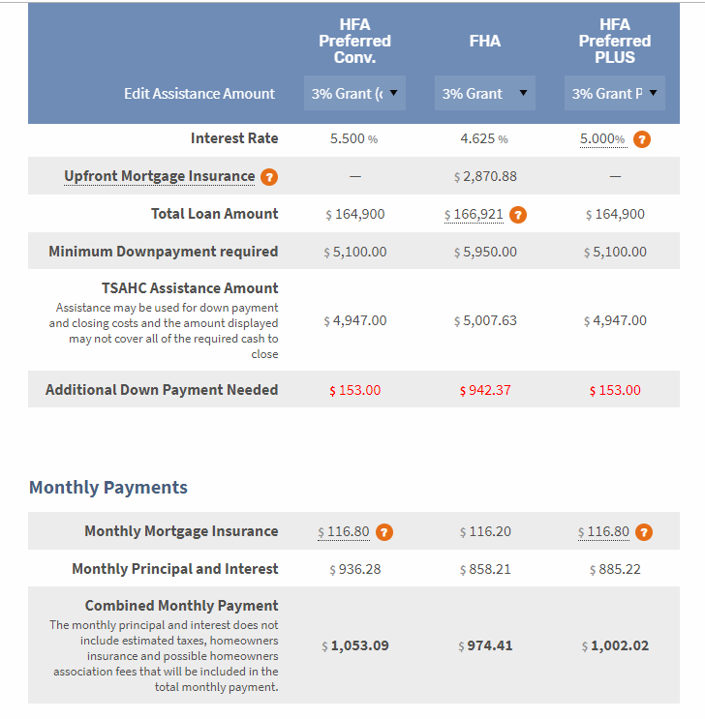
TSAHC Loan Comparison Calculator
Example: 680 FICO, $170,000 sales price, 3% DPA
Compare difference in down payment
Compare Monthly MI differences
Compare monthly payments
Notes:
To help you compare all of the different assistance and loan options you have with TSAHC, we created a Loan Comparison calculator. You can compare up to 3 loans at once and it will demonstrate:
Minimum down payment required
TSAHC assistance amount
Additional/Surplus down payment needed
Monthly mortgage insurance premium
Combined monthly payment
Looking at all of these things will help you make an educated decision on what is best for the buyer.

Slide 8
Loans with Down Payment Assistance
A borrower using TSAHC’s DPA or DPA/MCC program may purchase any of the following types of homes:
Not allowed: Rental homes, co-ops, investment properties, vacation and/or second homes.
Government Loans (FHA, VA, USDA)
New or existing homes Unit in a condo, townhouse, or PUD An entire duplex, triplex, or fourplex (one unit must be owner-occupied) Manufactured Homes (640+ FICO)
Notes:
You’ll see that TSAHC doesn’t restrict much about the type of property someone can purchase when using their assistance. They can even purchase a duplex, triplex, fourplex as long as they plan to occupy one of the units.

Slide 9
Loans with Down Payment Assistance
A borrower using TSAHC’s DPA or DPA/MCC program may purchase any of the following types of homes:
Conventional Loans
New or existing homes Townhomes, PUDs Condos (Follow Fannie or Freddie approval process as applicable) An entire duplex, triplex, or fourplex (Fannie Mae – HFA Preferred only) One unit must be occupied 3% borrower contribution required
Not allowed: Rental homes, co-ops, investment properties, vacation and/or second homes.
Notes:
Same goes with using a conventional loan. Not many property types are restricted other than the duplex, triplex, and fourplex option only being available on the HFA Preferred (Fannie Mae) product.

Slide 10
Mortgage Interest Tax Credits
Mortgage Credit Certificate (MCC)
First-time buyers only
(Waived for Qualified Veterans and Targeted Areas)
Annual tax credit
Must occupy the home as principal residence
Debt-to-income ratio reduced so buying power increased
FREE for Texas Heroes using our DPA program
Notes:
The second form of assistance is my personal favorite and I like to call it the gift that keeps on giving. This special mortgage interest tax credit is called a Mortgage Credit Certificate or MCC. This is a first-time homebuyer program only, with the definition of a first-time home buyer being anyone who hasn’t had ownership interest in a primary residence for the last 3 years.
As we discussed before, an MCC gives a homeowner the ability to claim an income tax credit equal to 20% of the mortgage interest paid annually. This credit may be used every year for the life of the loan, as long as they occupy the home as their principal residence. One of the best features of an MCC, is it can help your home buyer qualify by reducing the Debt-to-income ratio on the mortgage loan, which gives your home buyer more buying power!
Remember, this tax credit may be combined with TSAHC’s down payment assistance at the same time. Plus, its free for Texas Heroes who are also using TSAHC’s down payment assistance!
(Feel free to add personal testimonials regarding the Mortgage Credit Certificate program)

Slide 11
Mortgage Interest Tax Credits
Mortgage Credit Certificate (MCC):
Equal to 20% of the mortgage interest paid.
Credit Example
Loan Amount $200,000
Interest Rate x 5.75%
Interest Paid in 1st Full Year $11,500
20%=$2,300*
*No Longer Limited to a Maximum Amount
Notes:
In this example, the loan amount is $200,000 with an interest rate of 5.75%. The interest they would spend in that first full year would be $11,500. 20% of that is equal to $2,300. They would be able to take a tax credit equal to $2,300 that year.

Slide 12
Mortgage Interest Tax Credits
What’s the difference between a tax credit
and a tax deduction?
Tax Credits = Reduction of tax liability
or taxes owed
Tax Deductions = Reduction of taxable income
Notes:
Some folks may be thinking that, everyone benefits from mortgage interest on your income taxes so why does my home buyer need an MCC? This is true but only holders of an MCC benefit from the dollar for dollar credit that an MCC provides.
What’s the difference between a tax credit and a tax deduction? Tax credits provide a dollar-for-dollar reduction of income tax liability or taxes owed, while tax deductions allow one to lower the amount of taxable income by the amount of the mortgage interest. As an example, if you pay $5,000 in mortgage interest and your income is $50,000, you can reduce the amount of your taxable income by the amount of interest you paid, which would reduce your taxable income to $45,000. This is the amount of income you will pay taxes on. A $5,000 deduction, for example, might reduce your tax bill by only $300 to $400. A $2,300 tax credit cuts your tax bill by $2,300. It is a dollar for dollar savings.

Slide 13
Mortgage Interest Tax Credits
An MCC allows you to take
advantage of both forms of savings:
All home owners may take deductions but tax credits are only
available to holders of an MCC.
In this example, they can take the remaining mortgage interest in the amount of $9,200 ($11,500 - $2,300 credit) plus any property taxes, etc. as a deduction.
Notes:
An MCC allows you to take advantage of both forms of savings: Using the previous example, you can take the remaining mortgage interest in the amount of $9,200($11,500 - $2,300 credit) plus any property taxes, etc. as a deduction. An MCC is still better, let’s see what a dollar for dollar reduction of your tax liability can do for you on the next slide.

Slide 14
Mortgage Interest Tax Credits
Home buyer receives a refund every year? They may still benefit.
Payroll Income
Tax Withholding
Annual Tax Liability
$10,000
Paid too much
so they get a refund
Notes:
Let’s go over some fun examples on how the MCC works and how you might be able to more easily explain it to your home buyers. We have a lot of folks who say that they already receive a refund every year and they don't think they can benefit from the MCC. Well that's not always true, and I'll show you how. Let's say that this bucket represents our homebuyer Sally's income tax liability which happens to be $10,000 a year. Like most of us, Sally's employer has a portion of her paycheck set aside through her payroll income tax withholding, so that hopefully by the end of the year Sally will be able to cover her entire income tax liability. Fortunately for Sally, she had more than enough taken in payroll deductions to cover her $10,000 income tax liability. As you can see, once her bucket had $10,000, her remaining payroll deductions started over filling the bucket which resulted in a tax refund. In this example, Sally paid too much and gets her own money back as a tax refund. Let's see how an MCC could help Sally.

Slide 15
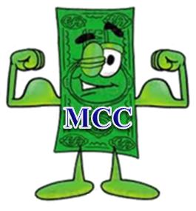
Mortgage Interest Tax Credits
Effect of an MCC on income tax liability
Payroll Income
Tax Withholding
stayed the same
The $2,300 MCC goes in the bucket
before payroll deductions
Borrower refund
increased by $2,300!
Remaining Tax Liability
$7,700
Annual Tax Liability
$10,000
Notes:
Let's say that Sally, again, has an income tax liability of $10,000 a year but this time she bought a new house as a first time home buyer and took advantage of the benefits of an MCC. Because Sally had an MCC, the $2300 MCC went into the bucket before any of her payroll deductions. Now, her remaining tax liability is only $7700. It directly reduced what she owed dollar for dollar. Let's assume Sally has the same amount taken out of each paycheck from her employer. Remember the bucket started off with the $2300 from the MCC in it first, so it's $2300 fuller now and more of the money that is being deducted from her paycheck is falling out of the bucket. Sally has more than covered her remaining tax liability of $7700 because she kept her payroll deductions the same, which means her tax refund has also increased by $2300. So, in this example Sally paid too much and gets her own money back as a tax refund which is now $2300 higher because of the MCC credit. Sally, instead, could update her W-4 form with her employer to reduce the amount of her payroll deductions by $191.67 a month. This is the $2,300 credit divided by 12. If Sally adjusts her W-4, then she will realize the credit every month by increasing her take home pay in the amount of $191.67.

Slide 16
Mortgage Interest Tax Credits
Mortgage Credit Certificate (MCC)
It’s the homebuyer’s responsibility to claim the mortgage interest credit on their federal income tax return every year.
The credit cannot be larger than the annual federal income tax liability, after all other credits and deductions have been considered.
Notes:
It is important that a home buyer check with a CPA to confirm that an MCC will benefit them. And, they will also need to claim this credit every year on their tax return. However, it will likely benefit them if they have a tax liability. A tax liability simply means that they owe taxes on their annual income. Most folks pay federal income taxes on their income, whether it is deducted from each pay check or paid at tax time on the tax return.
The credit cannot be greater than their income tax liability so a home buyer that does not pay income taxes will not benefit from this program. But remember, this is a “life of loan” product. If you have a buyer that doesn’t pay a whole lot in income taxes now, and you know their situation will be changing in the near future, then they should consider using the MCC. Any unused tax credit can be carried forward up to three years. Lets go over how the “carry forward” works.

Slide 17
Mortgage Interest Tax Credits
Any unused tax credit may be carried forward up to three years.
Notes:
Let’s say that Janie only had a tax liability last year of $1500. Based on the MCC rate of 40% or maximum $2000 calculation we discussed on the previous slides, she was eligible for the full $2000 credit. But because her liability was only $1500, she was unable to use the full $2000 credit. Janie owed no taxes that year but that also means $500 of the credit was left sitting on the table.

Slide 18
Mortgage Interest Tax Credits
Example:
Notes:
This year, Janie’s tax liability went up to $2500 because one of her children started school. She no longer has as much of a child care tax credit as she did in the previous year. With her $2000 credit, the balance of her income tax liability is $500 but because she is able to carry forward the unused tax credit from the previous year, she now owes nothing.

Slide 19
Mortgage Interest Tax Credits
Mortgage Credit Certificate (MCC)
The MCC can be used by itself or with our DPA program.
If MCC is used with other mortgage loan product:
Must be fixed rate mortgage – no requirement on term or product
Lender can sell loan to any investor/servicer
No minimum credit score or maximum DTI requirements
Notes:
Although the MCC may be combined with the DPA, it may be used with any other mortgage loan product if the homebuyer does not choose to use the down payment assistance. The only requirement is that it be used with a fixed rate mortgage loan. The income and purchase price limits still apply but there are no minimum credit score or DTI requirements.

Slide 20
Mortgage Interest Tax Credits
MCC Requirement ONLY:
Homebuyers using the MCC Program could potentially be subject to Recapture Tax if ALL three of the following occur:
Sell the home within 9 years,
Make a net profit on the sale, and
Income increases 5% every year borrower lived in the home
Notes:
Someone using the MCC program may be subject to recapture tax if all 3 listed items are met and it is truly all or nothing. Please remember for a moment though that our DPA program is a GIFT and no recapture is required.
To further clarify number 3; the borrowers income would need to increase by 5% over the income limit (not what they were making when they purchased) that was established the year they purchased their home. When determining if they are subject to the recapture tax, you use the income limit for the 115% AMFI the year they closed on the home.
Number 3 is what RARELY happens meaning that they wouldn’t be subject to recapture.
This program is a great benefit to first time buyers and recapture really shouldn’t scare people away from this WONDERFUL program.
Essentially, its as if they are getting a lower interest rate on the mortgage because they are getting some of the interest money back in the form of a tax credit!

Slide 21
Important Takeaways
Borrower can purchase anywhere in Texas.
FREE MCC for Texas Heroes using DPA
Turnaround times are fast!
No need to be a first-time buyer to use TSAHC DPA
2 DPA Options: TRUE GRANT or Low Interest 3-yr Deferred Forgivable 2nd Lien
Not required to stay in the home any number of years
Notes:
No need to be a first-time buyer to use TSAHC DPA
DPA is a TRUE GRANT, no need to be repaid – EVER!
Because this is a grant with no lien, there is NO requirement to stay in the home any number of years
A home buyer can purchase anywhere in the state of Texas because TSAHC is available STATEWIDE
There is no minimum time on the job required for Texas Heroes to get the free MCC
Turnaround times are fast! TSAHC’s turn time is 24-48 hours to review a file so it may not take any longer than a traditional loan.

Slide 22
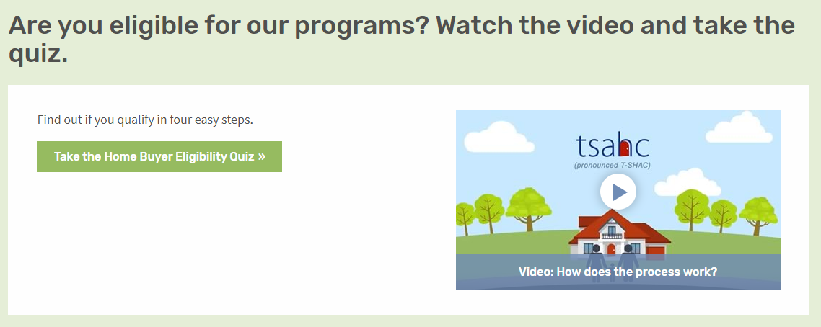
How to Get Started
Visit www.ReadyToBuyATexasHome.com to take the following steps:
1. Take the Eligibility Quiz
Notes:
LOAN OFFICERS: Slides 12-14 may be modified to promote you and your company.
REALTORS: Slides 12-14 may be modified to promote your preferred loan officer.
Any modification to the slides must be approved by TSAHC. Please email Joniel Crim at jcrim@tsahc.org for approval.
So how do you determine if you can use one or both of these programs?
First, visit www.ReadyToBuyATexasHome.com.
Click on the “Home Buyers & Renters” tab at the top of the page.
You will see ‘Take the Eligibility Quiz’.
This will walk you through the eligibility criteria with 4 easy questions.
Should you not see your job title listed, no worries! Just choose “my job title is not listed”.
You can also watch a short video about the programs!

Slide 23
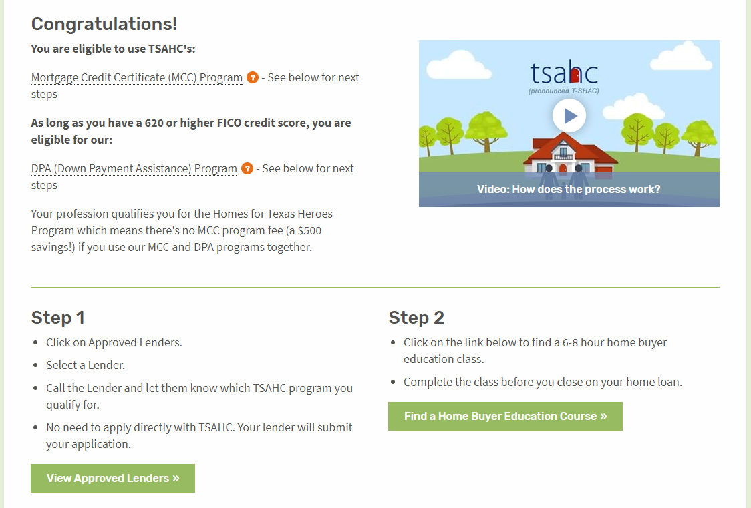
How to Get Started
Visit www.ReadyToBuyATexasHome.com to take the following steps:
2. Carefully read your quiz results for additional details and next steps.
Notes:
LOAN OFFICERS: Slides 12-14 may be modified to promote you and your company.
REALTORS: Slides 12-14 may be modified to promote your preferred loan officer.
Any modification to the slides must be approved by TSAHC. Please email Joniel Crim at jcrim@tsahc.org for approval.
Next, should you qualify, your quiz results will tell you what your next steps will be in order to move forward. Please note that for the Down Payment Assistance program, certain credit scores and debt to income ratios are required. To learn more about them, click on the link provided.
Step 1:
You will need to contact a preferred loan officer by clicking on the “View Lenders In Your Area” button. Choose a preferred loan officer from the list.
Then, simply inform the loan officer that you would like to use one or both of TSAHC’s programs. The loan officer will walk you through the remainder of the process, ensuring that you qualify and will also submit an application for the assistance on your behalf. No direct application to TSAHC is required. Everything is done by the loan officer.
Step 2:
Before closing on your home, you will need to complete a homebuyer education class. This class is extremely beneficial to you as a homeowner and will teach you all about the home buying process. You can find one in your area or online by clicking on the “Find a Home Buyer Education Course” button.

Slide 24
How to Get Started
Visit www.ReadyToBuyATexasHome.com to take the following steps:
3. Contact an Approved Lender to Apply.
Notes:
LOAN OFFICERS: Slides 24 may be modified to promote you and your company.
REALTORS: Slides 24 may be modified to promote your preferred loan officer.
Any modification to the slides must be approved by TSAHC. Please email Joniel Crim at jcrim@tsahc.org for approval.
When choosing a loan officer, know that TSAHC highlights loan officers who are knowledgeable and experienced in both the DPA and MCC programs.
The “Statewide Top Performing” section highlights loan officers who have done the most business with TSAHC statewide. Because of their extensive use of both the MCC and DPA programs, they are very knowledgeable about the process - providing a sense of confidence that a home buyer will have a good experience using either of TSAHC’s programs when working with them.
The same applies to the “Regional Top Performing Loan Officers” section that highlights loan officers who have done the most business with TSAHC in their particular region of Texas.
Also, in the “Preferred Loan Officers by County” section, you can find a list of loan officers that are approved in your county. These folks have helped at least four families use our programs in the past year.
And finally, the “Approved Mortgage Companies” section will help you see the companies that have been approved to use our programs in the state of Texas. Any loan officer working for one of these companies may help you purchase a home using TSAHC’s programs. If the loan officer is not yet familiar with TSAHC’s programs, simply put them in touch with TSAHC.

Slide 25
How to Get Started
Visit www.ReadyToBuyATexasHome.com to take the following steps:
4. Take a Home Buyer Education Course (Online or In Person)
Notes:
Home buyers need to complete a homebuyer education course prior to closing on the home loan.
When choosing a Home Buyer Education class, you have the option of taking an “Online Class” or an “In-Person Class”. The 3 online options that TSAHC allows are listed in the “Online Classes” section. Please just choose one to take and that will suffice. Should you like an “In-Person” class, you can find one near you by clicking on the “Find a Class Near You” button.

Slide 26
How to Get Started
Visit www.ReadyToBuyATexasHome.com to take the following steps:
4. Find a Participating Realtor
Notes:
LOAN OFFICERS: Slide 26 may be modified and additional slides added to promote your preferred Realtor.
REALTORS: Slide 26 may be modified and additional slides added to promote you and your company.
Any modification to the slides must be approved by TSAHC. Please email Joniel Crim at jcrim@tsahc.org for approval.
TSAHC does not require you to work with a REALTOR® that has been approved by TSAHC. However, if you are looking for a REALTOR®, TSAHC offers several resources to help you find one familiar with TSAHC’s down payment assistance and mortgage tax credit programs. Use this search tool to find a REALTOR® in your area that has participated in trainings offered by TSAHC.

Slide 27
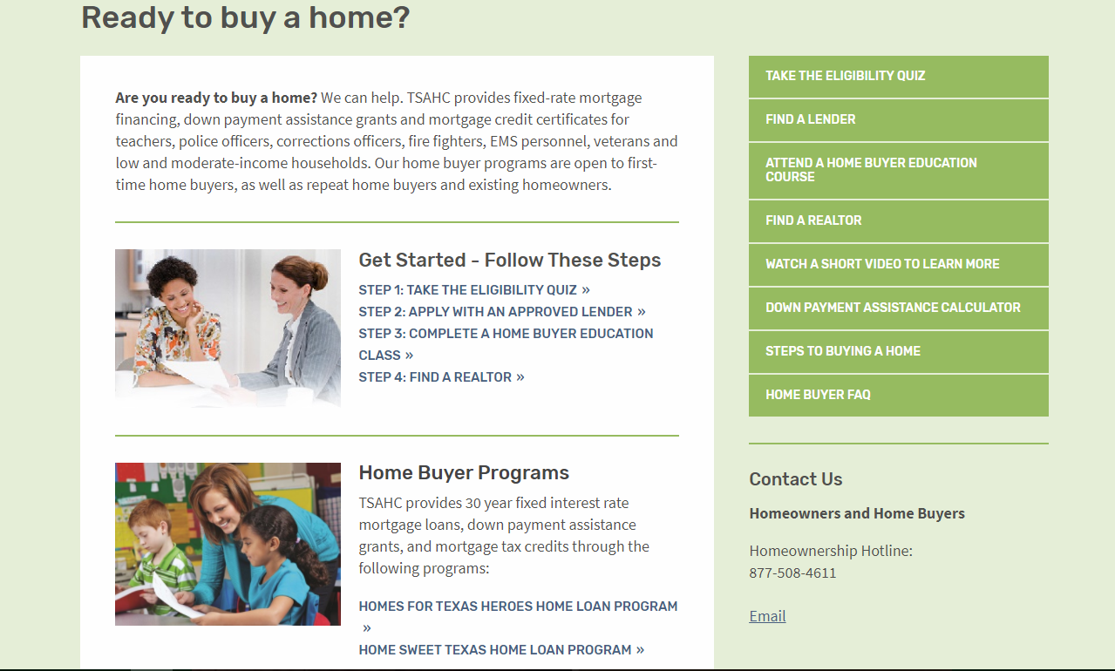
www.ReadyToBuyATexasHome.com
Notes:
Again, when visiting the Home Buyers and Renters section of www.ReadyToBuyATexasHome.com, you will find:
The Eligibility Quiz
Information for the Loans with Down Payment Assistance program
More information about the Mortgage Credit Certificate program
Many consumer resources including a “Steps to Buying a Home” page and webinar and the Texas Mortgage Calculator

Slide 28
Questions
ENTER YOUR CONTACT INFORMATION HERE
Visit www.ReadyToBuyATexasHome.com
Call TSAHC’s Homeownership Hotline: (877) 508-4611
Email Homeownership@TSAHC.org
Notes:
I want to thank you for your time today. I hope you are excited about the opportunity these programs may provide you to become a homeowner. I’m happy to answer any questions you might have for me now. If you have further questions, feel free to contact me with the following contact information. Should you want to talk to TSAHC directly, they may be contacted at the homeownership hotline, (877) 508-4611 or you may email them at Homeownership@tsahc.org.

