Slide 1
Down Payment Help Available
With TSAHC’s Home for Texas Heroes Program
Notes:
Welcome! Let’s Talk About Homeownership
Buying a home can feel overwhelming
You’re not alone
TSAHC is here to help
“Welcome, and thank you for being here today! Buying a home can feel exciting—and honestly, a little overwhelming. That’s completely normal.
Our goal today is to break things down, answer common questions, and show you how TSAHC can help make homeownership more affordable and achievable.”

Slide 2
Personal Introduction

Slide 3
Objectives
Key Takeaways
DPA and MCC programs exist and are easy to use!
How to access these programs:
Eligibility Quiz
Homebuyer Education
Find a Lender
Notes:
“Before we dive in, I want to set expectations. Today’s presentation is for educational purposes—it’s not an application, and eligibility is determined by a participating lender.
Everyone’s situation is different, so please feel free to ask questions along the way.”
“By the end of today’s presentation, you’ll have a better understanding of TSAHC’s programs, how down payment assistance works, and what your next steps could look like if you decide homeownership is right for you.”

Slide 4
Agenda
About TSAHC
  Mission
  Vision
Programs
  Down Payment Assistance
  Mortgage Credit Certificates
  How Does One Qualify?

Slide 5
About TSAHC
TSAHC is a 501(c)3 nonprofit organization.
Our mission is to facilitate, preserve, and expand affordable housing opportunities for Texans.
Our vision is that every Texan will have a place to call home.
Notes:
“TSAHC stands for the Texas State Affordable Housing Corporation.” We are not the state agency (that is TDHCA)
A nonprofit organization created to help Texans—just like you—access affordable homeownership opportunities. Our mission is to facilitate, preserve, and expand affordable housing opportunities for Texans. Our vision is that every Texan will have a place to call home.

Slide 6
About TSAHC
Build:
Programs for Developers
Helping developers build affordable housing
Buy:
Programs for Homebuyers, Lenders, and Realtors
Helping homebuyers achieve their dream of homeownership
Stay:
Programs for Homeowners and Housing Counselors
Helping homeowners sustain homeownership and improve their finances
Notes:
TSAHC fulfills their mission and vision through this concept of: Build, Buy, and Stay.
We help developers BUILD and rehabilitate both single family and multi-family affordable housing across Texas.
We help homebuyers BUY with our DPA and MCC programs that make purchasing a home more affordable. That is what we are here to focus on today.
We help families STAY, by bringing in education to nonprofits providing financial education, credit counseling, home buyer education so that they may then bring that knowledge back to their communities and help families be successful and remain in their homes and communities for years to come. We also require anyone using our home buyer programs to buy their homes to take a home buyer education class that many of these nonprofits and units of local government provide.

Slide 7
Reasons to Buy a Home
Did you know?
Down payments don’t need to break the bank. TSAHC can help!
78% of Texans may qualify to use our programs!
You can check your credit report for free using www.annualcreditreport.com
Homeowners have significantly higher net worth, often 40 times greater, than renters.
Homeownership counselors help improve your credit for FREE. Visit www.texasfinancialtoolbox.com to find a counselor near you.
In 2022, the median homeowner’s net worth was around $400,000 while that of renter’s was just $10,400
Notes:
We came up with some interesting facts to help you overcome some of these obstacles. Most people think that they can't afford the down payment to purchase a home. when in reality, the out-of-pocket expense for first and last months rent and deposit when renting may not be that much cheaper in comparison to a down payment to purchase your own home if you are using a down payment assistance program like TSAHC has to offer. So down payments don't have to break the bank and TSAHC can help you overcome this hurdle with our down payment assistance Grant's!
And of course, one of the biggest obstacles in buying a home is poor credit or too much debt and unfortunately, we aren't taught in high school how to handle our personal finances or the importance of a good credit score. We're thrown out there into the big world and expected to figure it out on our own. Some of us having to experience bad credit or high debt before we learn. TSAHC recognizes that this is a common obstacle for families looking to enjoy the pride of homeownership and has created a tool to help you overcome it. We created a website called Texas financial toolbox and this website will help you find a homeownership counselor near you. There is no need to pay a company to repair your credit when you can do it yourself for free and these counsellors can show you how. Sometimes you could use some help and just need advice from an expert. These Homeownership counselors typically work with nonprofit agencies and they're available to work with you in meeting your homeownership goals and can help provide you the education to improve your own credit and manage your finances. We have also provided you with the website created by the three major credit reporting agencies to access your credit report for free. It's called annual credit report.com.
Homeowners build wealth more quickly and more significantly through home appreciation leading to long term wealth accumulation benefits where rent payments are a sunk cost.

Slide 8




About TSAHC
Home Sweet Texas Home Loan Program
Homes for Texas Heroes Home Loan Program
Notes:
“TSAHC offers two main program categories. These programs are available to all Texans that meet the FICO and income limit requirements.
Home Sweet Texas is available to eligible homebuyers who meet income and purchase price guidelines.
Texas Heroes is designed to support Texas teachers, first responders, and other eligible public service professionals. Both programs offer the same benefits—the difference is who qualifies and those that fall under the Texas Hero category are offered the MCC for free – a $400 savings. Texas Heroes also have higher income limits!”

Slide 9

About TSAHC
Notes:
Specifically, The Homes for Texas Heroes Home Loan Program is open to k-12 public school teachers, corrections officers, EMS personnel, fire fighters, police officers, public school librarians, public school counselors, public school nurses, and veterans/active military . These professions were selected by the Texas Legislature as professions for which the state wanted to make home buying programs available.

Slide 10


Who Qualifies?
Public School Teachers
Public School Teacher Aides
Public School Librarians
Public School Counselors
Public School Nurses
Notes:
Professional Educator means a full-time, public school kindergarten through 12th grade:
• classroom teacher,
• teacher aide,
• school librarian,
• school counselor certified under Subchapter B, Chapter 21, Education Code, or
• school nurse.
(This slide may be deleted if presenting to a specific profession)

Slide 11


Who Qualifies?
Peace Officer
  Police
  Sheriffs
  State Troopers
Public Security Officer
Notes:
Peace or Police Officer means a person elected, employed, or appointed as a full-time peace/police officer under Article 2.12, Code of Criminal Procedure, Section 51.212 or 51.214, Education Code, or other law. Peace officers are licensed through the Texas Commission on Law Enforcement (TCOLE).
Public Security Officer means a person employed or appointed full-time as an armed security officer by this state or a political subdivision of this state. The term does not include a security officer employed by a private security company that contracts with this state or a political subdivision of this state to provide security services for the entity. Public security officers must be licensed through the Texas Commission on Law Enforcement (TCOLE).
(This slide may be deleted if presenting to a specific profession)

Slide 12

Who Qualifies?
Corrections Officer
Juvenile Corrections Officer
County Jailer
Notes:
Corrections Officer means all full-time employees of the Texas Department of Criminal Justice (TDCJ) who receive hazardous duty pay. Hazardous duty pay employees must have a VOE through TDCJ.
Juvenile Corrections Officer means all full-time employees of the Texas Juvenile Justice Department (TJJD) who receive hazardous duty pay. Juvenile corrections officers must have a VOE through TJJD.
County Jailer means a person employed full-time as a county jail guard under Section 85.005, Local Government Code. County jailers must be licensed through the Texas Commission on Law Enforcement (TCOLE).
(This slide may be deleted if presenting to a specific profession)

Slide 13


Who Qualifies?
Fire Fighter
Emergency Care Attendant
Emergency Medical Technician
Licensed Paramedic
Notes:
Fire Fighter means a member of a fire department who performs a function listed in Section 419.021(3)(c), Government Code. Permanent, full-time fire department employees who are not secretaries, stenographers, clerks, budget analysts, or similar support staff persons or other administrative employees and who are assigned duties in one or more of the following categories:
• fire suppression;
• fire inspection;
• fire and arson investigation;
• marine firefighting;
• aircraft rescue and firefighting;
• fire training;
• fire education;
• fire administration; and
• Any other position necessarily or customarily related to fire prevention or suppression.
Emergency Medical Services Personnel has the meaning assigned by Section 773.003, Health and Safety Code. Emergency medical services personnel means a full-time:
• emergency care attendant;
• emergency medical technicians;
• emergency medical technicians-intermediate;
• emergency medical technicians-paramedic; or
• licensed paramedic.
(This slide may be deleted if presenting to a specific profession)

Slide 14


Who Qualifies?
Veterans
Active Military
Notes:
Veteran means a person who was honorably discharged and who:
•served more than 90 days on active duty in the Army, Navy, Air Force, Coast Guard, United States Public Health Service or Marine Corps of the United States, or
• has enlisted or received an appointment in the Texas National Guard, or
• served in the armed forces of the Republic of Vietnam between February 28, 1961 and May 7, 1975;
Veteran’s under this definition also qualify for exemption from the first time home buyer requirement on the bond DPA or the MCC programs.
Active Duty Military means a person who is serving on active duty, at the time of application and assigned to a military base or facility in Texas, and has officially designated Texas as the applicant’s home of record.
Active Duty Military do not qualify for exemption from the first time home buyer requirement on the bond DPA or the MCC programs.
(This slide may be deleted if presenting to a specific profession)

Slide 15

About TSAHC
Both programs are offered STATEWIDE (even if moving from out of state)
Down Payment Assistance
Mortgage Credit Certificate
Notes:
Under the Texas Heroes program and the Home Sweet Texas program, TSAHC offers fixed rate mortgage loans with Down Payment Assistance.
TSAHC also offers a tax savings program (MCC) for first-time homebuyers! Both programs are offered Statewide, even if moving from out of state!

Slide 16
Down Payment Assistance
2%
of the loan amount
No DPA
0%
of the loan amount
5%
of the loan amount
No First-time home buyer requirement for Non-Bond DPA
Can be used to cover down payment AND/OR closing costs
Notes:
“TSAHC offers down payment assistance options ranging from 2% to 5% of the total loan amount.
For Example - $200,000 mortgage with 5% assistance would = $10,000 in assistance
TSAHC sets the interest rate on the first lien, 30-year fixed rate loan – 2% offers lowest rate we have available and 5% offers the highest rate we have available. Up to the buyer and lender to determine which option they’d like (if they qualify for all options)
For buyers who don’t need assistance, a No DPA loan option is also available.”
No DPA is a competitive interest rate loan offering for buyers who also want the MCC! In fact, all of these options can be combined with our MCC program which you will hear about shortly.

Slide 17
Down Payment Assistance
Grant
3-year Deferred Forgivable 2nd Lien
OR
Gov’t Loans only
Treated like a GIFT
Fully forgiven after 6 months
Gov’t and Conv loans
Fully forgiven after 3 years
No interest; No payments
Notes:
“Repayment terms and forgiveness timelines vary by program and must be met to qualify.”
Grants are available for Government loans; fully forgiven after 6 months
3Year Forgivable 2nd lien is forgiven in 3 years
2nd lien offers lower interest rates than the grant
Please note that our Conventional loans only require a 3% down payment!

Slide 18
Down Payment Assistance
The Forgivable 2nd lien terms are as follows:
0% interest
No monthly payments due
3-year term
Forgiven, in-full, 3 years from the closing date. Not forgiven on a pro-rated basis.
Must be repaid, in full, during 3-year term if you sell, transfer, refinance, or if the first lien mortgage is paid in full for any reason, or failure to occupy property as principal residence, or other event of default.
3-year Deferred Forgivable
2nd Lien
Notes:
The Forgivable 2nd lien terms are as follows:
0% interest
No monthly payments due
3-year term
Forgiven, in-full, 3 years from the closing date. Not forgiven on a pro-rated basis.
Must be repaid, in full, during 3-year term if you sell, transfer, refinance,
or if the first lien mortgage is paid in full for any reason,
or failure to occupy property as principal residence,
or other event of default.

Slide 19

Eligible Properties – Primary Residence only!
New and existing SF homes
Condos and Townhomes
2-4 unit properties
Manufactured Homes
Meets HUD requirements
Double Wide or greater
Not constructed prior to 1994
Minimum 640 FICO
No leaseholds
One unit must be owner occupied.
Net rental income used to qualify will count against the income limit.
Condos must have proper approval by HUD/FHA, VA, or Fannie/Freddie.
Homes defined as standard single-family homes by appraisal
One-time close construction loans are not eligible
Notes:
The home being purchased must be located in the State of Texas. The Lender should verify the property’s location by reviewing the property appraisal and location where the property taxes are collected.
640+ credit required for manufactured homes

Slide 20

Story Time
Meet Andrew Armstrong, a military veteran that always called Texas home. Jake West, a TSAHC top lender, helped Andrew and his family buy their dream home in South Texas.
Andrew was able to use our Homes for Texas Heroes program in combination with a VA loan and receive $7,000 in down payment assistance which he was able to use to cover his closing costs and even walk away from the closing table with his earnest money cash in his pocket!
Notes:
The TSAHC DPA program can help cover closing costs too! Here is a great story of a Veteran using our VA +DPA combo. He walked away with his earnest money in hand!

Slide 21
Mortgage Credit Certificate
First Time Homebuyer Definition:
In the last 3 years, has not had ownership in a primary residence, nor resided primarily in a residence they own.
This definition means you can still qualify even if you have owned a home in the past, as long as you haven't owned a primary residence in the last three years.
Notes:
Our second program is the Mortgage Credit Certificate.
MCC available when added to any DPA options; FREE for Texas Heroes
It’s like a 15% discount on your mortgage interest rate
First-time buyers only (Waived for Qualified Veterans and Targeted Areas)
First Time Homebuyer definition: Have not owned a primary residence in the last 3 years.
Must occupy the home as principal residence
FREE for Texas Heroes
MCC is a Tax Credit, but you can still do standard Tax Deductions as a homeowner!

Slide 22

Mortgage Credit Certificate
Get 15%
of the
Mortgage Interest
Back…
EVERY YEAR!
Notes:
Claim this credit each year at tax time and get 15% back of the Mortgage Interest you paid last year.
It’s like a 15% discount on your mortgage interest rate

Slide 23

Mortgage Credit Certificate
MCC Calculator – Fun to show impact over 30 years!
https://www.tsahc.org/homebuyers-renters/mortgage-credit-certs
Year 1 Savings
Year 30 Savings
Notes:
TSAHC’s MCC calculator shows how much mortgage interest you can save year over year!
As a homeowner, you will claim this MCC as long as you live in the home, for the first 30 years!
Most homeowners will save TENS of THOUSANDS of dollars in mortgage interest year over year.

Slide 24
Mortgage Credit Certificate
How does the MCC impact the mortgage interest rate?
Mortgage Interest Rate 7.00% - 15%
=
5.95%
Effective Rate
Notes:
Here is an example on how the MCC can impact your effective rate on the mortgage loan.
Payments will still be based on the 7% rate, but you will get 15% of the interest back, so effectively you are only paying a 5.95% rate on your mortgage loan!
The Note, Loan Approval and monthly payment will still reflect the higher rate; but this is a great way lower your rate – Add the MCC

Slide 25
Mortgage Credit Certificate
Credit Example
Loan Amount $280,000
Interest Rate x 7.0%
Interest Paid in 1st Full Year $19,600
15%
of $19,600 = $2,940
Notes:
Here is an example on how the Tax Credit is calculated. You can see that 15% of $19,500 is $2,925. This is how much the MCC is worth in that first year and it will be similar each year there after. Of course, as you pay less in interest, your credit will also be less. But over the 30 year life of the loan, you will save 10’s of thousands of dollars in interest with the MCC.

Slide 26

Mortgage Credit Certificate
15%
of $19,600 = $2,940
$2,940 / 12 months
=
$245/mo
Lender can use the $245 as additional monthly income
Increasing Buying Power
Lowering Debt to Income Ratio
May help get loan approved
Notes:
The MCC can benefit your loan approval! Take the expected credit, divide by 12 months in the year!
The Lender can use this calculated credit as additional income on your loan application! This can help lower your debt to income ratio and also help you get approved!

Slide 27


Mortgage Credit Certificate
How does a tax refund generally work?
Payroll Income
Tax Withholding
Paid too much
so, they get a refund
Annual Tax Liability
$10,000
Notes:
Sally has an annual tax liability of $10,000.
Her employer sets aside a designated amount, in hopes that they will get a refund!

Slide 28

Mortgage Credit Certificate
How does the MCC impact the borrower at Income Tax Time?
Any unused credit can roll over for up to 3 years!
Payroll Income
Tax Withholding
Borrower refund
increased by $2,940!
Annual Tax Liability
$10,000
Remaining Tax Liability
$7,060
Notes:
Sally has an annual tax liability of $10,000.
She bought a house and has an MCC! This will lower her Tax Liability! (using the same example as before!)
Her employer sets aside the same designated amount, and her tax refund increases by $2,940!

Slide 29

Mortgage Credit Certificate
The MCC issuance fee is waived for Texas Heroes!
Notes:
Currently, the benefit for Texas Heroes includes a FREE MCC. The $400 MCC issuance fee is waived for all Texas Heroes. If you qualify for it, it’s a no-brainer!

Slide 30

Story Time
Angel from Corpus Christie just scored their dream home—thanks to TSAHC’s Homes Sweet Texas program! Angel, a 20-year City of Corpus employee, discovered TSAHC’s down payment assistance (DPA) and knew it was the perfect opportunity to purchase a home. He teamed up with Kerra Garcia, one of Corpus’ top lenders, to figure out how to turn his dream into reality.
Kerra worked her magic, connecting him with DPA and a mortgage credit certificate (MCC)—helping with the down payment and making homeownership even more affordable. Now, Angel is a homeowner with a mortgage payment that matches his previous rent payment!!

Slide 31
How to Qualify – Who is a Texas Hero?
The Texas Legislature, through statute, defines who qualifies for TSAHC’s Texas Heroes program.
It’s not an open-ended “all public service jobs” list; it depends on how the law defines occupations.
Registered nurses working in clinical/hospital settings (or other nursing roles not defined in the statute) are not listed under the current eligible occupations.
Notes:
Because the statute is specific, if an occupation is not listed in the statute (or an amendment) then that occupation is not automatically eligible under the Texas Hero Program, however, they would be eligible under Home Sweet Texas.
the “list” isn’t arbitrary — it comes from legislative definitions. These definitions are embedded in state law or statutes. For example, TSAHC was created by the Legislature and operates under its oversight.

Slide 32
How to Qualify – who is a Texas Hero?
Professional Educators:
Teachers
Teachers Aides
School Librarians
School Counselors
School Nurses
Nursing or Allied Health Faculty
Public Security Officers
Corrections Officers
&
Juvenile Corrections
Officers
Remember:
Anyone in Texas
that meets our Income and Credit Score Limits
may qualify!
First Responders:
Police Officers
Firefighters
EMS personnel
Veterans
Or
Active Military
Notes:
These are the specific Texas Hero requirements. But remember, ANYONE can gain access to our programs!
Professional educators, which includes the following full-time positions in a public school district: school teachers, teacher aides, school librarians, school counselors, and school nurses
First Responders, which includes police officers, firefighters and EMS personnel
Public security officers
Veterans or active military
Correction officers and juvenile corrections officers
Nursing faculty and allied health faculty

Slide 33
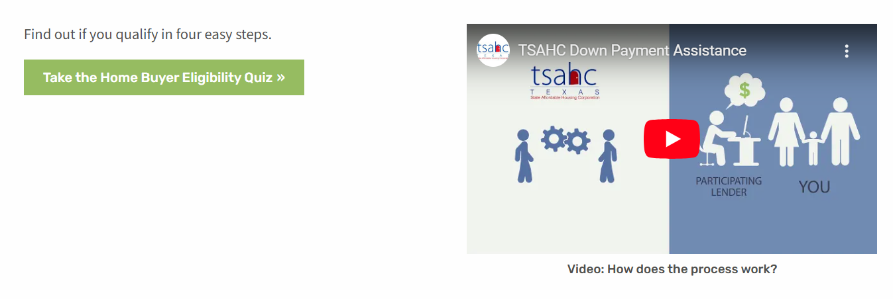

How to Qualify
Take our Eligibility Quiz to get started!
www.tsahc.org
TSAHC requirements:
**Minimum 620 FICO credit score
**Income limits vary by county
Notes:
Use our Pathfinder quiz to help you determine next steps.
Texas Heroes have higher income limits for our DPA only program!

Slide 34
How to Qualify – Review results for next steps!
If results state you may not qualify,
don’t stop there!
Seek additional clarification from TSAHC or a licensed Loan Officer to confirm eligibility!
Notes:
It will point you to a lender, however, you will already have a TSAHC preferred lender relationship to which you will refer your client.
620 or higher credit
Even if your quiz results say you may not qualify, please contact your lender to be sure. There are many factors to calculating your income and eligibility and a Lender can best confirm!
Help them find a HBE course – online or in person (Spanish options available)

Slide 35



How to Qualify – Get Educated!
At least 1 borrower on the loan must complete a Homebuyer Education Course.
Homebuyer Education course must be HUD approved or meet National Industry Standards
A homeowner is 33% less likely to fall behind on their mortgage if they’ve taken a home buyer education course
Education Certificates are valid for 1 whole year
In-person and Online options available; Some are FREE!
Notes:
A homeowner is 33% less likely to fall behind on their mortgage if they’ve taken a home buyer education course
Visit www.texasfinancialtoolbox.com to find a course near your borrower
There may be a cost associated with this course.
Good for 1 year prior to closing

Slide 36
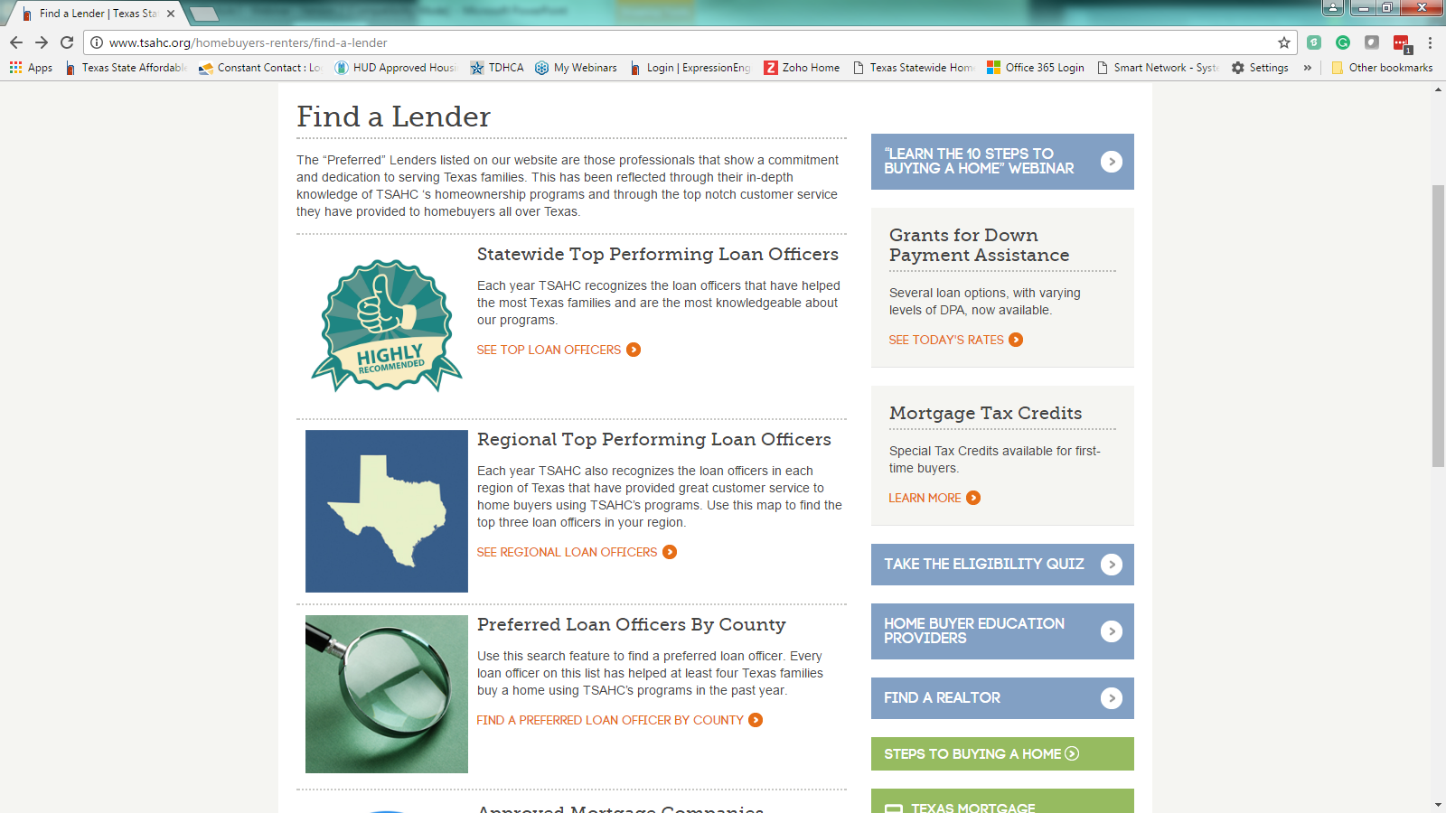
How to Qualify – Find a Lender
Your Mortgage Lender must be approved by TSAHC.
Choose from our list of experience Loan Officers to help get started!
Notes:
Use TSAHC’s Find a Lender page to find experts that serve your area. Any LO licensed to operate in TX can offer the programs if:
The Loan Officer (including Brokers) is working with a TSAHC approved company can offer our programs once they take the required training.
Loan Officer profiles on TSAHC’s Find a Lender page are reserved for active LOs that closed 4 or more TSAHC loans within the last 12 months.

Slide 37
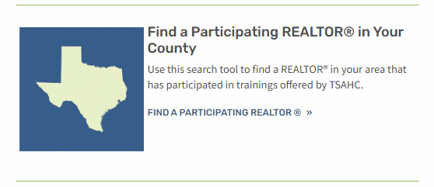
How to Qualify - Find a Realtor
Any Texas Realtor can represent a homebuyer using TSAHC!
Our Find a Realtor page is full of Realtors that have taken a TSAHC Realtor CE training within the last year!
Notes:
Use TSAHC’s Find a Realtor page!
https://www.tsahc.org/homebuyers-renters/find-a-realtor
Realtors don’t have to be “approved” to help connect you to TSAHC. However, we do have a list of participating realtors that have taken our training and are familiar with TSAHC if you’d like to connect with one. We do have a list on our website where you can find Realtors in your county familiar with TSAHC!

Slide 38
Important Takeaways
No need to be a first-time buyer to use DPA
2 DPA Options: Grant or 3-year Deferred Forgivable 2nd lien
Can purchase anywhere in Texas – even if moving from out of state
MCC program provides a 15% discount on the mortgage interest
Anyone at or below our income limits may be eligible.
However, Texas Heroes have higher income limits!
Turnaround times are fast!
On average, TSAHC loans close within 30 days.

Slide 39

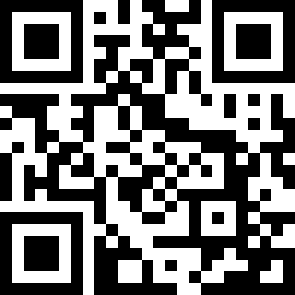
Stay Informed! Watch our webinar!
https://tinyurl.com/32dhtzv
Your 10 steps to buying a home!
Notes:
Use our 10 steps flyer to stay on track! You can also watch our webinar for more information!

Slide 40



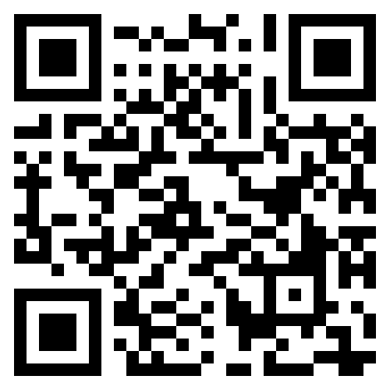
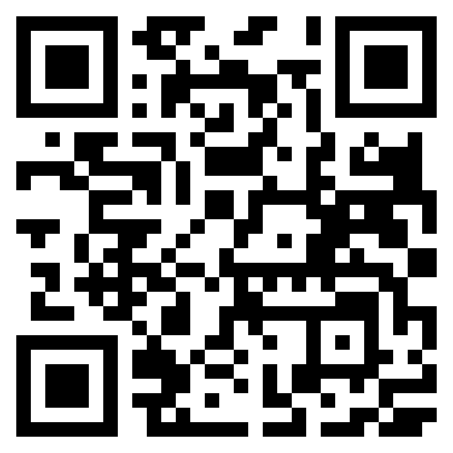
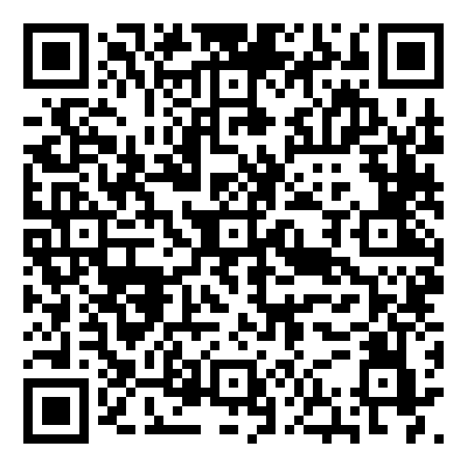
Follow Us!
Notes:
TSAHC is active on these three social media sites. Feel free to follow us for more educational opportunities and see how our success in helping Texans!

Slide 41
Contact Us
Homeownership Hotline: (877) 508-4611
General Questions:
Email: homeownership@tsahc.org
Notes:
TSAHC’s Homeownership team is happy to answer your questions!

Slide 42
Contact Me
Notes:
Place your contact information on this slide

