Slide 1
Down Payment Assistance
Serve More Buyers & Close More Deals With TSAHC

Slide 2
Agenda
About TSAHC
  Mission
  Vision
Programs
  Down Payment Assistance
  Mortgage Credit Certificates
  How Does One Qualify?
Marketing
  Flyers and Brochures
  Ideas to Market yourself using these programs

Slide 3
About TSAHC
TSAHC is a 501(c)3 nonprofit organization.
Our mission is to facilitate, preserve, and expand affordable housing opportunities for Texans.
Our vision is that every Texan will have a place to call home.
Notes:
“TSAHC stands for the Texas State Affordable Housing Corporation.” We are not the state agency (that is TDHCA)
A nonprofit organization created to help Texans—just like you—access affordable homeownership opportunities. Our mission is to facilitate, preserve, and expand affordable housing opportunities for Texans. Our vision is that every Texan will have a place to call home.

Slide 4
About TSAHC
Build:
Programs for Developers
Helping developers build affordable housing
Buy:
Programs for Homebuyers, Lenders, and Realtors
Helping homebuyers achieve their dream of homeownership
Stay:
Programs for Homeowners and Housing Counselors
Helping homeowners sustain homeownership and improve their finances
Notes:
TSAHC fulfills their mission and vision through this concept of: Build, Buy, and Stay.
We help developers BUILD and rehabilitate both single family and multi-family affordable housing across Texas.
We help homebuyers BUY with our DPA and MCC programs that make purchasing a home more affordable. That is what we are here to focus on today.
We help families STAY, by bringing in education to nonprofits providing financial education, credit counseling, home buyer education so that they may then bring that knowledge back to their communities and help families be successful and remain in their homes and communities for years to come. We also require anyone using our home buyer programs to buy their homes to take a home buyer education class that many of these nonprofits and units of local government provide.

Slide 5




About TSAHC
Home Sweet Texas Home Loan Program
Homes for Texas Heroes Home Loan Program
Notes:
“TSAHC offers two main program categories. These programs are available to all Texans that meet the FICO and income limit requirements.
Home Sweet Texas is available to eligible homebuyers who meet income and purchase price guidelines.
Texas Heroes is designed to support Texas teachers, first responders, and other eligible public service professionals. Both programs offer the same benefits—the difference is who qualifies and those that fall under the Texas Hero category are offered the MCC for free – a $400 savings. Texas Heroes also have higher income limits for the DPA only program”

Slide 6

About TSAHC
Both programs are offered STATEWIDE (even if moving from out of state)
Down Payment Assistance
Mortgage Credit Certificate
Notes:
TSAHC offers fixed rate mortgage loans with Down Payment Assistance.
TSAHC also offers a tax savings program (MCC) for first-time homebuyers! Both programs are offered Statewide, even if moving from out of state!

Slide 7
Down Payment Assistance
All of these options can be combined with the MCC!
2%
of the loan amount
No DPA
0%
of the loan amount
5%
of the loan amount
No First-time home buyer requirement for Non-Bond DPA
Can be used to cover down payment AND/OR closing costs
Notes:
“TSAHC offers down payment assistance options ranging from 2% to 5% of the total loan amount.
For Example - $200,000 mortgage with 5% assistance would = $10,000 in assistance
TSAHC sets the interest rate on the first lien, 30-year fixed rate loan – 2% offers lowest rate we have available and 5% offers the highest rate we have available. Up to the buyer and lender to determine which option they’d like (if they qualify for all options)
For buyers who don’t need assistance, a No DPA loan option is also available.”
No DPA is a competitive interest rate loan offering for buyers who also want the MCC! In fact, all of these options can be combined with our MCC program which you will hear about shortly.

Slide 8
Down Payment Assistance
Grant
3-year Deferred Forgivable 2nd Lien
OR
Gov’t Loans only
Treated like a GIFT
Fully forgiven after 6 months
Gov’t and Conv loans
Fully forgiven after 3 years
No interest; No payments
Notes:
“Repayment terms and forgiveness timelines vary by program and must be met to qualify.”
Grants are available for Government loans; fully forgiven after 6 months
3Year Forgivable 2nd lien is forgiven in 3 years
2nd lien offers lower interest rates than the grant
Please note that our Conventional loans only require a 3% down payment!

Slide 9
Down Payment Assistance
The 2nd lien terms are as follows:
0% interest
3-year term (maturity on third anniversary of the date of the Note)
No monthly payments due
Forgiven, in-full, 3 years from the closing date. Not forgiven on a pro-rated basis.
Repayable, in full, during 3-year term upon sale, transfer, refinance, or if the first lien mortgage is paid in full for any reason or failure to occupy property as principal residence or other event of default
3-year Deferred Forgivable
2nd Lien
Notes:
The Forgivable 2nd lien terms are as follows:
0% interest
No monthly payments due
3-year term
Forgiven, in-full, 3 years from the closing date. Not forgiven on a pro-rated basis.
Must be repaid, in full, during 3-year term if you sell, transfer, refinance,
or if the first lien mortgage is paid in full for any reason,
or failure to occupy property as principal residence,
or other event of default.

Slide 10

Eligible Properties – Primary Residence only!
New and existing SF homes
Condos and Townhomes
2-4 unit properties
Manufactured Homes
Meets HUD requirements
Double Wide or greater
Not constructed prior to 1994
Minimum 640 FICO
No leaseholds
One unit must be owner occupied.
Net rental income used to qualify will count against the income limit.
Condos must have proper approval by HUD/FHA, VA, or Fannie/Freddie.
Homes defined as standard single-family homes by appraisal
One-time close construction loans are not eligible
Note: Homes located in Targeted Areas allow for higher income limits
Notes:
The home being purchased must be located in the State of Texas. We don’t really restrict much regarding property types – generally if the loan type accepts it, we will as well.
640+ credit required for manufactured homes

Slide 11
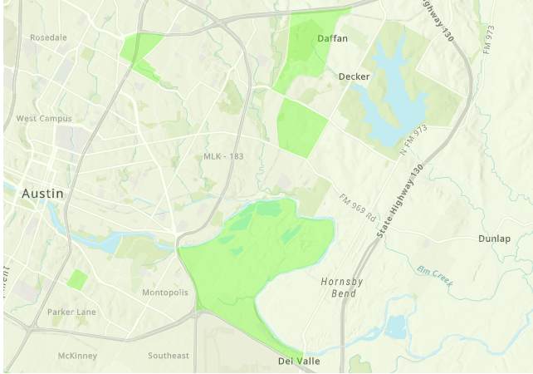
What is a Targeted Area??
Targeted areas are specific census tracts within a county that are designated for economic revitalization
Targeted Areas have higher income limits for the MCC program, and the first-time homebuyer requirement (if any) is waived!
TSAHC has a look up tool and an easy-to-use map that specifies Targeted Areas across Texas
Notes:
Visit our Targeted Areas Resources Page for more information! https://www.tsahc.org/homebuyers-renters/targeted-areas-resources
Targeted areas are specific census tracts within a county that are designated for economic revitalization
Targeted Areas have higher income limits for the MCC program, and the first-time homebuyer requirement (if any) is waived!
TSAHC has a look up tool and an easy-to-use map that specifies Targeted Areas across Texas

Slide 12
Mortgage Credit Certificate
First Time Homebuyer Definition:
In the last 3 years, has not had ownership in a primary residence, nor resided primarily in a residence they own.
This definition means you can still qualify even if you have owned a home in the past, as long as you haven't owned a primary residence in the last three years.
Notes:
Our second program is the Mortgage Credit Certificate.
MCC available when added to any DPA options; FREE for Texas Heroes
It’s like a 15% discount on your mortgage interest rate
First-time buyers only (Waived for Qualified Veterans and Targeted Areas)
First Time Homebuyer definition: Have not owned a primary residence in the last 3 years.
Must occupy the home as principal residence
FREE for Texas Heroes
MCC is a Tax Credit, but you can still do standard Tax Deductions as a homeowner!

Slide 13

Mortgage Credit Certificate
Get 15%
of the
Mortgage Interest
Back…
EVERY YEAR!
Notes:
Claim this credit each year at tax time and get 15% back of the Mortgage Interest you paid last year.
It’s like a 15% discount on your mortgage interest rate

Slide 14

Mortgage Credit Certificate
MCC Calculator – Fun to show impact over 30 years!
https://www.tsahc.org/homebuyers-renters/mortgage-credit-certs
Year 1 Savings
Year 30 Savings
Notes:
TSAHC’s MCC calculator shows how much mortgage interest you can save year over year!
As a homeowner, you will claim this MCC as long as you live in the home, for the first 30 years!
Most homeowners will save TENS of THOUSANDS of dollars in mortgage interest year over year.

Slide 15
Mortgage Credit Certificate
How does the MCC impact the mortgage interest rate?
Mortgage Interest Rate 7.00% - 15%
=
5.95%
Effective Rate
Notes:
Here is an example on how the MCC can impact your effective rate on the mortgage loan.
Payments will still be based on the 7% rate, but you will get 15% of the interest back, so effectively you are only paying a 5.95% rate on your mortgage loan!
The Note, Loan Approval and monthly payment will still reflect the higher rate; but this is a great way lower your rate – Add the MCC

Slide 16
Mortgage Credit Certificate
Credit Example
Loan Amount $280,000
Interest Rate x 7.0%
Interest Paid in 1st Full Year $19,600
15%
of $19,600 = $2,940
Notes:
Here is an example on how the Tax Credit is calculated. You can see that 15% of $19,500 is $2,925. This is how much the MCC is worth in that first year and it will be similar each year there after. Of course, as you pay less in interest, your credit will also be less. But over the 30 year life of the loan, you will save 10’s of thousands of dollars in interest with the MCC.

Slide 17
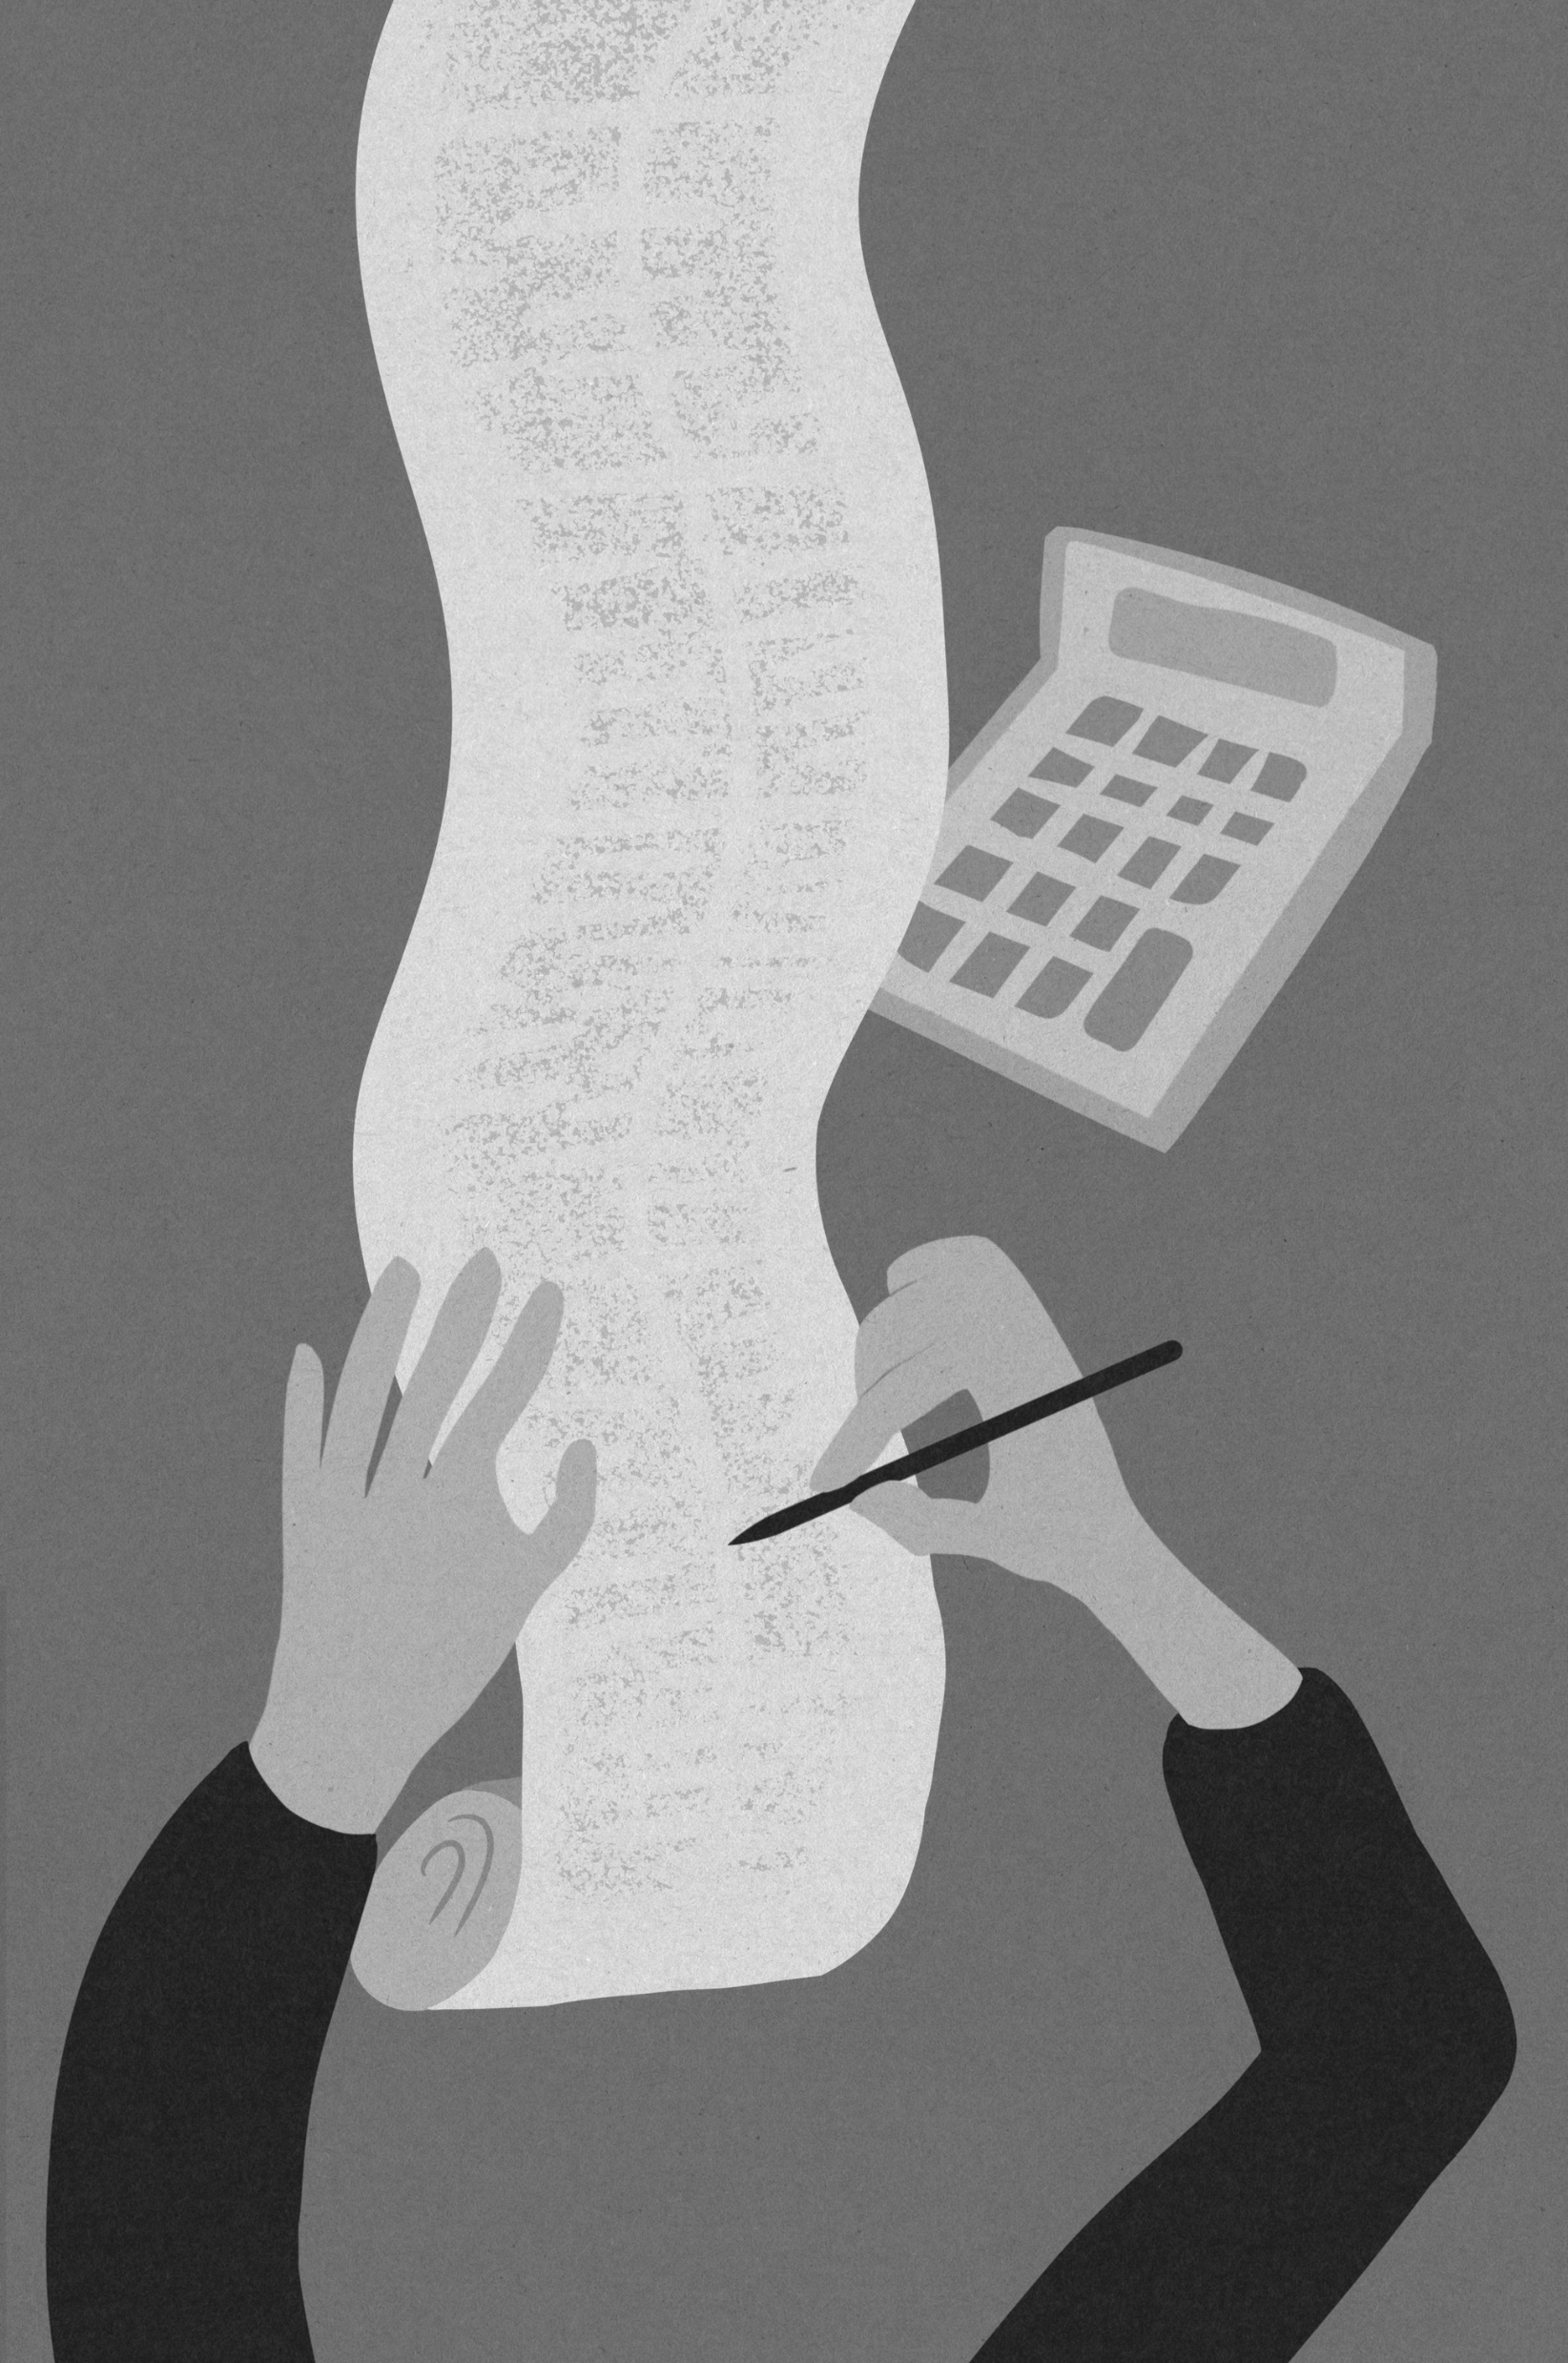
Mortgage Credit Certificate
15%
of $19,600 = $2,940
$2,940 / 12 months
=
$245/mo
Lender can use the $245 as additional monthly income
Increasing Buying Power
Lowering Debt to Income Ratio
May help get loan approved
Notes:
The MCC can benefit your loan approval! Take the expected credit, divide by 12!
The Lender can use this calculated credit as additional income on your loan application!

Slide 18


Mortgage Credit Certificate
How does a tax refund generally work?
Payroll Income
Tax Withholding
Paid too much
so, they get a refund
Annual Tax Liability
$10,000
Notes:
Sally has an annual tax liability of $10,000.
Her employer sets aside a designated amount, in hopes that they will get a refund!

Slide 19
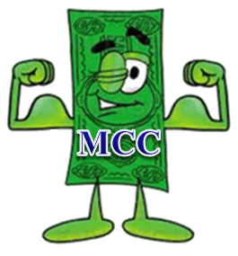
Mortgage Credit Certificate
How does the MCC impact the borrower at Income Tax Time?
Any unused credit can roll over for up to 3 years!
Payroll Income
Tax Withholding
Borrower refund
increased by $2,940!
Annual Tax Liability
$10,000
Remaining Tax Liability
$7,060
Notes:
Sally has an annual tax liability of $10,000.
She bought a house and has an MCC! This will lower her Tax Liability! (using the same example as before!)
Her employer sets aside the same designated amount, and her tax refund increases by $2,940!

Slide 20

Mortgage Credit Certificate - Things to Note
Homeowner is responsible for filing their credit – 8396 form
Recapture Tax Notice will be provided (only affects 2% of buyers)
MCC holders may claim remaining interest, property taxes, etc. as a deduction
Non-Taxed income earners may not benefit (the MCC reduces your tax liability)
Notes:
“With an MCC, the homeowner is responsible for claiming the credit when they file their federal tax return.
Homeonwers will receive a recapture tax notice, though it only applies in limited situations. Recapture tax is only triggered if the home is sold within the first nine years, the homeowner’s income increases above certain limits, and the sale results in a profit. Even then, there are caps and exemptions, and many homeowners never pay recapture tax.”
MCC holders may also be able to deduct any remaining mortgage interest that isn’t used as a credit, and
it’s important to note that buyers who don’t owe federal income taxes may see little or no benefit from the MCC.”

Slide 21

Story Time
Meet Andrew Armstrong, a military veteran that always called Texas home. Andrew and his family buy their dream home in South Texas.
Andrew was able to use our Homes for Texas Heroes program in combination with a VA loan and receive $7,000 in down payment assistance which he was able to use to cover his closing costs and even walk away from the closing table with his earnest money cash in his pocket!
Notes:
The TSAHC DPA program can help cover closing costs too! Here is a great story of a Veteran using our VA +DPA combo. He walked away with his earnest money in hand!

Slide 22

Story Time
Angel from Corpus Christie just scored their dream home—thanks to TSAHC’s Homes Sweet Texas program! Angel, a 20-year City of Corpus employee, discovered TSAHC’s down payment assistance (DPA) and knew it was the perfect opportunity to purchase a home.
The lender worked her magic, connecting him with DPA and a mortgage credit certificate (MCC)—helping with the down payment and making homeownership even more affordable. Now, Angel is a homeowner with a mortgage payment that matches his previous rent payment!!

Slide 23

You might be asking yourself….
DOES MY CLIENT QUALIFY?
Notes:
It is important to note that the license Mortgage Loan Officer will be responsible for confirming loan eligibility.
TSAHC is always here to help clarify confusions or guide you in the right direction. Let’s talk about the basic steps to determine eligibility.

Slide 24
How to Qualify – Choosing a program category
Homes for Texas Heroes: specific professions providing a great target audience for marketing.
Home Sweet Texas: Anyone that meets our income and credit score limits can apply.
Notes:
Professional educators, which includes the following full-time positions in a public school district: school teachers, teacher aides, school librarians, school counselors, and school nurses
First Responders, which includes police officers, firefighters and EMS personnel
Public security officers
Veterans or active military
Correction officers and juvenile corrections officers
Nursing faculty and allied health faculty

Slide 25
How to Qualify – Who is a Texas Hero?
The Texas Legislature, through statute, defines who qualifies for TSAHC’s Texas Heroes program.
It’s not an open-ended “all public service jobs” list; it depends on how the law defines occupations.
Registered nurses working in clinical/hospital settings (or other nursing roles not defined in the statute) are not listed under the current eligible occupations.
Notes:
Because the statute is specific, if an occupation is not listed in the statute (or an amendment) then that occupation is not automatically eligible under the Texas Hero Program, however, they would be eligible under Home Sweet Texas.
The “list” isn’t arbitrary — it comes from legislative definitions. These definitions are embedded in state law or statutes. For example, TSAHC was created by the Legislature and operates under its oversight.

Slide 26
How to Qualify – Who is a Texas Hero?
Professional Educators:
Teachers
Teachers Aides
School Librarians
School Counselors
School Nurses
Nursing or Allied Health Faculty
Public Security Officers
Corrections Officers
&
Juvenile Corrections
Officers
Remember:
Anyone in Texas
that meets our Income and Credit Score Limits
may qualify!
First Responders:
Police Officers
Firefighters
EMS personnel
Veterans
Or
Active Military
Notes:
Professional educators, which includes the following full-time positions in a public school district: school teachers, teacher aides, school librarians, school counselors, and school nurses
First Responders, which includes police officers, firefighters and EMS personnel
Public security officers
Veterans or active military
Correction officers and juvenile corrections officers
Nursing faculty and allied health faculty

Slide 27
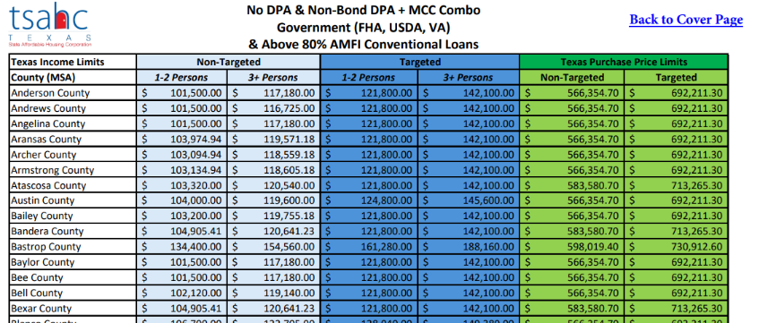
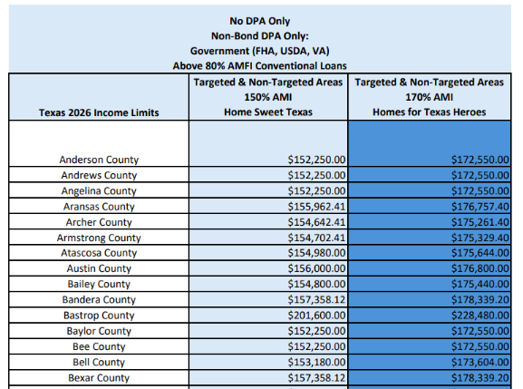
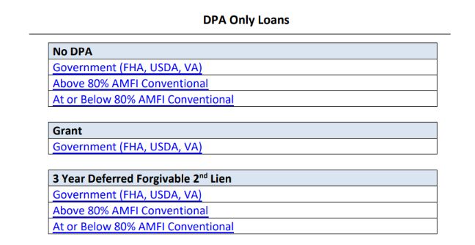
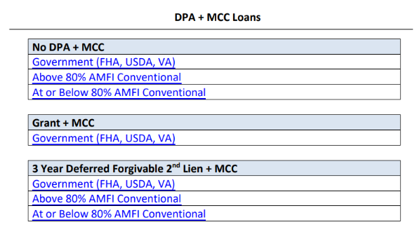
How to Qualify – DPA and MCC Income and Purchase limits
Notes:
You can access our Income and Purchase price limits on our website. We have a PDF and will eventually have a fun tool to help confirm the income limit.
To make it easy, we have created a cover page that details program type and loan type that will take you to the income chart for the program you choose.
***For Non-Bond DPA only, you may notice things look different. TSAHC's Non-Bond DPA Only program will no longer have different income limits between targeted and non-targeted areas. Previously, homebuyers purchasing in a targeted area could qualify under higher income limits. Instead, we have an income limit for Home Sweet Texas program, and the Texas Heroes program will have a higher income limit. Again, with Non-Bond DPA only, the property location doesn’t change the income limit.
For the MCC Program, targeted areas will continue to be considered when determining income limit eligibility. While Texas Heroes do not receive higher MCC income limits, they will continue to benefit from the waiver of the MCC program fee. "Texas Heroes using the MCC continue to receive a valuable benefit—the MCC fee is waived."

Slide 28
How to Qualify – consider income
Income Limits
Vary by County
DPA Income Limits:
$152,250
to
$201,600
MCC Income limit:
$101,500
To
$154,560
The Loan Officer is licensed to calculate this income! Please seek their expertise to confirm income eligibility!
Note: These limits are as of 2026! Income limits are updated in the month of May or June each calendar year!
Notes:
Non-Bond DPA only considers qualifying income on the loan application
MCC program (or a limited Bond program) will consider gross household income (anyone signing the DOT)
I like to bring up the range of income limits to help prove a point.
We have expanded our programs to also help Moderate income earners who need help buying a home.
These income ranges are as of 2026. Limits are updated once per year when HUD releases the new AMI data.
NOTE: TSAHC’s DPA only programs have higher income limits for Texas Heroes.
NOTE: The MCC program has higher income limits if property is located in a Targeted Area.

Slide 29
How to Qualify – FICO requirements
Government Loans (FHA, VA, USDA):
Minimum 620 FICO score
Manual Underwriting is allowed; minimum 640 FICO
Borrower without a score can still be eligible
640 FICO required for Manufactured homes
Conventional Loans (HFA Preferred/HFA Advantage:
Minimum 640 FICO score
Manual Underwriting not allowed
Borrower without a score can still be eligible if another borrower meets 640 FICO requirement
Notes:
TSAHC homebuyers must have at least a 620. 640 FICO is required for all Manual Underwrites or Manufactured Homes.

Slide 30



How to Qualify – Get Educated!
At least 1 borrower on the loan must complete a Homebuyer Education Course.
Homebuyer Education course must be HUD approved or meet National Industry Standards
Cannot use another HFA’s course if it does not meet these standards
Education Certificates are valid for 1 whole year
In-person and Online options available; Some are FREE!
Notes:
A homeowner is 33% less likely to fall behind on their mortgage if they’ve taken a home buyer education course
Visit www.texasfinancialtoolbox.com to find a course near your borrower
There may be a cost associated with this course.
Good for 1 year prior to closing
These two providers are free, online and available in Spanish.

Slide 31
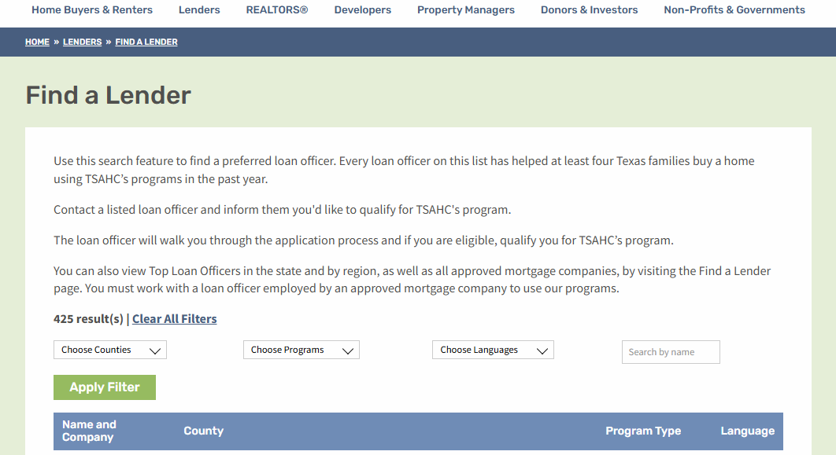
How to Qualify - Find an approved Lender
Any Loan Officer (including Brokers) working with a TSAHC approved company can offer our programs once they take the required training.
Loan Officer profiles on TSAHC’s Find a Lender page are reserved for active LOs that closed 4 or more TSAHC loans within the last 12 months.
Notes:
Use TSAHC’s Find a Lender page to find experts that serve your area. Any LO licensed to operate in TX can offer the programs if:
The Loan Officer (including Brokers) is working with a TSAHC approved company can offer our programs once they take the required training.
Loan Officer profiles on TSAHC’s Find a Lender page are reserved for active LOs that closed 4 or more TSAHC loans within the last 12 months.
https://www.tsahc.org/homebuyers-renters/find-a-lender
If you are a Lender – this is where you can promote yourself as an educated TSAHC lender
If you are Realtor – this is where you can reassure them that you have TSAHC lenders on call and ready to help your buyers.

Slide 32
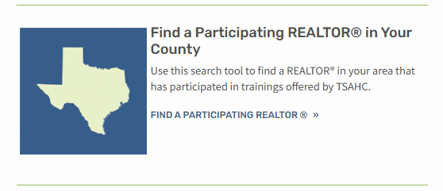
How to Qualify - Find a Realtor
Any Texas Realtor can represent a homebuyer using TSAHC!
Our Find a Realtor page is full of Realtors that have taken a TSAHC Realtor CE training within the last year!
Notes:
Use TSAHC’s Find a Realtor page!
https://www.tsahc.org/homebuyers-renters/find-a-realtor
Realtors don’t have to be “approved” to help connect you to TSAHC. However, we do have a list of participating realtors that have taken our training and are familiar with TSAHC if you’d like to connect with one. We do have a list on our website where you can find Realtors in your county familiar with TSAHC!

Slide 33
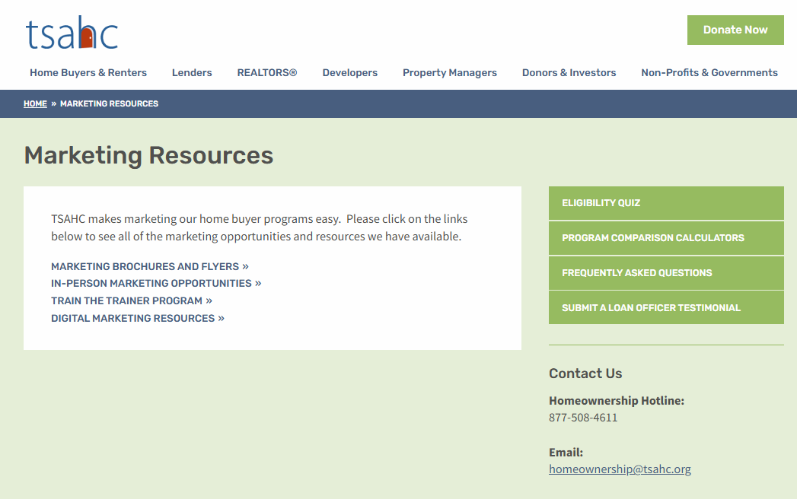
Marketing Resources - www.tsahc.org
Print or Download flyers with your contact information!
Order brochures to be shipped FREE! (50 of each)
Other videos and digital marketing available!
Notes:
Use TSAHC’s FREE marketing resources from our website to brand yourself and offer literature to your clients!

Slide 34




Marketing Resources - Brochures
Notes:
These are some examples of brochures you can order! There is a space for your business card on the back. These are free of charge and will be mailed to you.

Slide 35

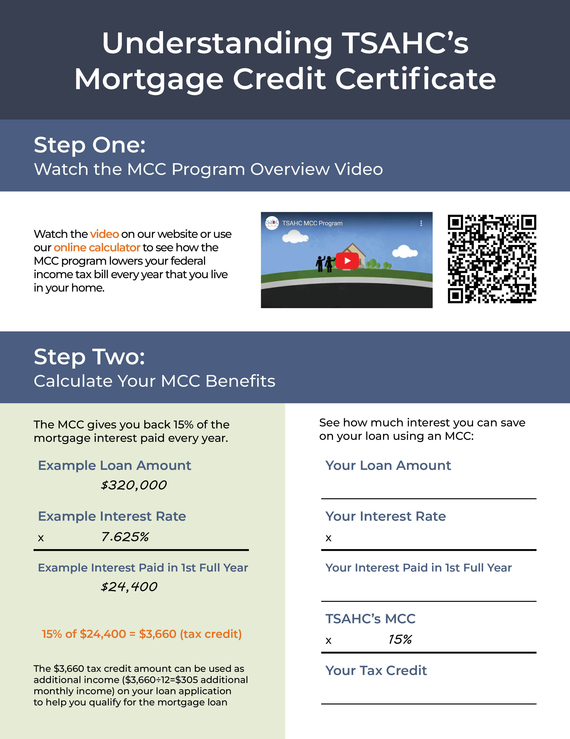


Marketing Resources - Flyers
Notes:
These flyers can be downloaded or printed. With options to co-brand and Spanish versions too!

Slide 36



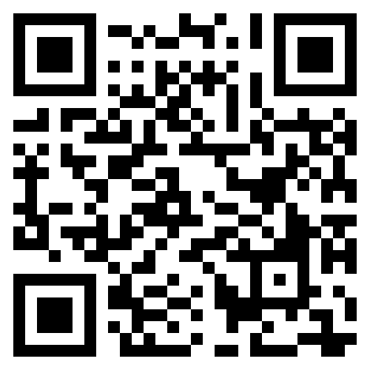
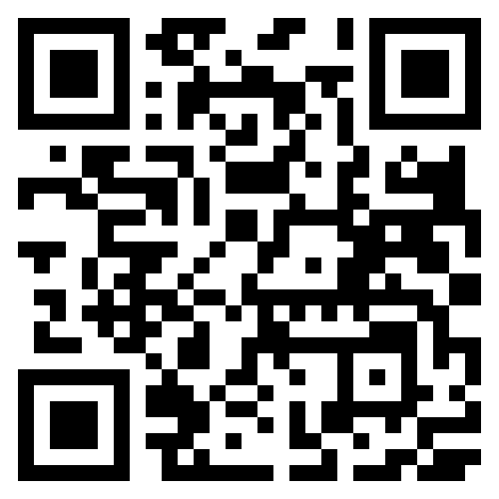
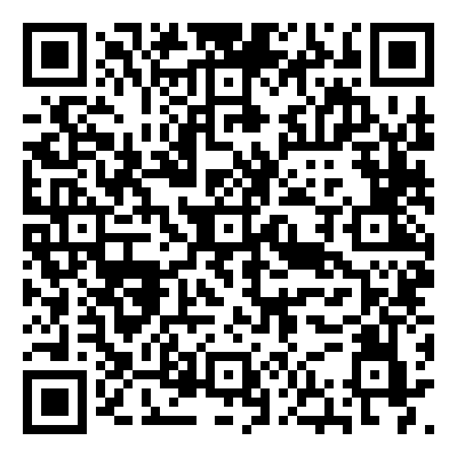
Marketing Opportunities – Follow us!!
Notes:
TSAHC is active on these three social media sites. Feel free to follow us for more educational opportunities and see how our success in helping Texans!
TSAHC hosts a FACEBOOK LIVE once per month; all are welcome!

Slide 37
Contact TSAHC
Homeownership Hotline: (877) 508-4611
Training/Marketing/General Questions:
Email: homeownership@tsahc.org
Notes:
TSAHC’s Homeownership team is happy to answer your questions!

Slide 38
Contact Me
Notes:
Place your contact information on this slide

